Slide 1
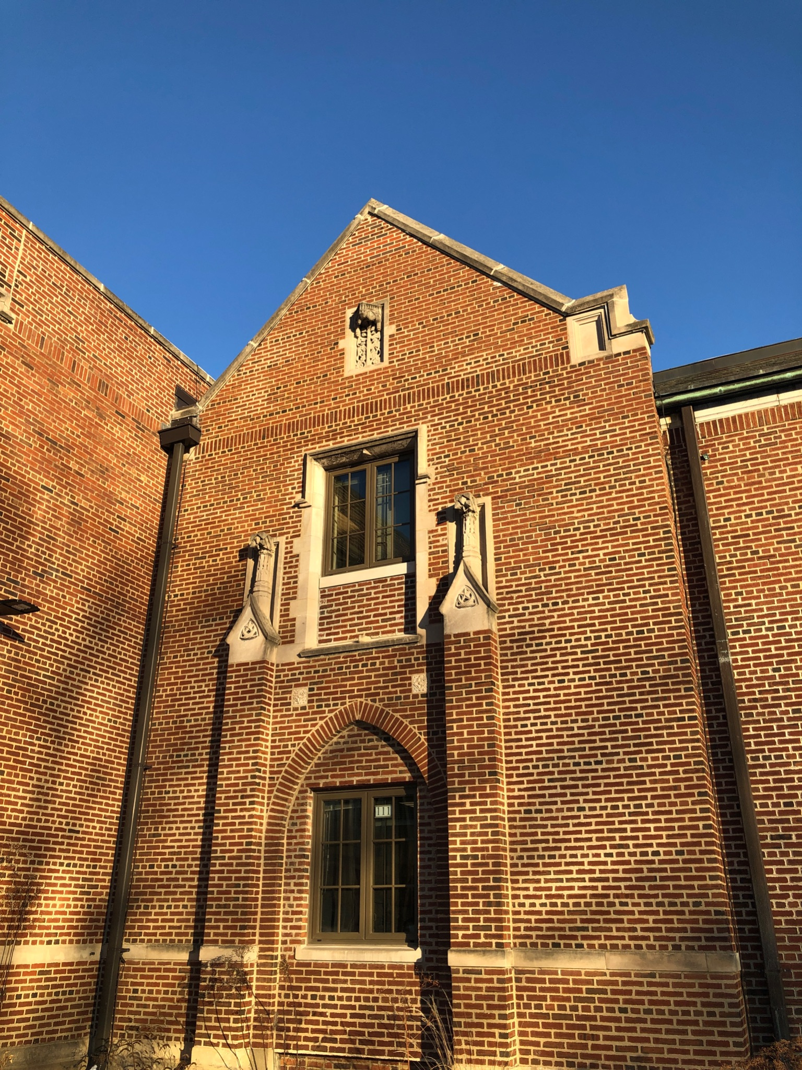
Roosevelt LLC
2022 - 2023
Roosevelt Middle School Library Learning Center
7560 Oak River Forest, IL 60305

Slide 2
13,344 = # of items checked out
this school year
Most Popular Fiction
Most Popular Nonfiction
Most Popular Biography
Most Popular
Graphic Novel
2022 - 2023

Slide 3
Top twenty books that students checked out
Fiction Nonfiction Biography Graphic Novel
The Getaway The Terrible Two Ghost The War That Saved My Life Booked The Hunger Games Roderick Rules Dog Days Space Case Because of Mr. Terupt The Ugly Truth Big Shot Swindle The Tale of Despereaux Spirit Hunters The Lion of Mars The Last Straw The Blackbird Girls Catching Fire Mockingjay
Guinness World Records, 2019 The Story of the Chicago Bears The Great Chicago Fire Guinness World Records, 2015 Guinness World Records, 2017 Where is Alcatraz? Forgotten Women: The Scientists 125 Cool Inventions Plagues and Pandemics Golden Retrievers The Deadliest Fires Then and Now Guinness World Records, 2014 Guinness World Records, 2016 Gamers Wonder Women Changing the Equation The Universe Space Exploration Breakthroughs in Space Travel Dogs German Shepherds
Lebron James Who Was Lucille Ball? Stephen Curry
Who Was Princess Diana?
Patrick Mahomes
Becoming Kareem Curious Bones Eugenie Clark Marie Curie Marie Curie Who Was Amelia Earhart? Who On Earth is Dian Fossey? Light Shining Through the Mist Who On Earth is Jane Goodall? Who Is Kamala Harris? Who Was Henry VIII? Grace Hopper Mae Jemison NASA Mathematician Katherine Johnson
Who Is Michael Jordan?
Sisters Guts New Kid When Stars Are Scattered Smile Drama Ghosts Real Friends Katie the Catsitter Sunny Side Up I Survived the Sinking of the Titanic Jessi’s Secret Language Roller Girl I Survived the Nazi Invasion Kristy’s Great Idea Swim Team Class Act Swing It, Sunny! Allergic Frizzy
2022 - 2023

Slide 4
LLC Book Checkouts by Grade
5th Grade
4,151
6th Grade
2,302
7th Grade
1,433
8th Grade
738
Other
395
This reading app is available to all Roosevelt students
With an RFPL library card students can access public library books
3,151 SORA checkouts during 2022-2023
2022 - 2023

Slide 5
RESOURCE | SEARCHES/LOG INS
Biography Reference Bank | 2,720
Biography Reference Center | 3,130
Britannica | 41,065
Fact Cite | 107
LibGuides | 13,538
Noodle Tools | 3,744
Middle Search Plus | 2,936
Novelist | 70
Points of View Reference Center | 5,313
Topic Overviews | 4,138
Using Roosevelt LLC Research Tools
2022 - 2023

Slide 6
STEM Leaders 2022-2023 - Brennan | 2,812
Elizabethan Era/Shakespeare | 1,176
6th Grade - Activism & Community Service | 1,120
7th Grade - Les Régions de France - Feeley | 1,051
5th Grade - Les Pays Francophones - Feeley | 967
8th Grade - Elizabethan/Shakespearean Research - Humanities | 870
7th Grade - Harlem Renaissance - Humanities | 869
Famous Francophones - Feeley | 676
6th Grade - Mars/Terraforming Mars - Painter | 619
6th Grade - L’Afrique Francophone - Feeley | 592
6th Grade Unsolved Mysteries | 580
6th Grade Winter Celebrations - Graves | 542
LibGuides
Research assistance, subject guides and useful resources compiled by your Roosevelt Library Staff
This table indicates the titles and number of views of the most used Roosevelt LibGuides for the 2022-2023 school year.
2022 - 2023

Slide 7
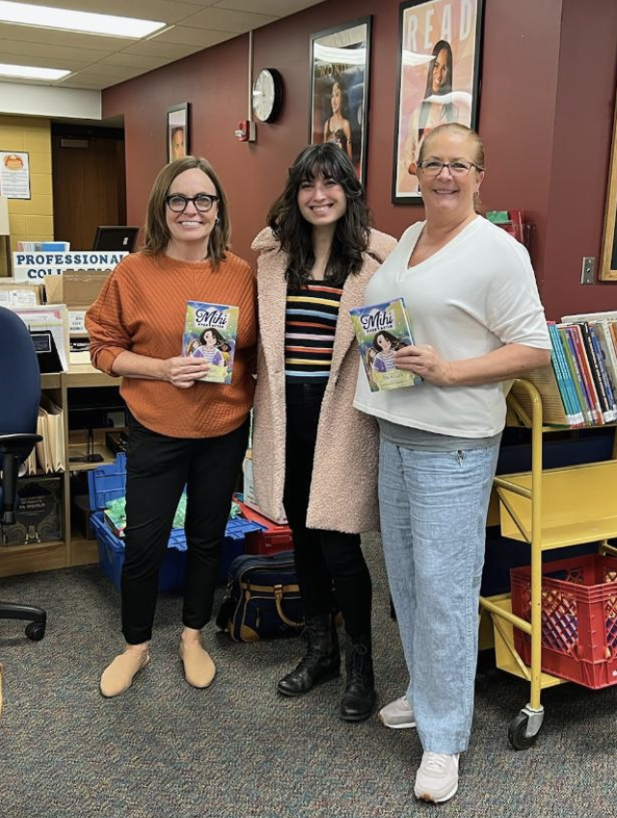
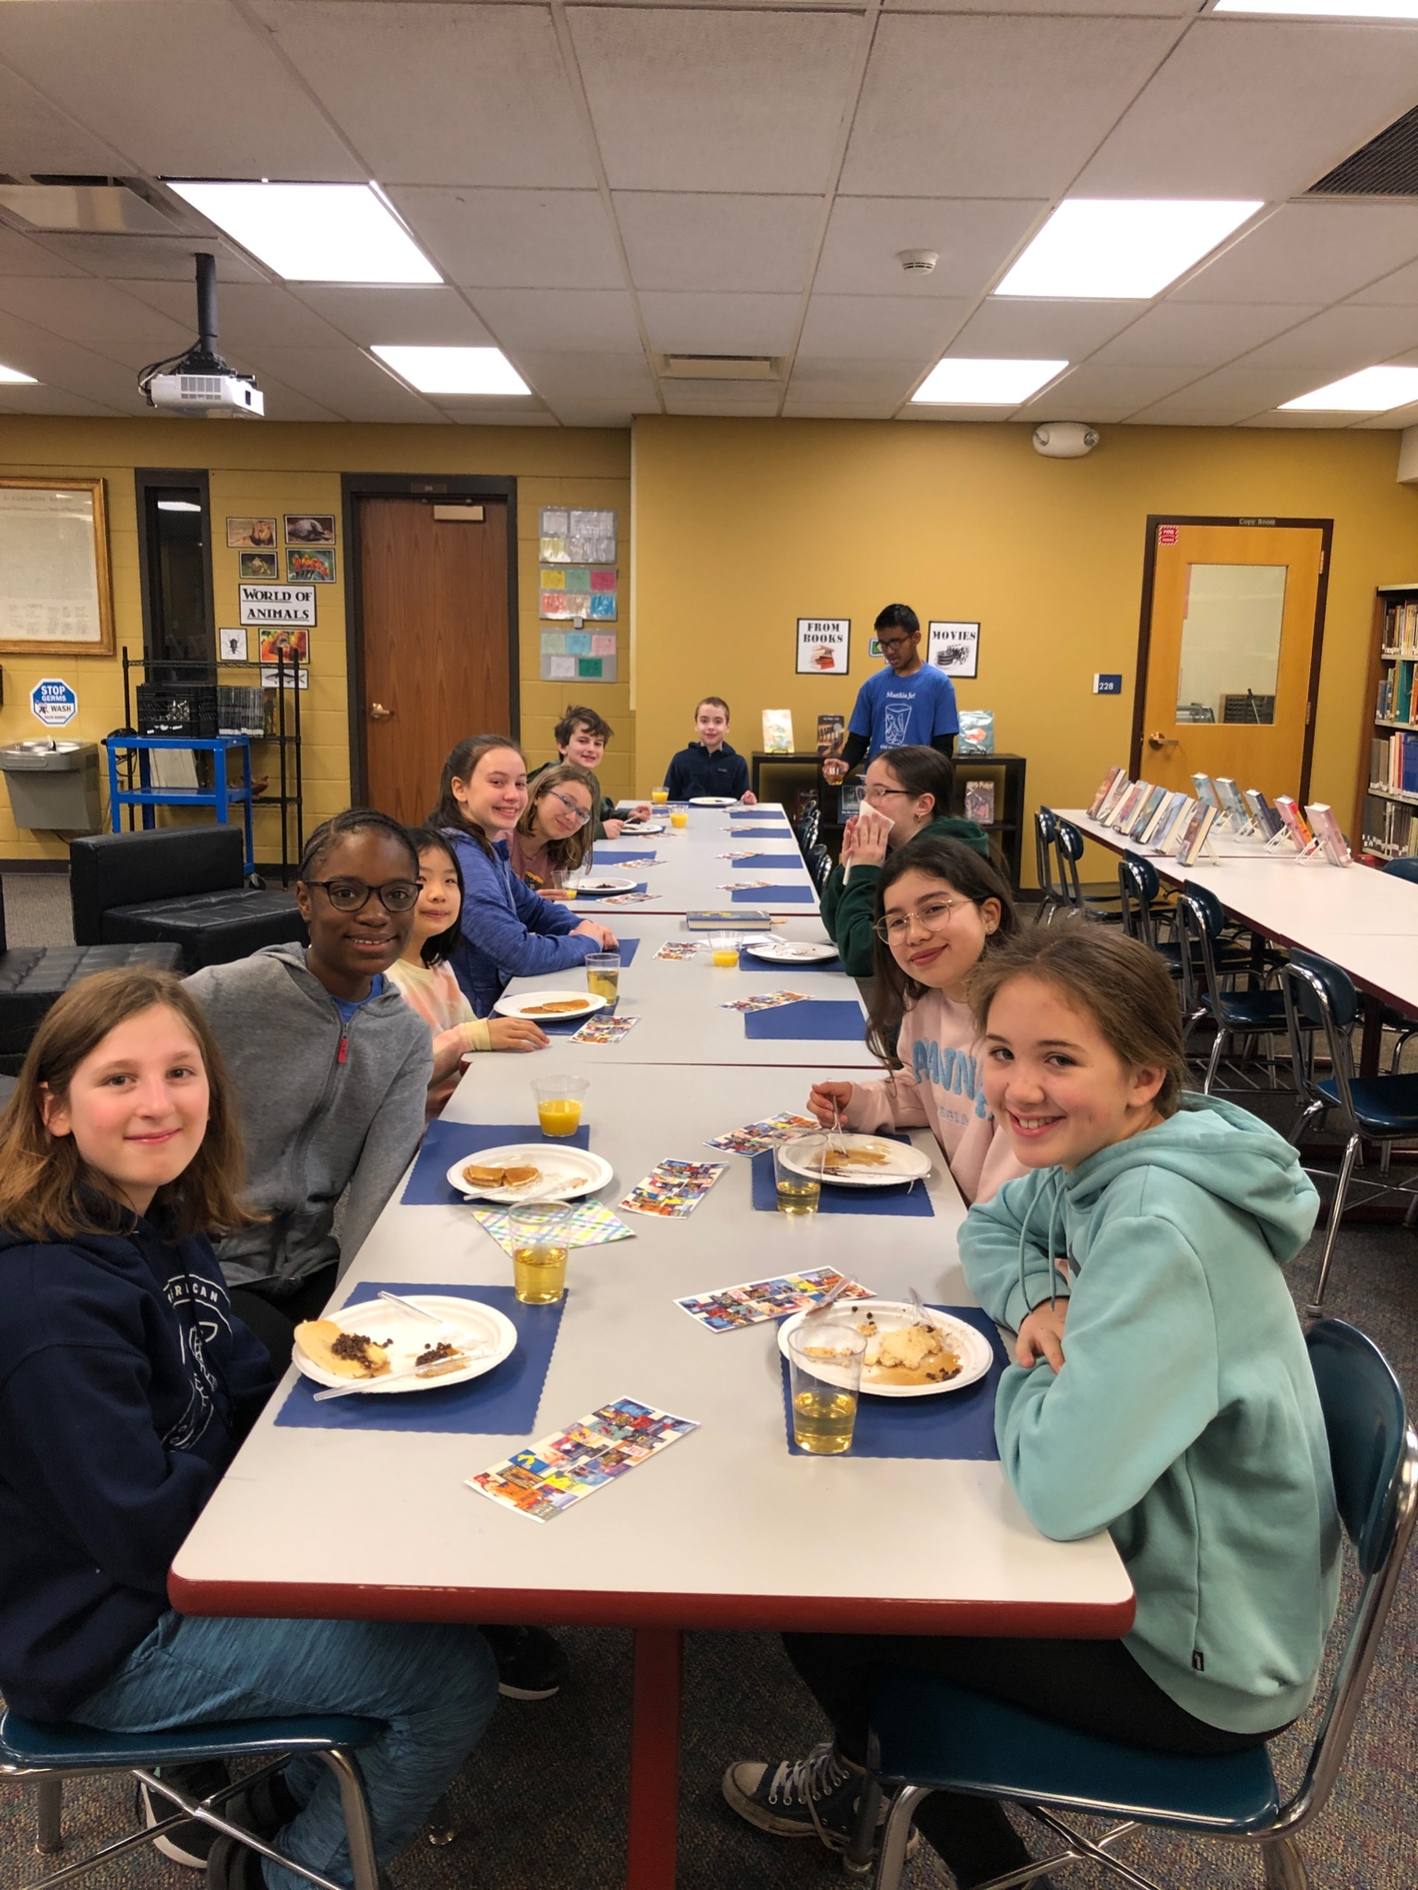
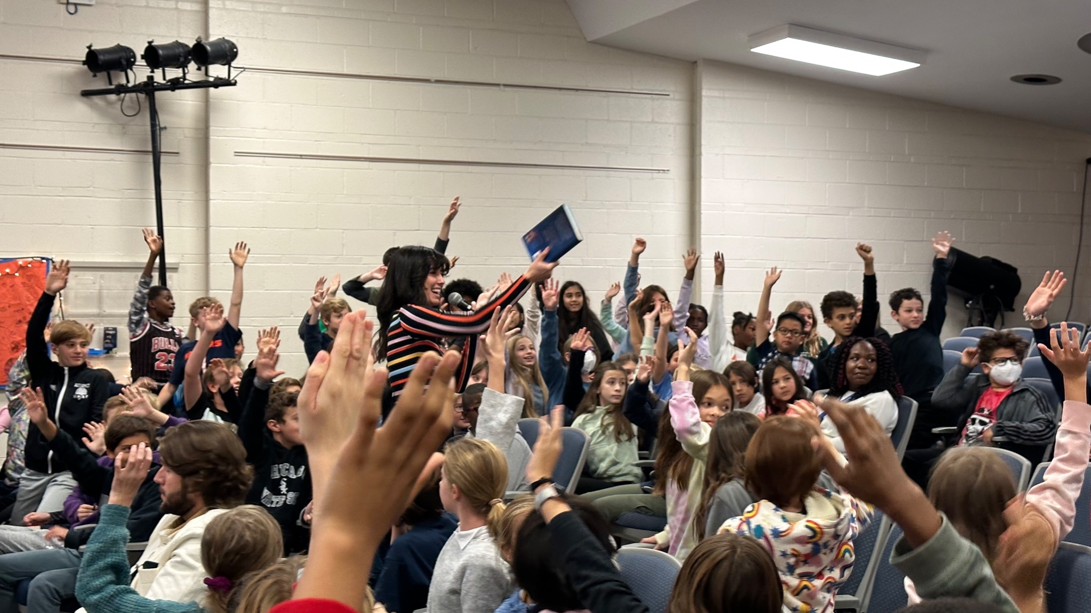
Caudill Pancake Breakfast and Voting
Author Visit

Slide 8
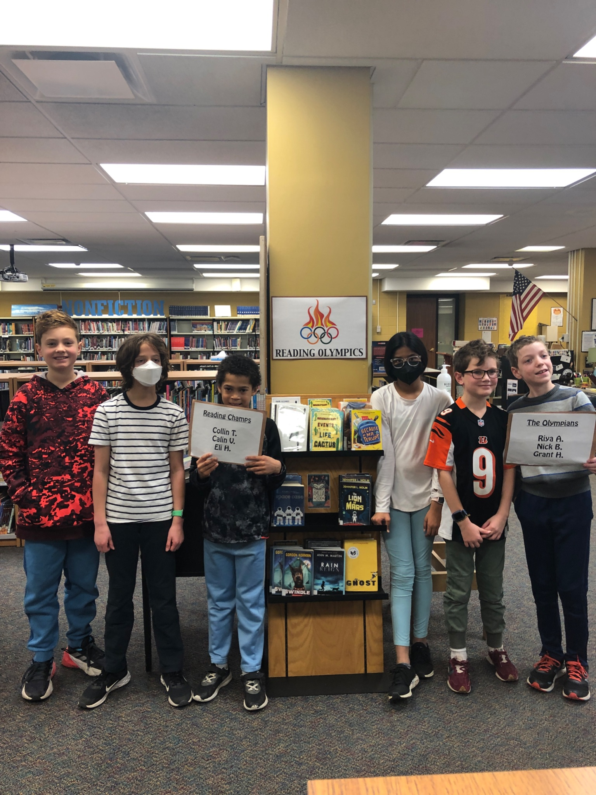
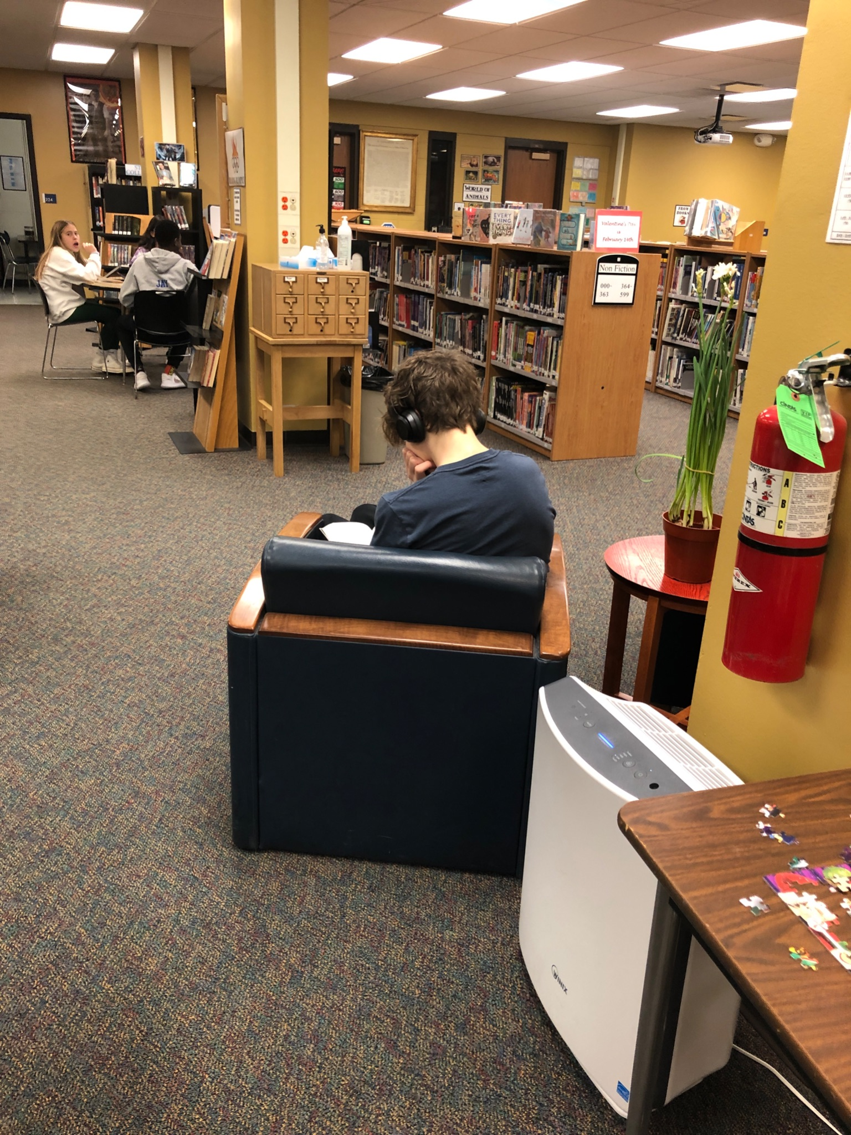
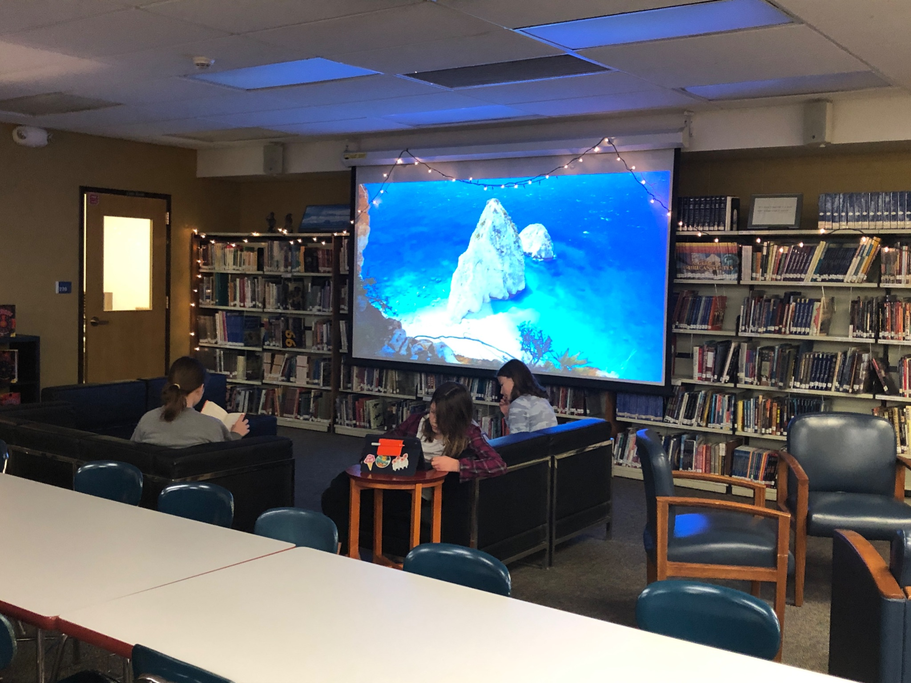
Quiet Reading
Fall Reading Olympics

Slide 9
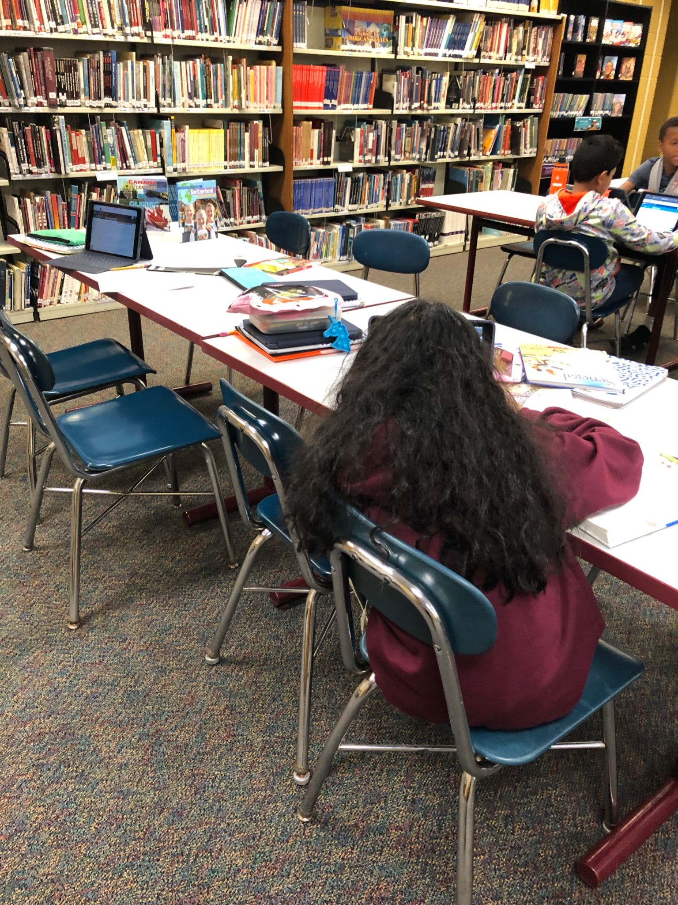
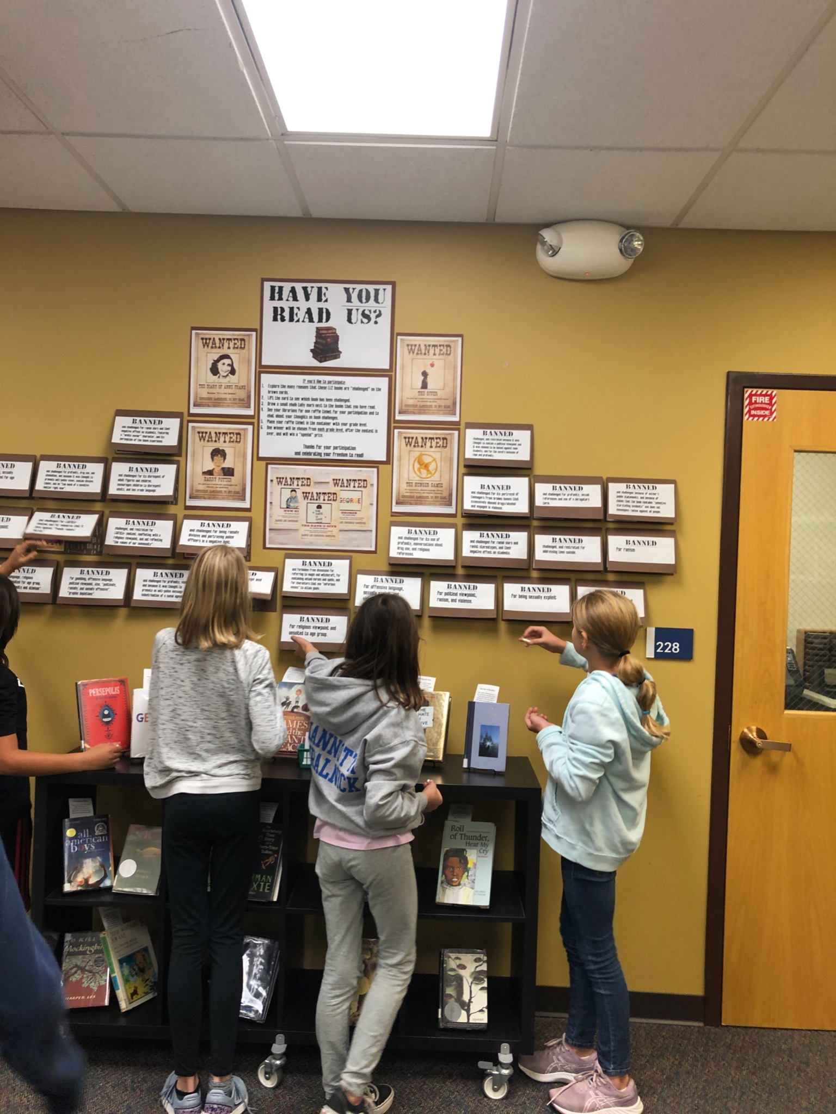
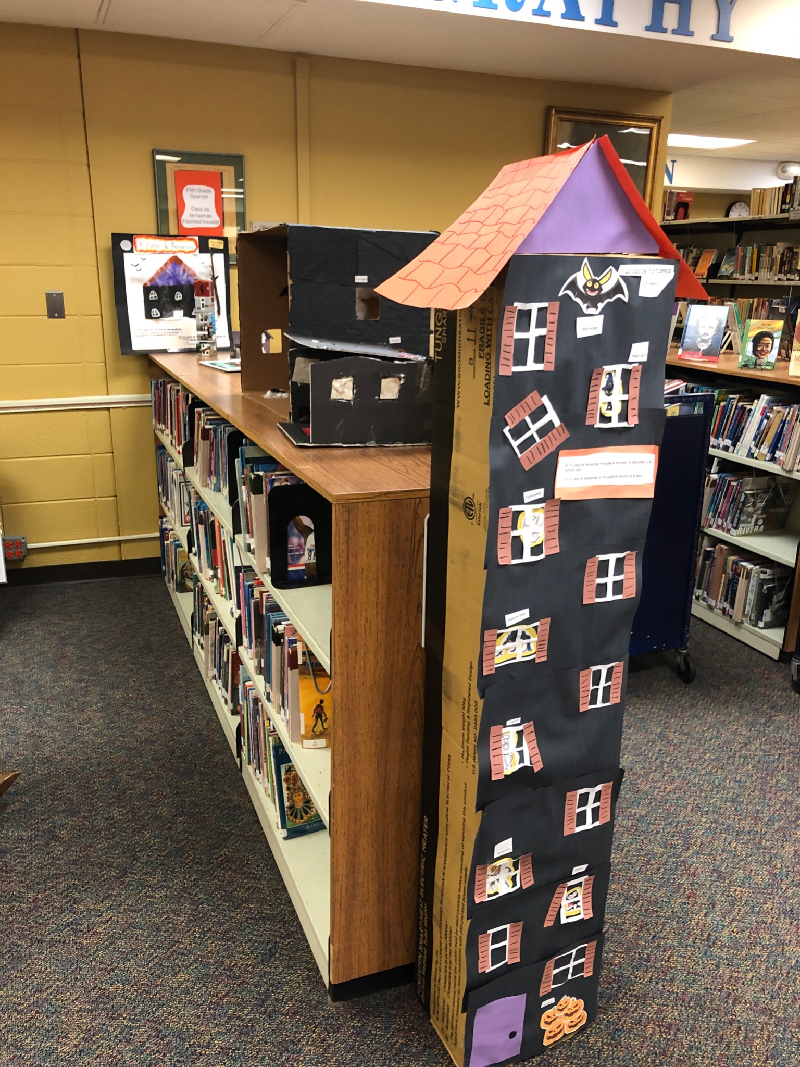
Research
Banned Books Week
Displays of student work

Slide 10
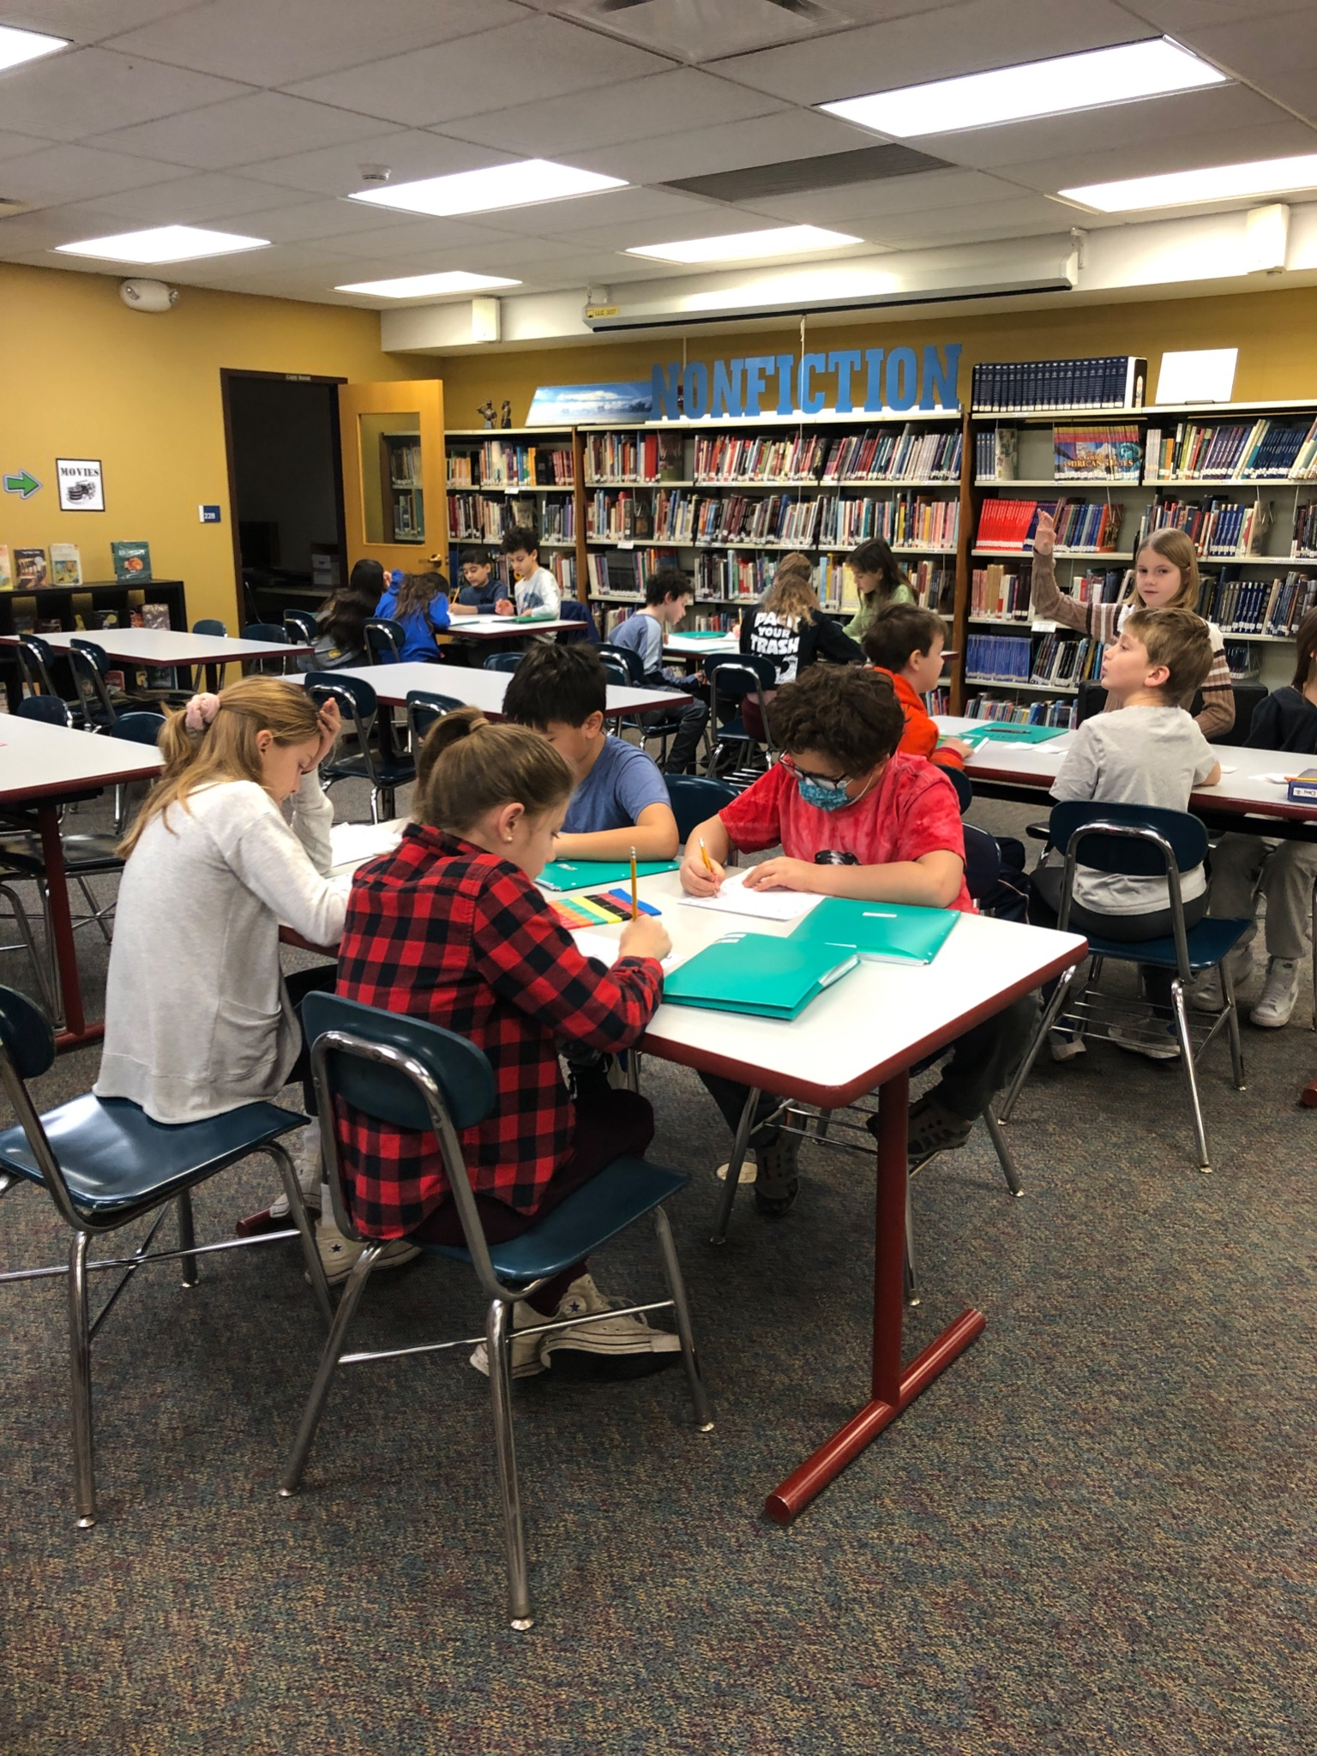
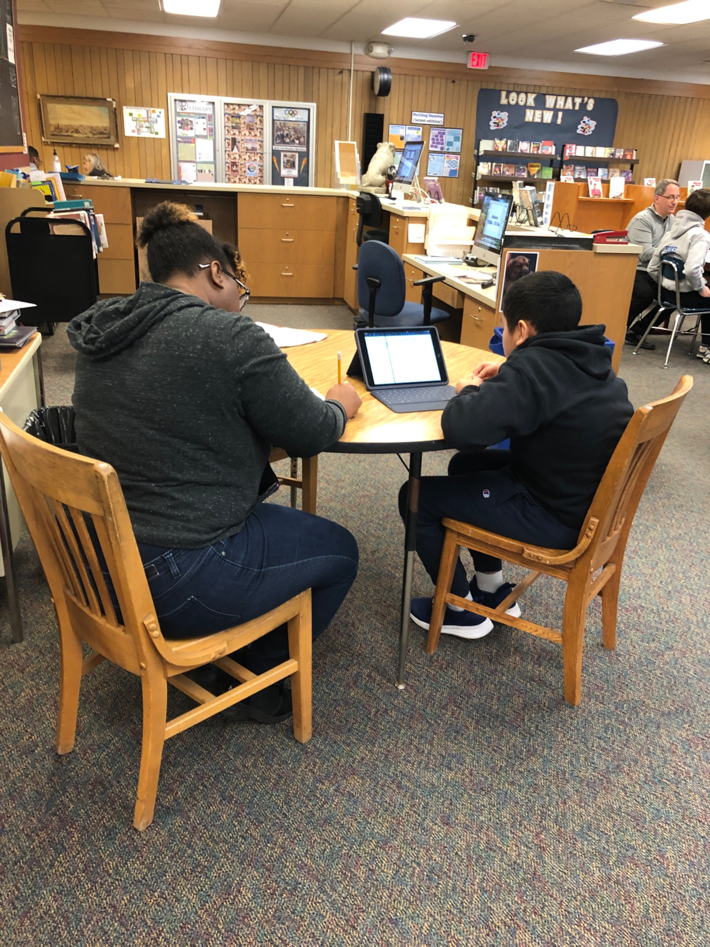
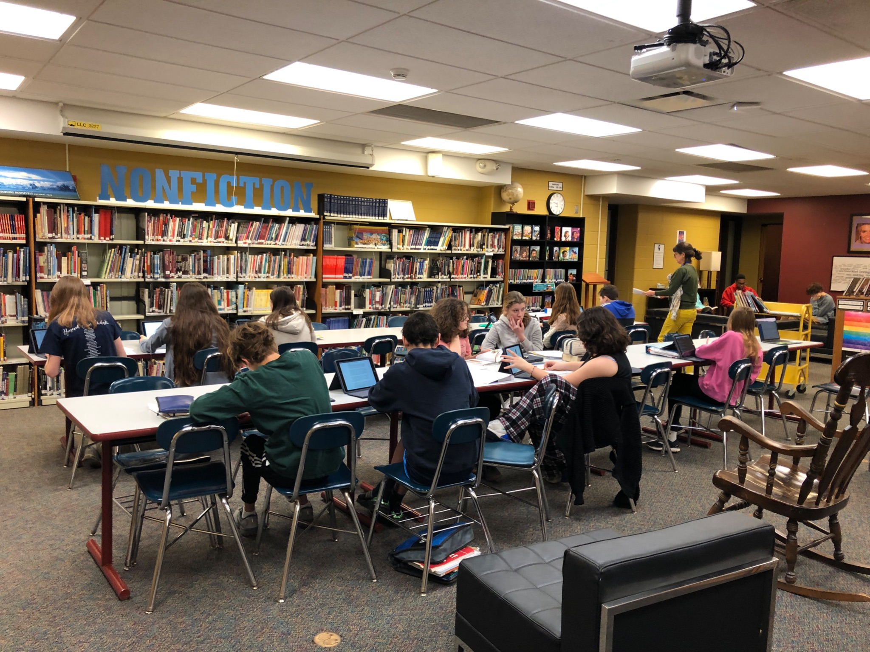
Research and Small Groups

Slide 11
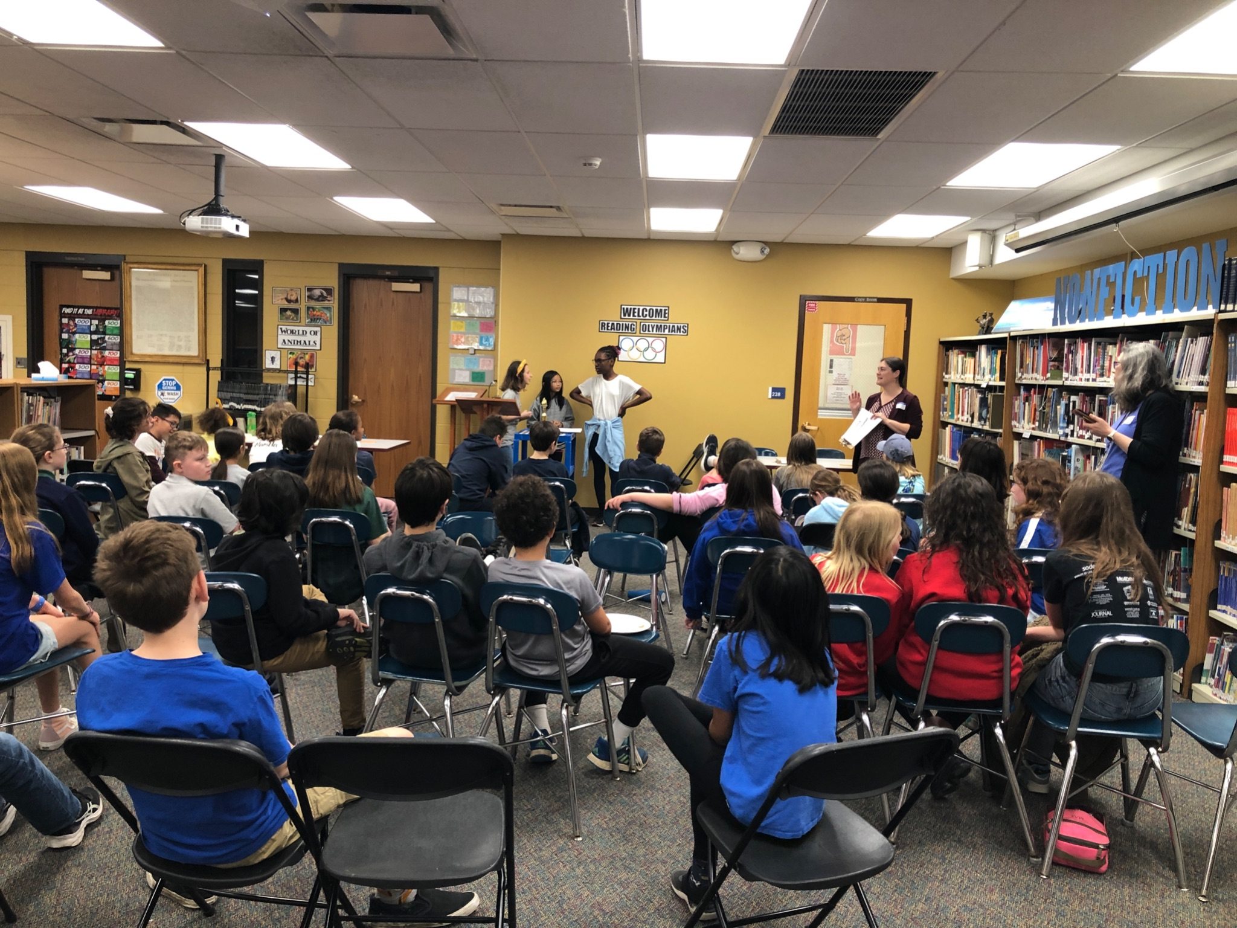
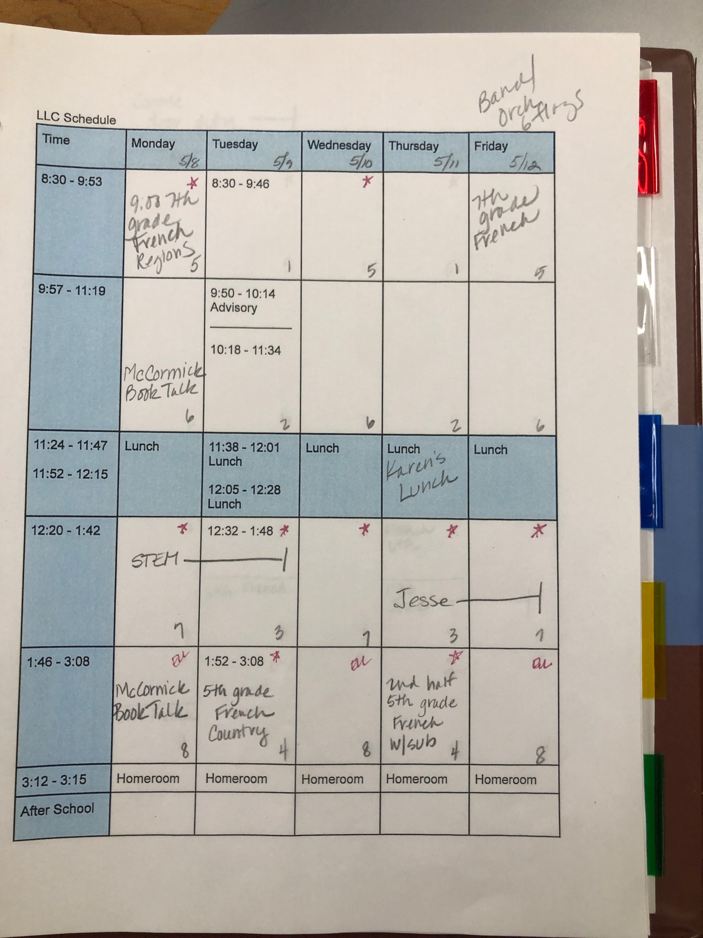
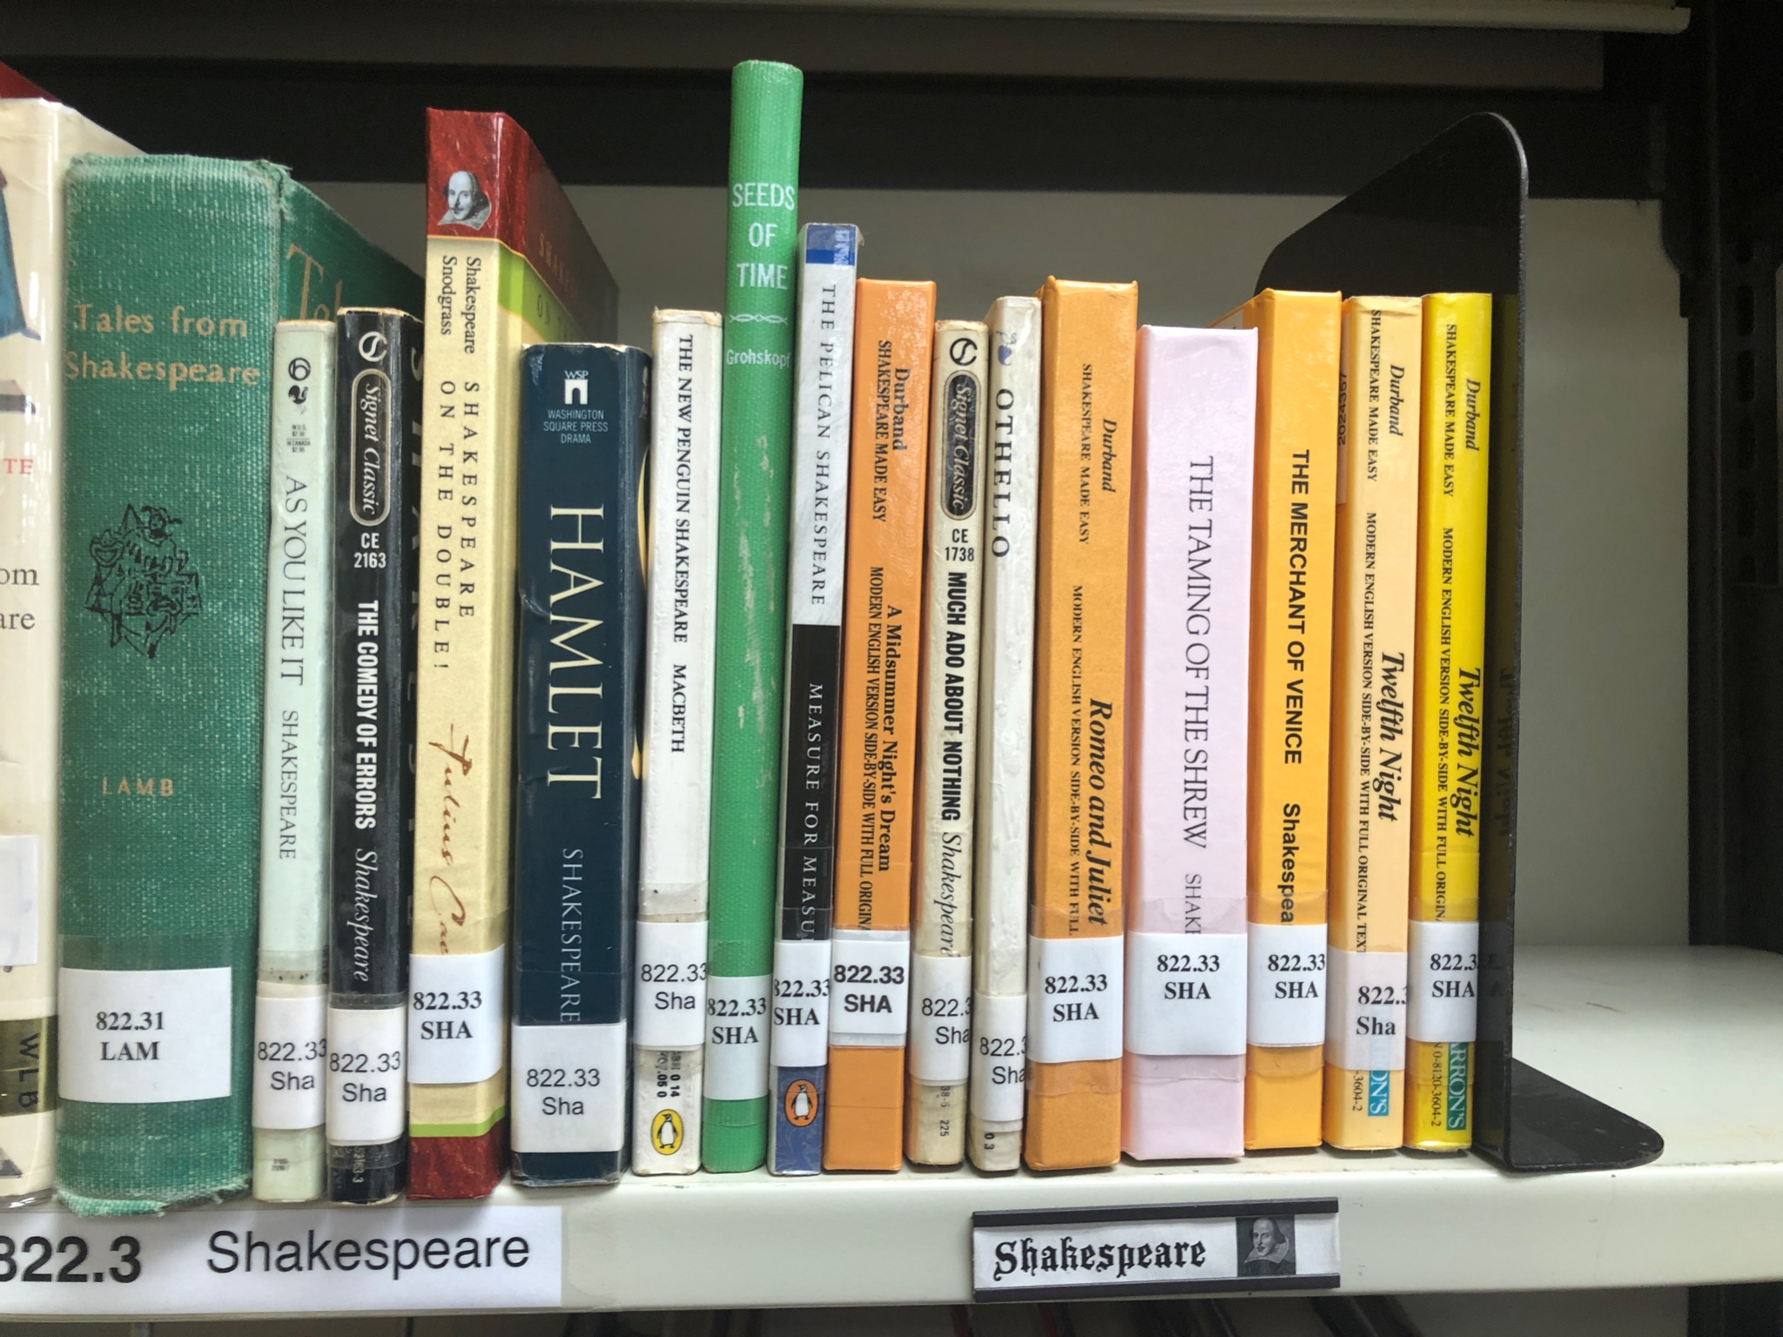
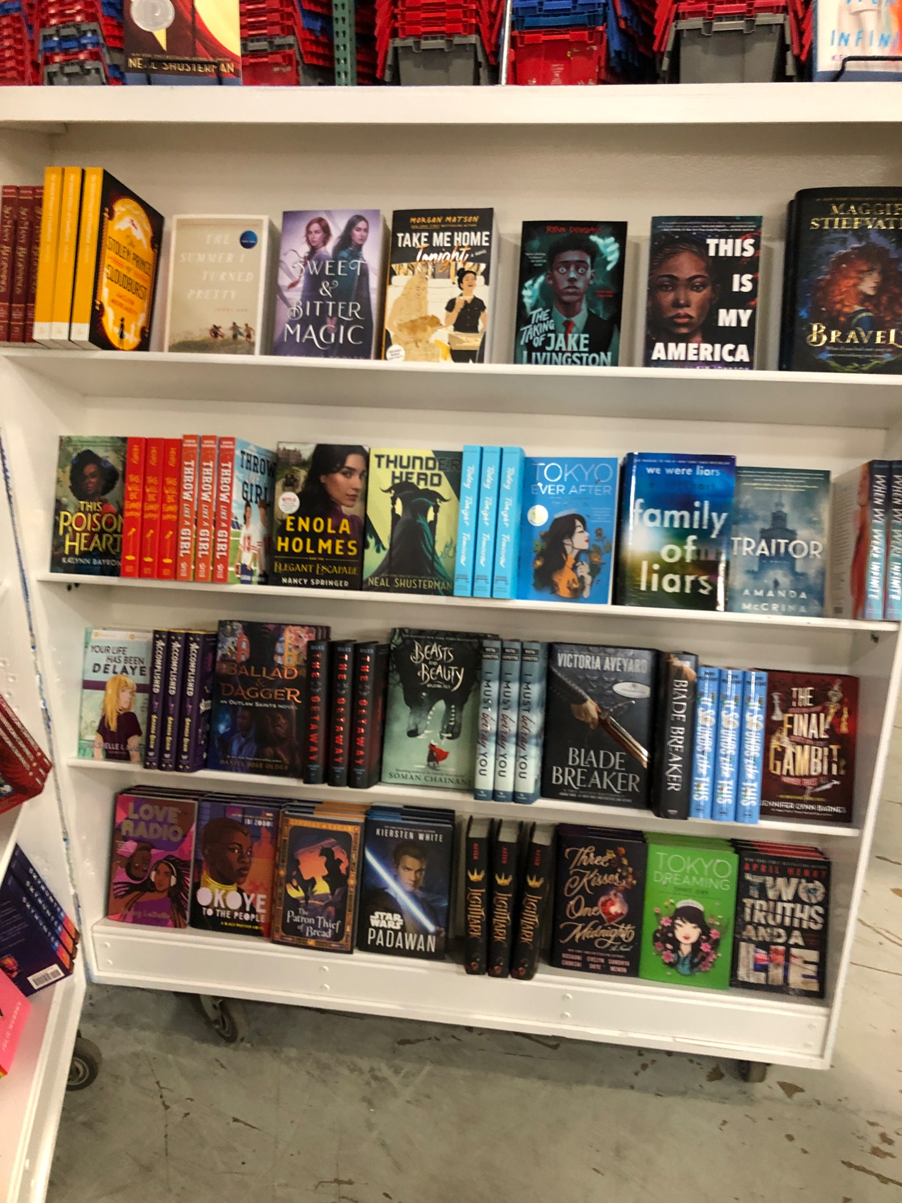
Hosting
Regional
Reading Olympics
Schedule
Book Fair

Slide 12
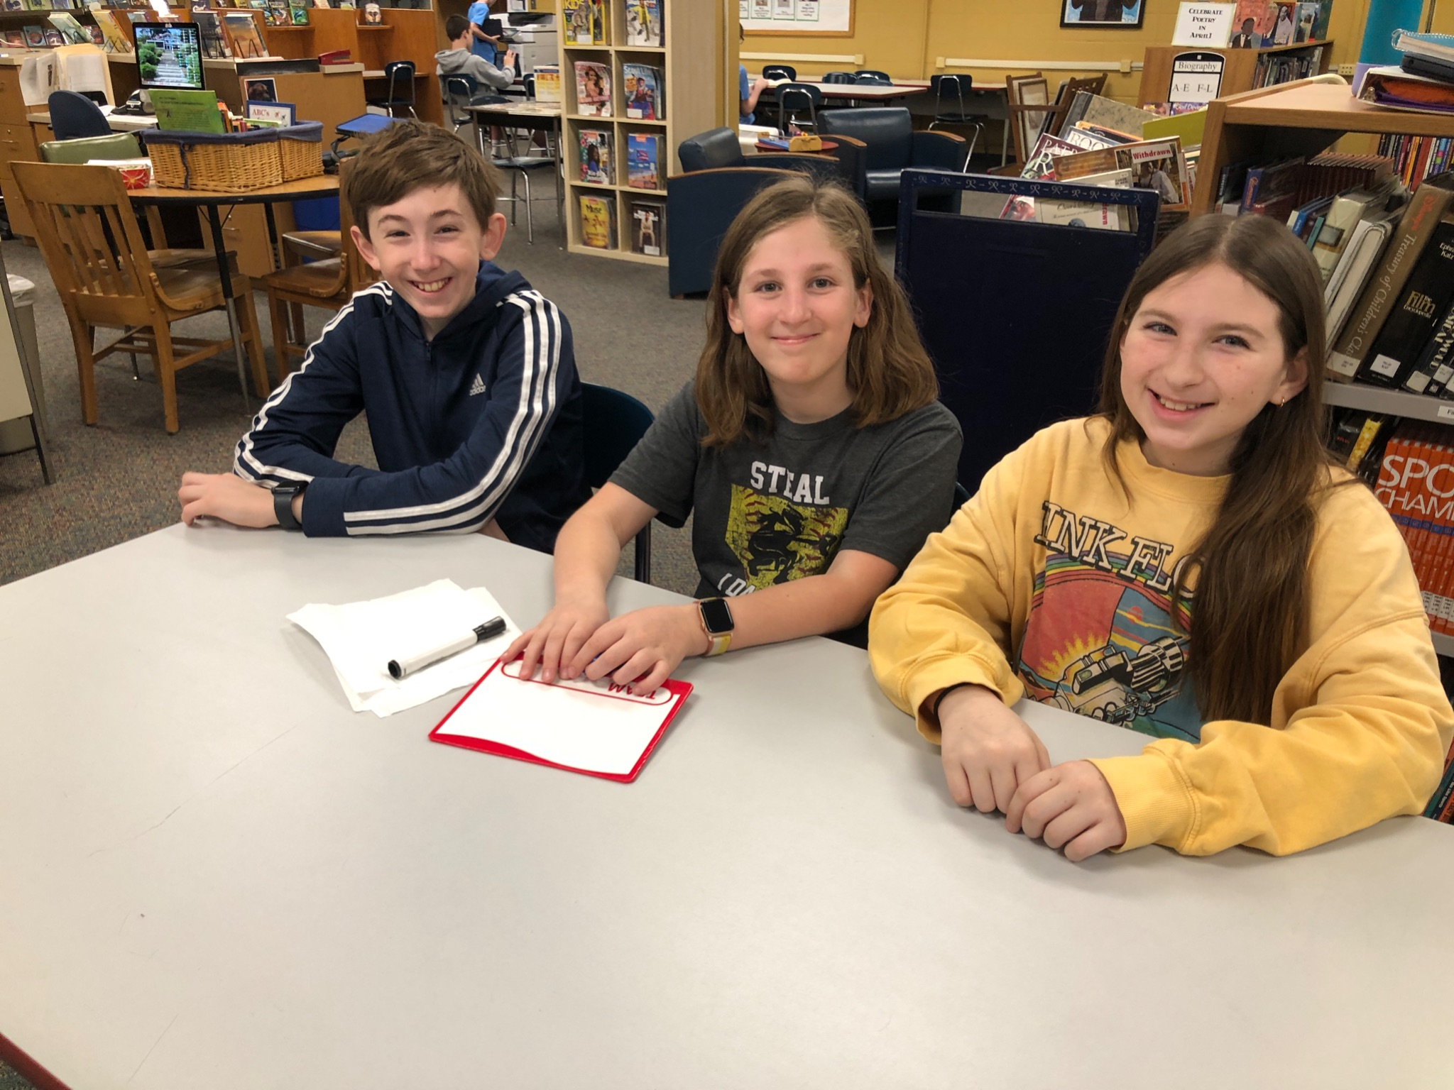
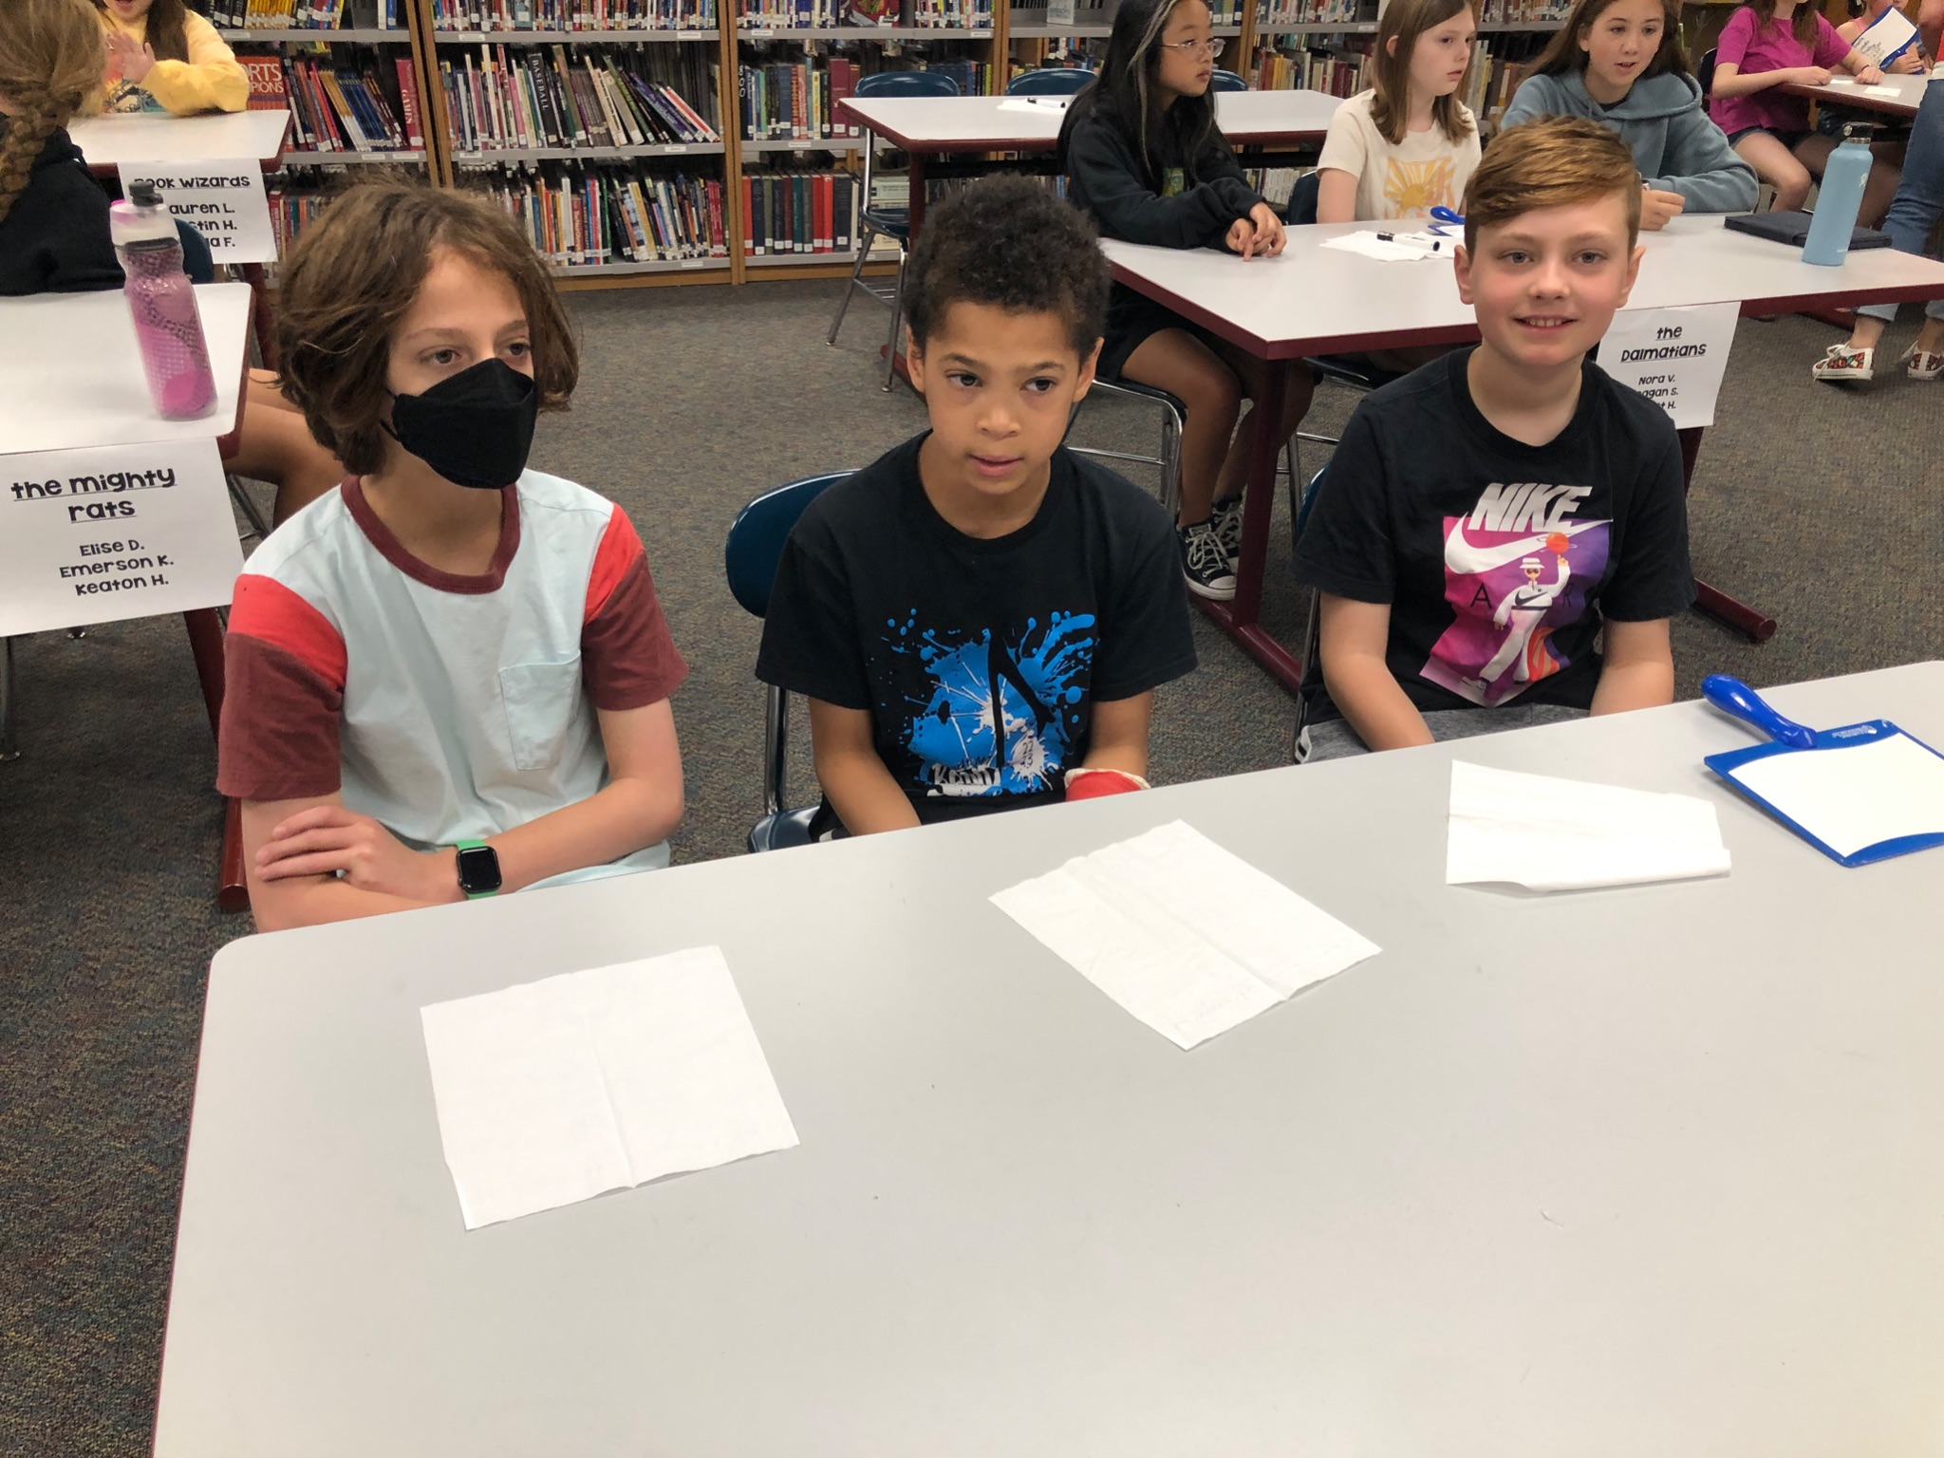
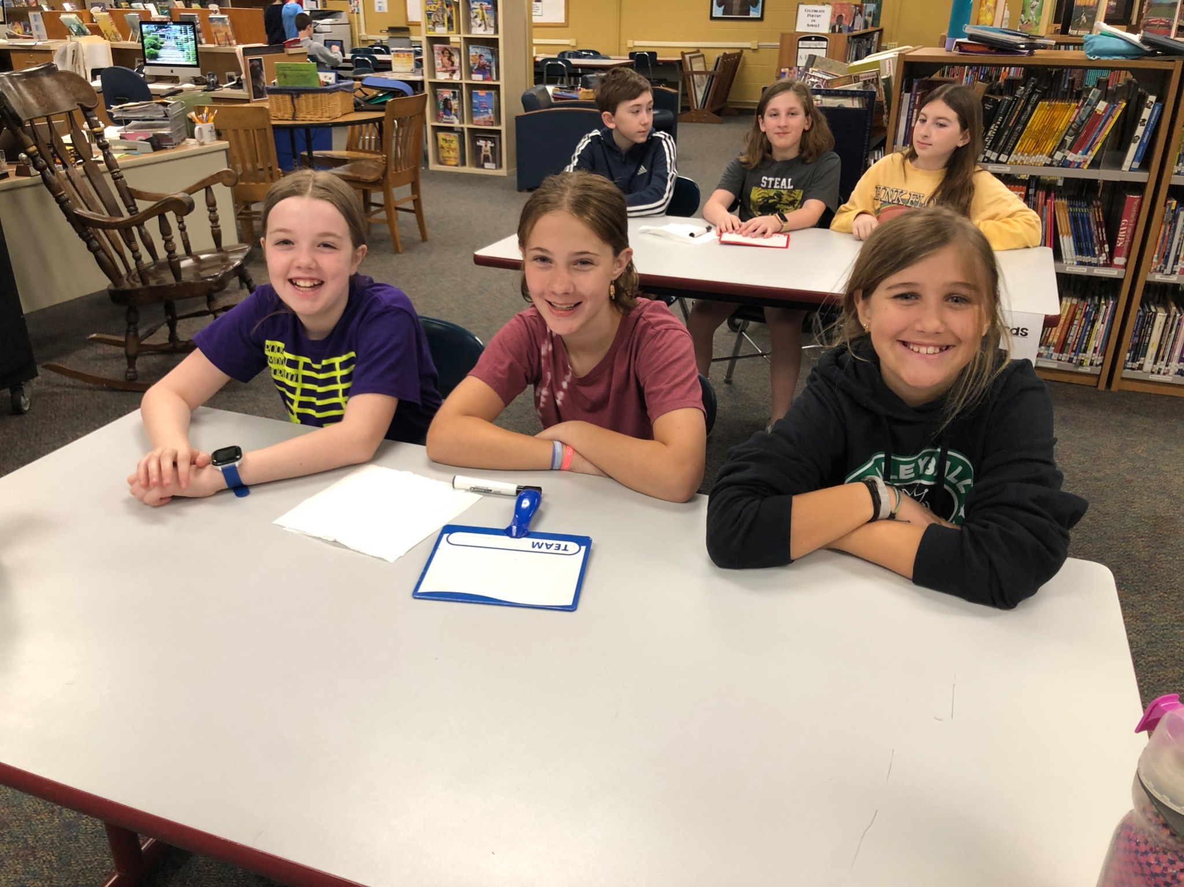
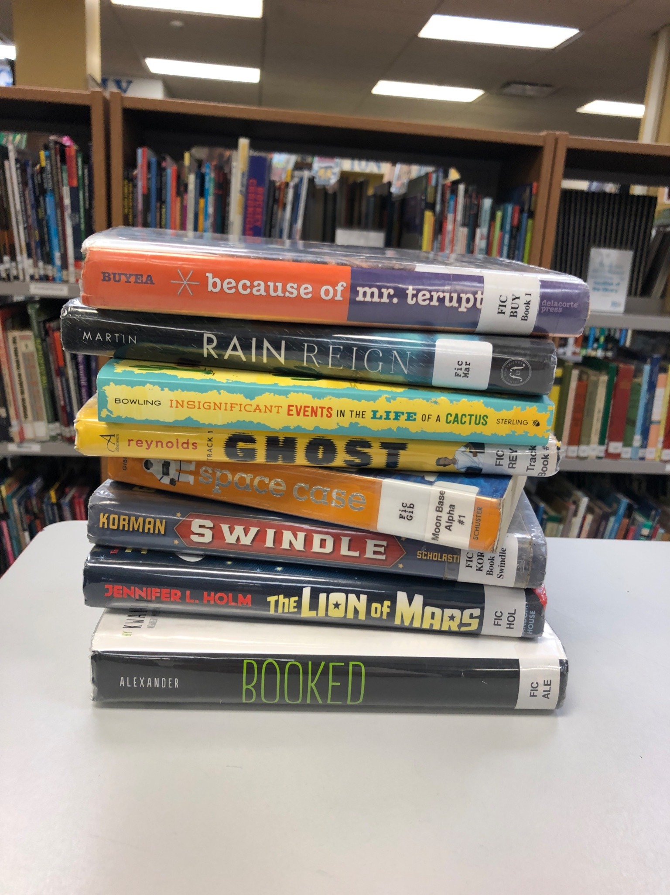
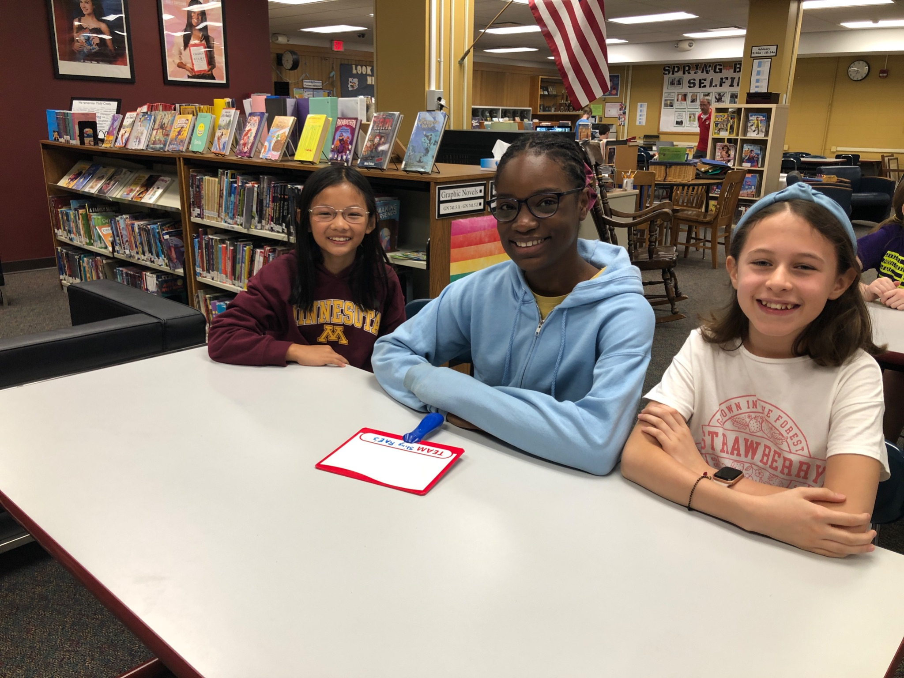
Reading
Olympics for
5th Graders

Slide 13
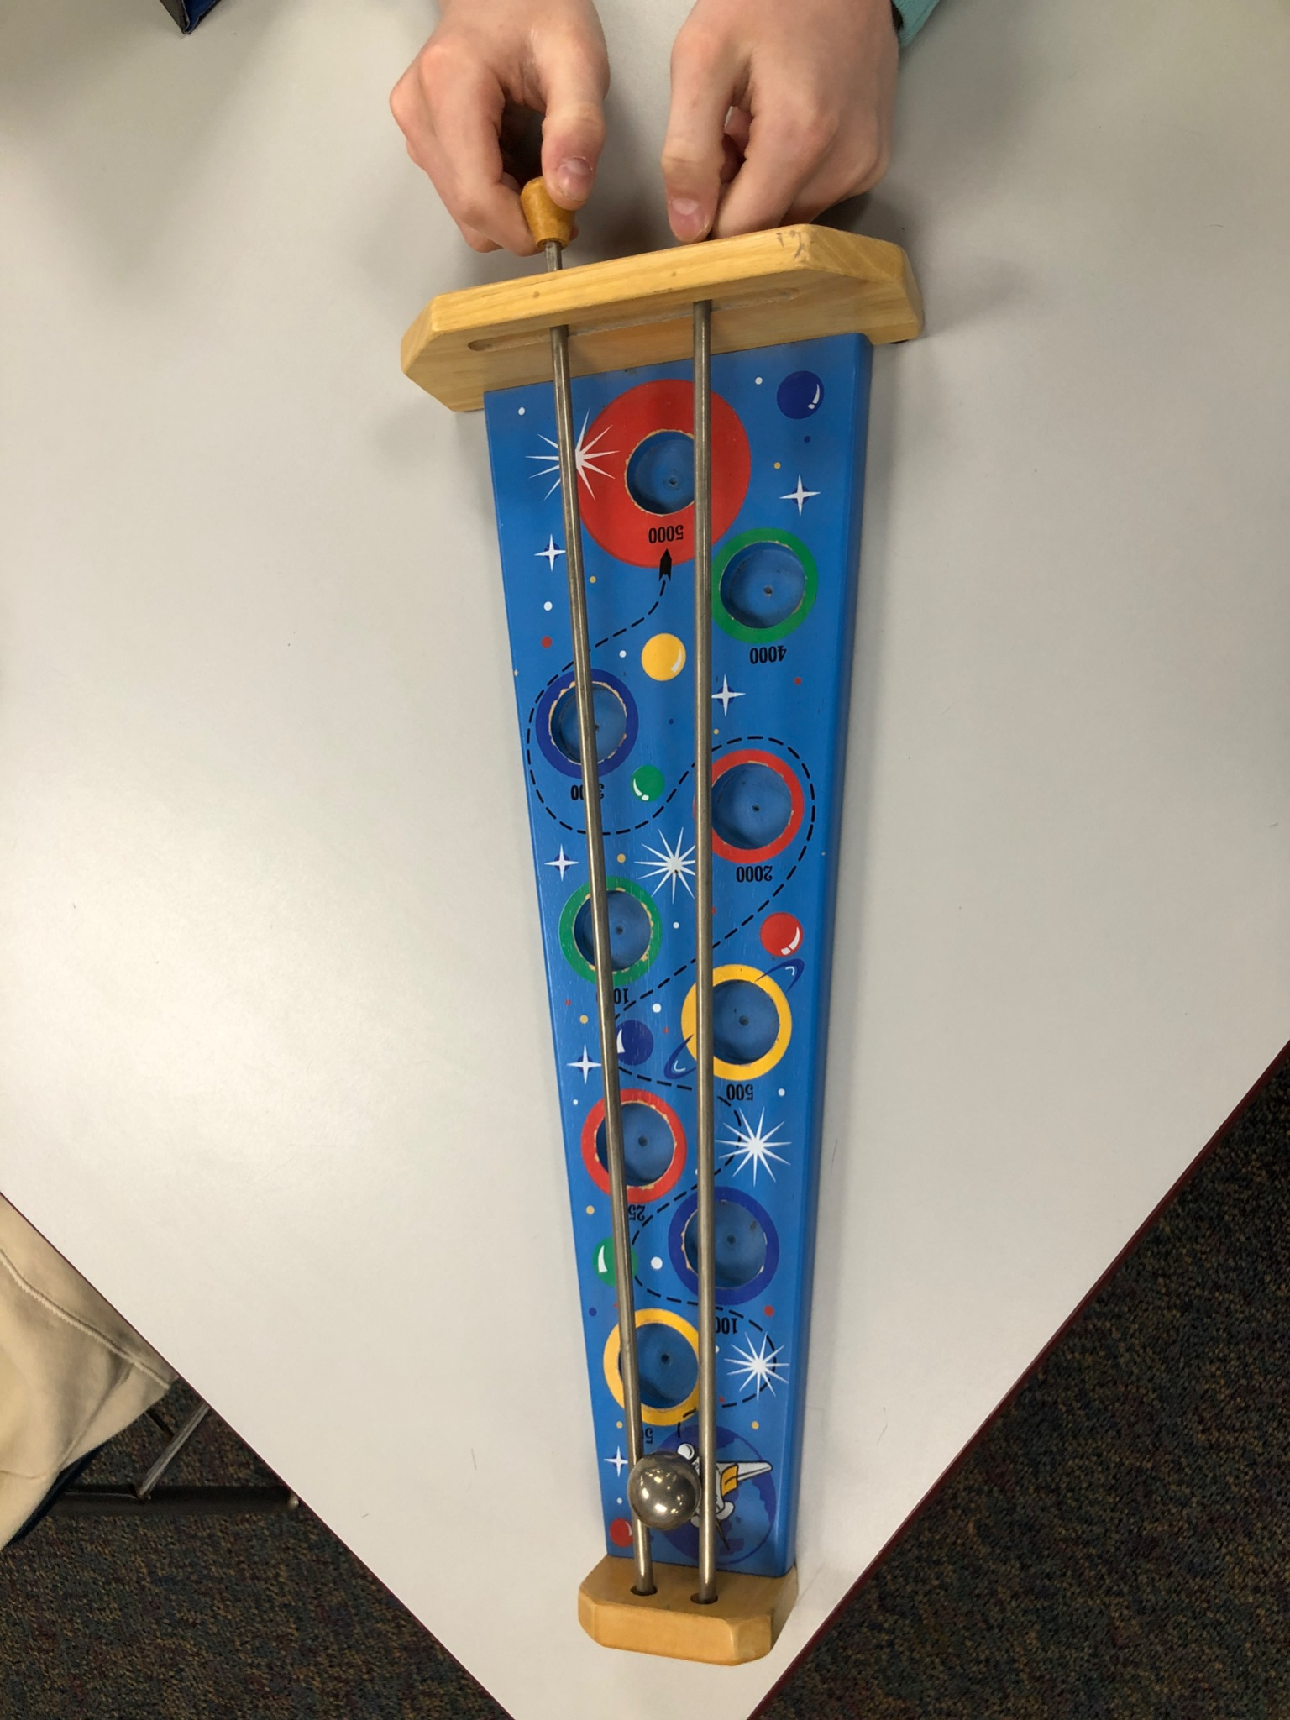
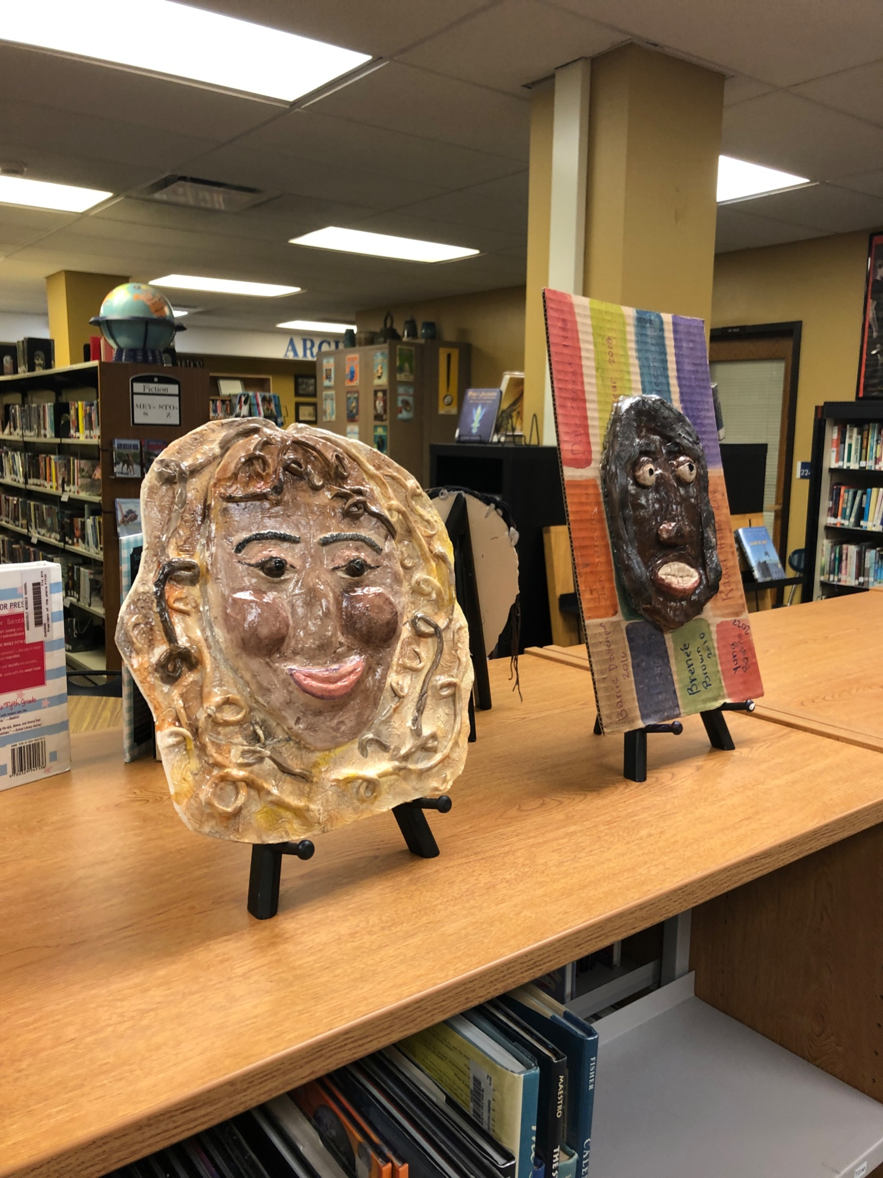
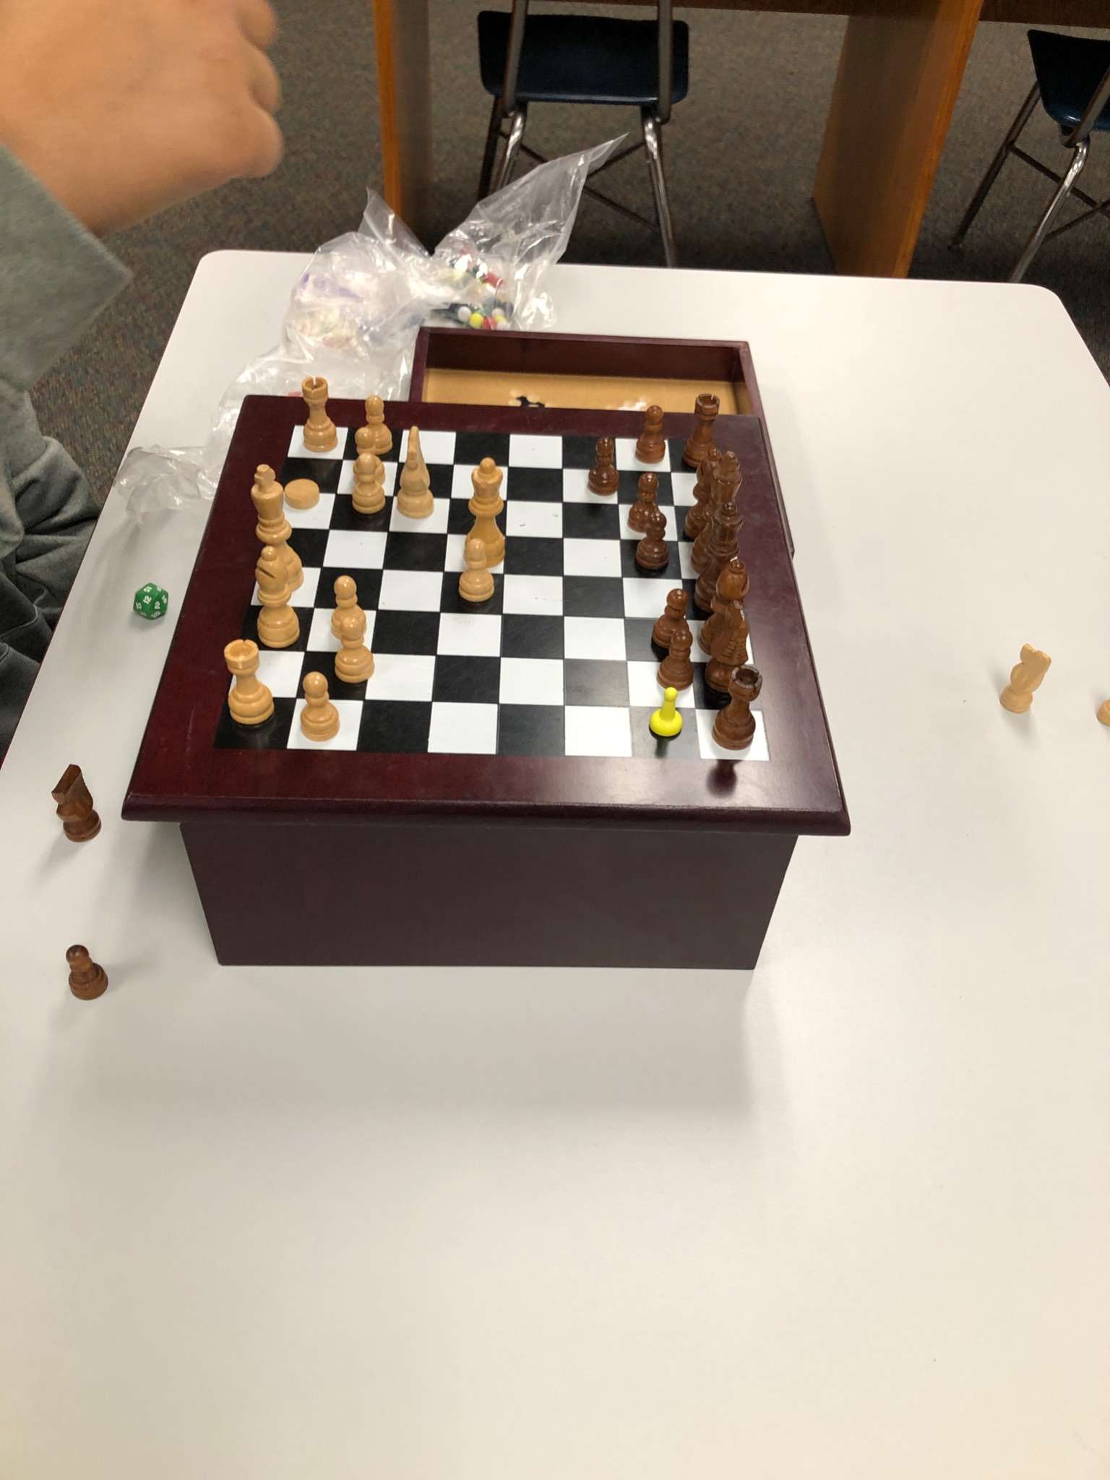
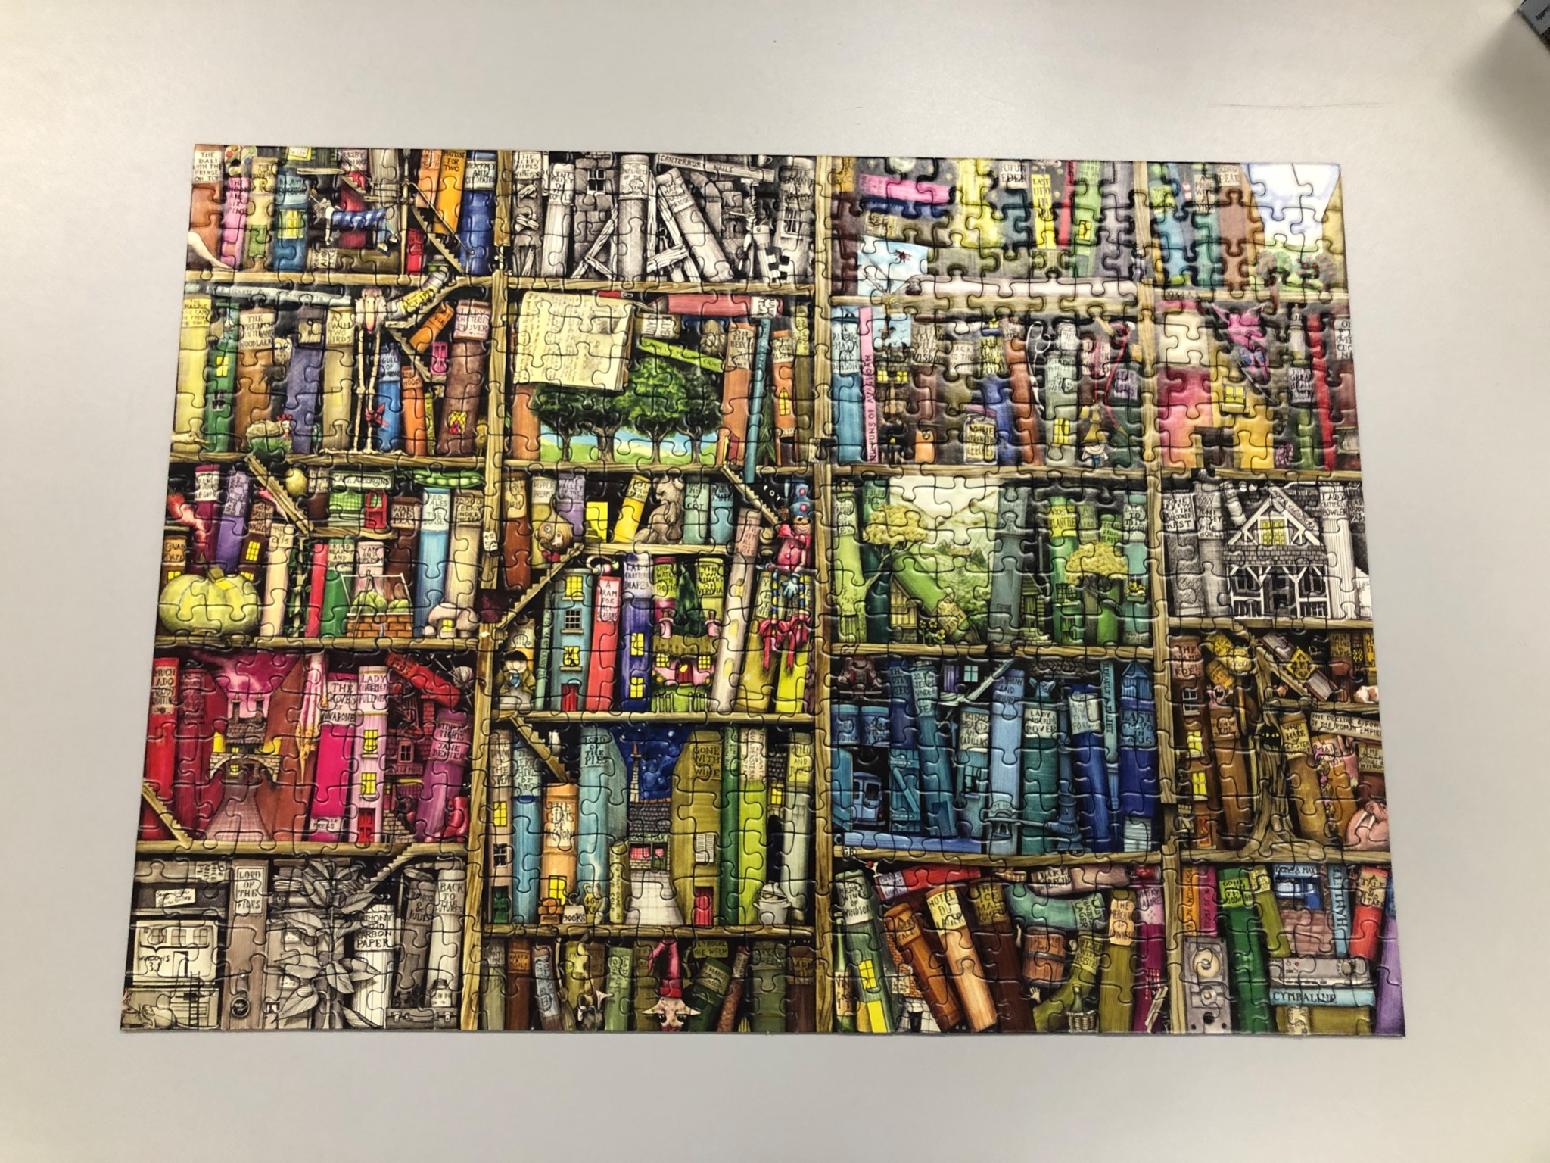
Other ways to relax
Student Art on display

Slide 14
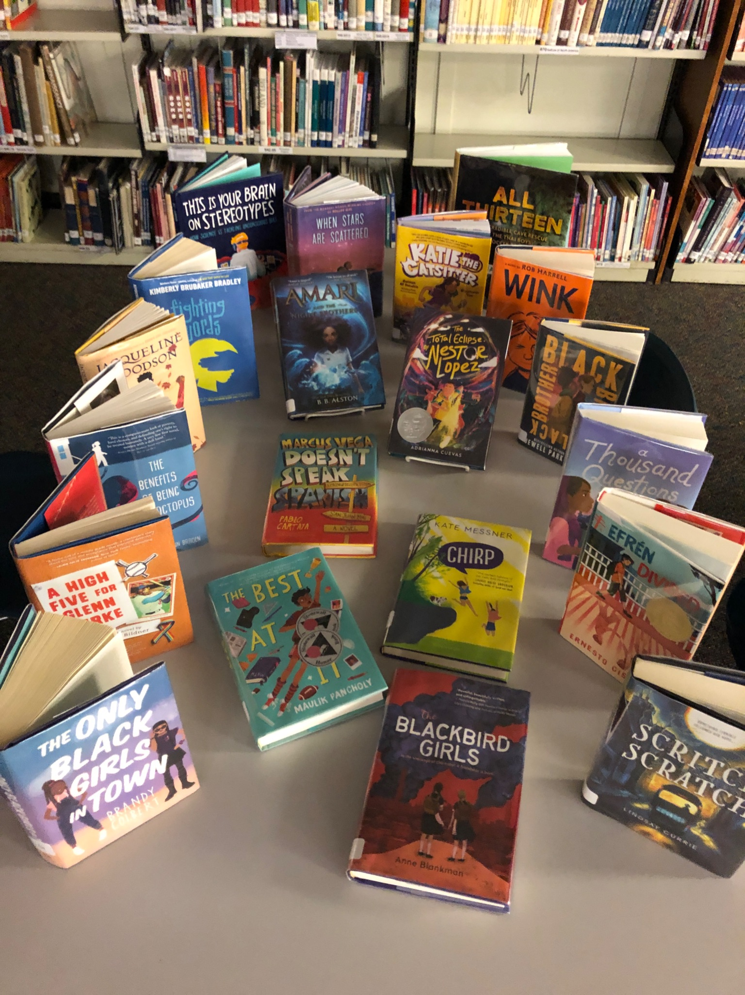
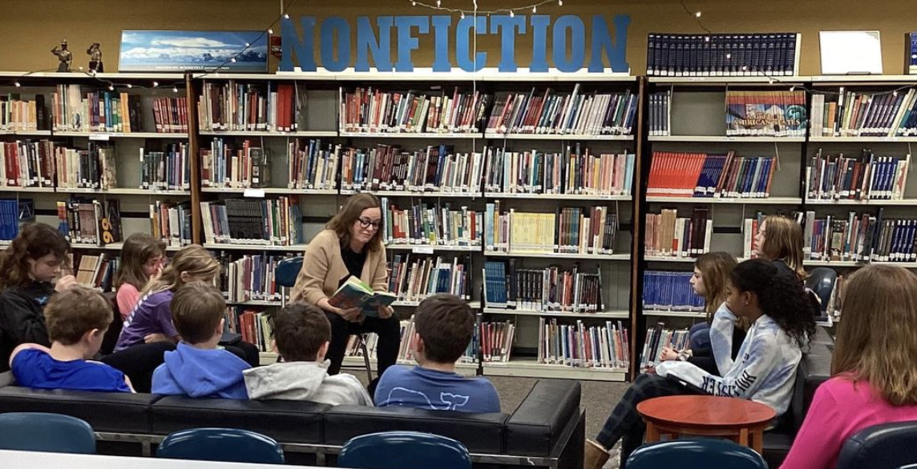
LBSS Grant
Book Talks

Slide 15
Stay in touch with the Roosevelt Middle School Library Learning Center!
LLC Website
LLC Book Catalog
Twitter - Mrs. Ziegler
Twitter - Mrs. Rogers
Caudill 2024 List
Reading Olympics Info.
Roosevelt Archives
Summer Reading Ideas
2022 - 2023

Slide 16
Mrs. Connie Rogers
School Library Media Specialist
Roosevelt Middle School
7560 Oak Avenue
River Forest, IL 60305
(708) 366-9230 x8648
rogersc@district90org
2022 - 2023

