Slide 1
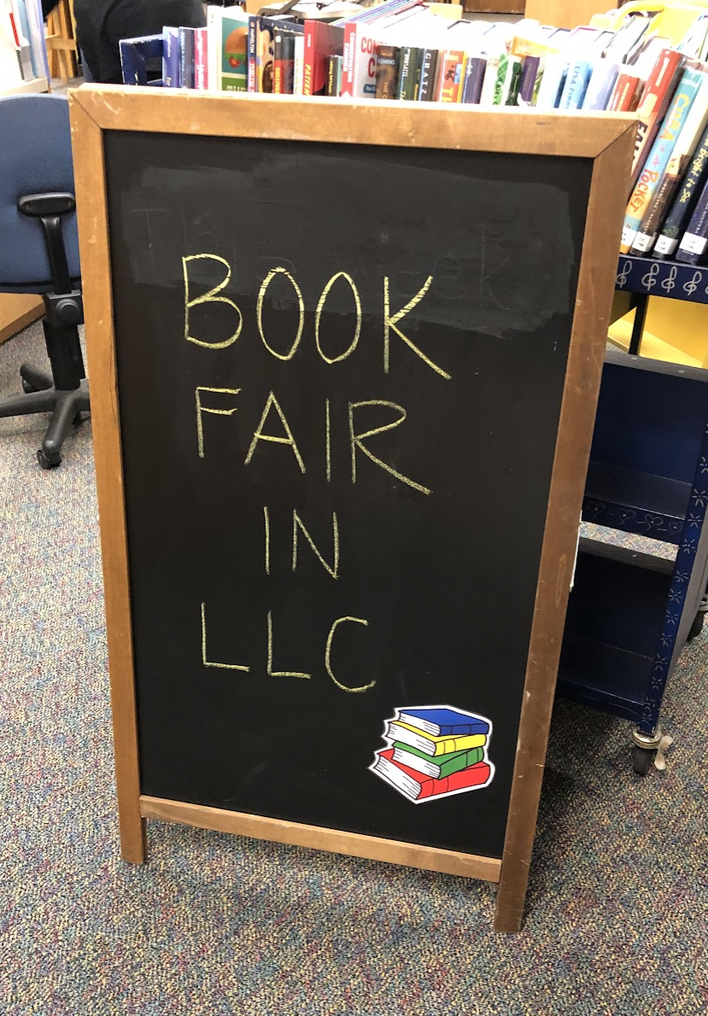
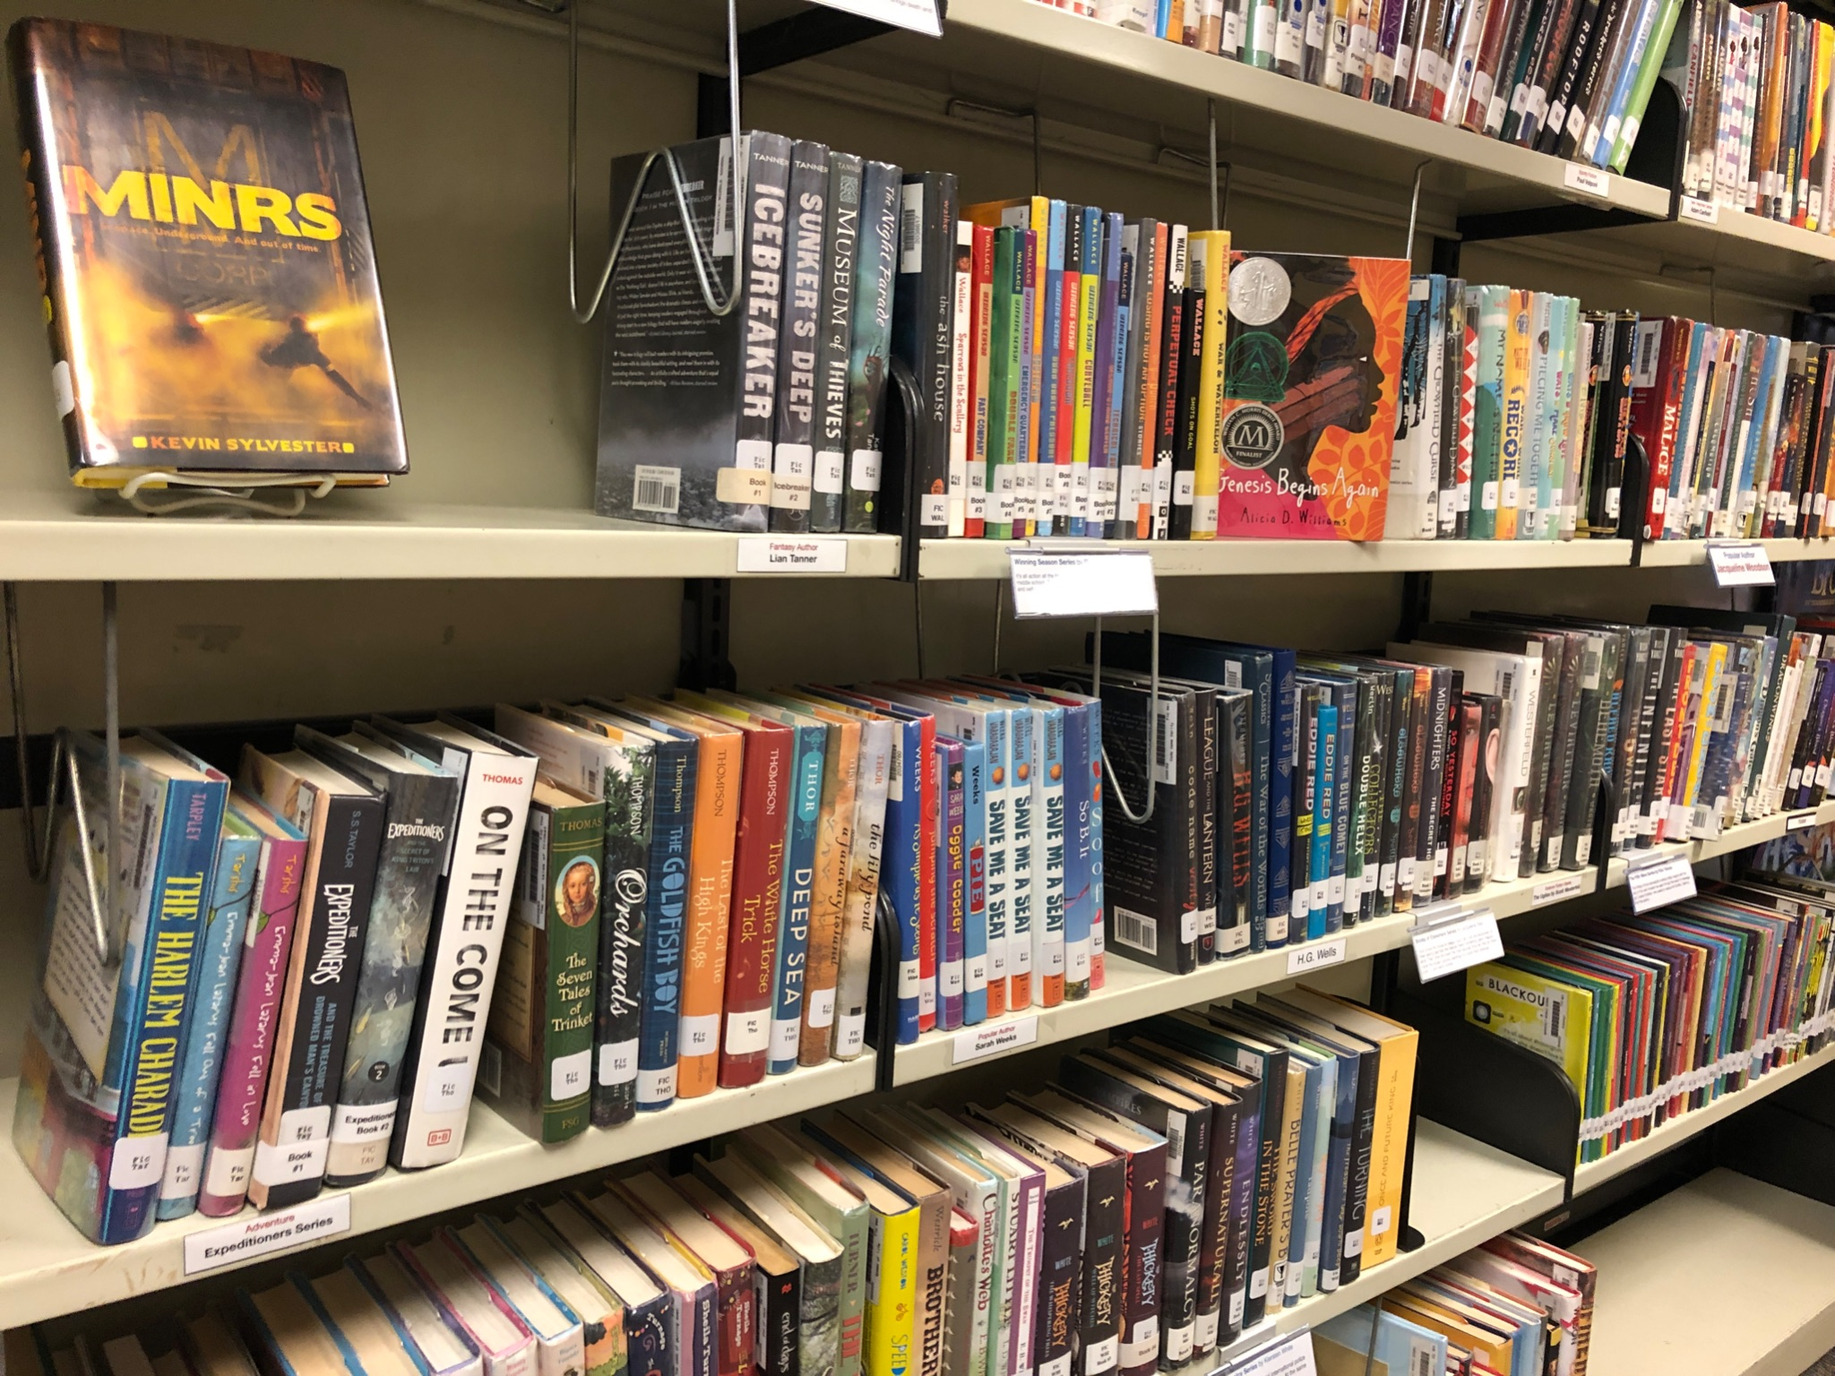
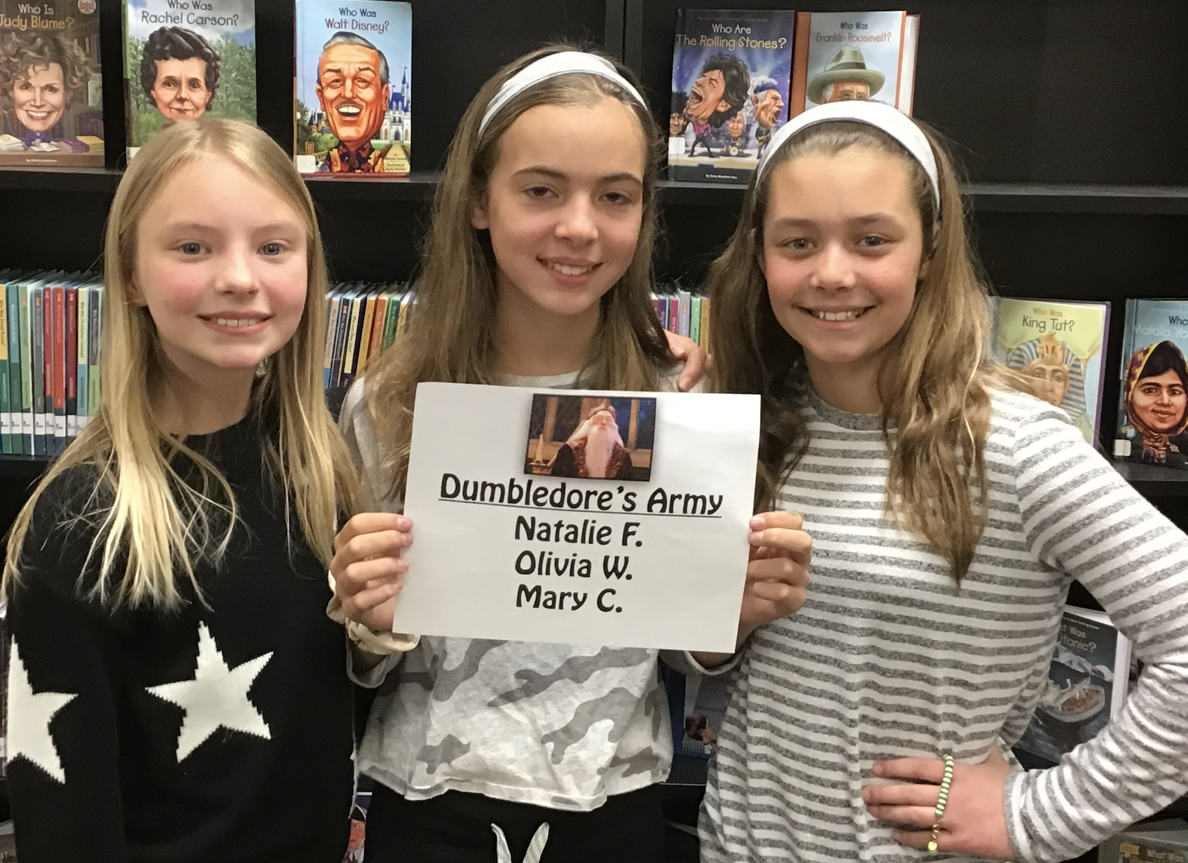
Roosevelt LLC
Roosevelt Middle School Library Learning Center
7560 Oak River Forest, IL 60305
2021-2022

Slide 2
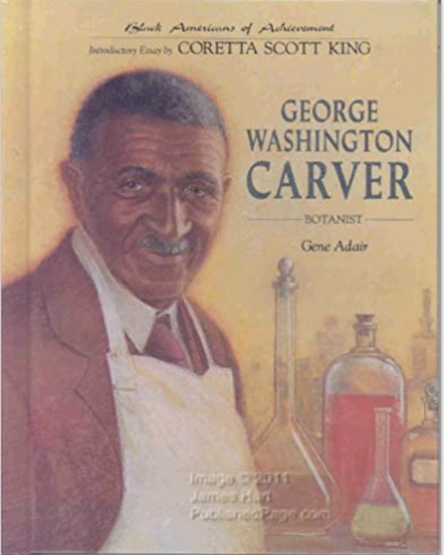
11,068 = # of Items Checked Out This Year
Most Popular Fiction
Most Popular Nonfiction
Most Popular Biography
Most Popular Graphic Novel
2021-2022

Slide 3
Top Twenty in student checkouts
Fiction
Nonfiction
The Getaway
The Hunger Games
Among the Hidden
Roderick Rules
Space Case
Escape from Mr. Lemoncello’s Library
Out of My Mind
The War That Saved My Life
From the Desk of Zoe Washington
Greg Heffley’s Journal
Double Down
Amina’s Voice
Harry Potter and the Sorcerer’s Stone
Dog Days
The Ugly Truth
Big Shot
The Lightning Thief
The Terrible Two
Catching Fire
Gregor the Overlander
Lives of the Scientists
Women Pioneers of Science
Good Night Stories for Rebel Girls (1)
Rad American Women A-Z
Black Inventors
African American Inventors
Good Night Stories for Rebel Girls (2)
Unsung Heroes of Technology
Torpedoed
Top 101 Remarkable Women
Women in Technology
What Would She Do?
Biology
Chemistry
Engineering
Inventors
Medicine
Headstrong
Top 101 Women of STEM
Top 101 Scientists

Slide 4
Top Twenty in student checkouts
Biography
Graphic Novel
George Washington Carver
Virginia Apgar
Rachel Carson and the Environmental Movement
Rachel Carson
Grace Hopper
Space Rocks
Sylvia Earle
Who on Earth is Sylvia Earle?
Who on Earth is Dian Fossey?
Light Shining Through the Mist
Mae Jemison
NASA Mathematician Katherine Johnson
Ada Lovelace
Ellen Ochoa
Who Was Sally Ride?
The Story of Rachel Carson and the Environmental Movement
Marie Curie
Marie Curie
Who is Jane Goodall?
Programming Pioneer Ada Lovelace
Sisters
New Kid
Drama
Guts
Swing It, Sunny
Ghosts
Kristy’s Great Idea
Class Act
Smile
Real Friends
Kristy and the Snobs
Roller Girl
Dawn and the Impossible Three
Claudia and the New Girl
Fake Blood
Sunny Side Up
The Okay Witch
Awkward
Be Prepared
Camp

Slide 5
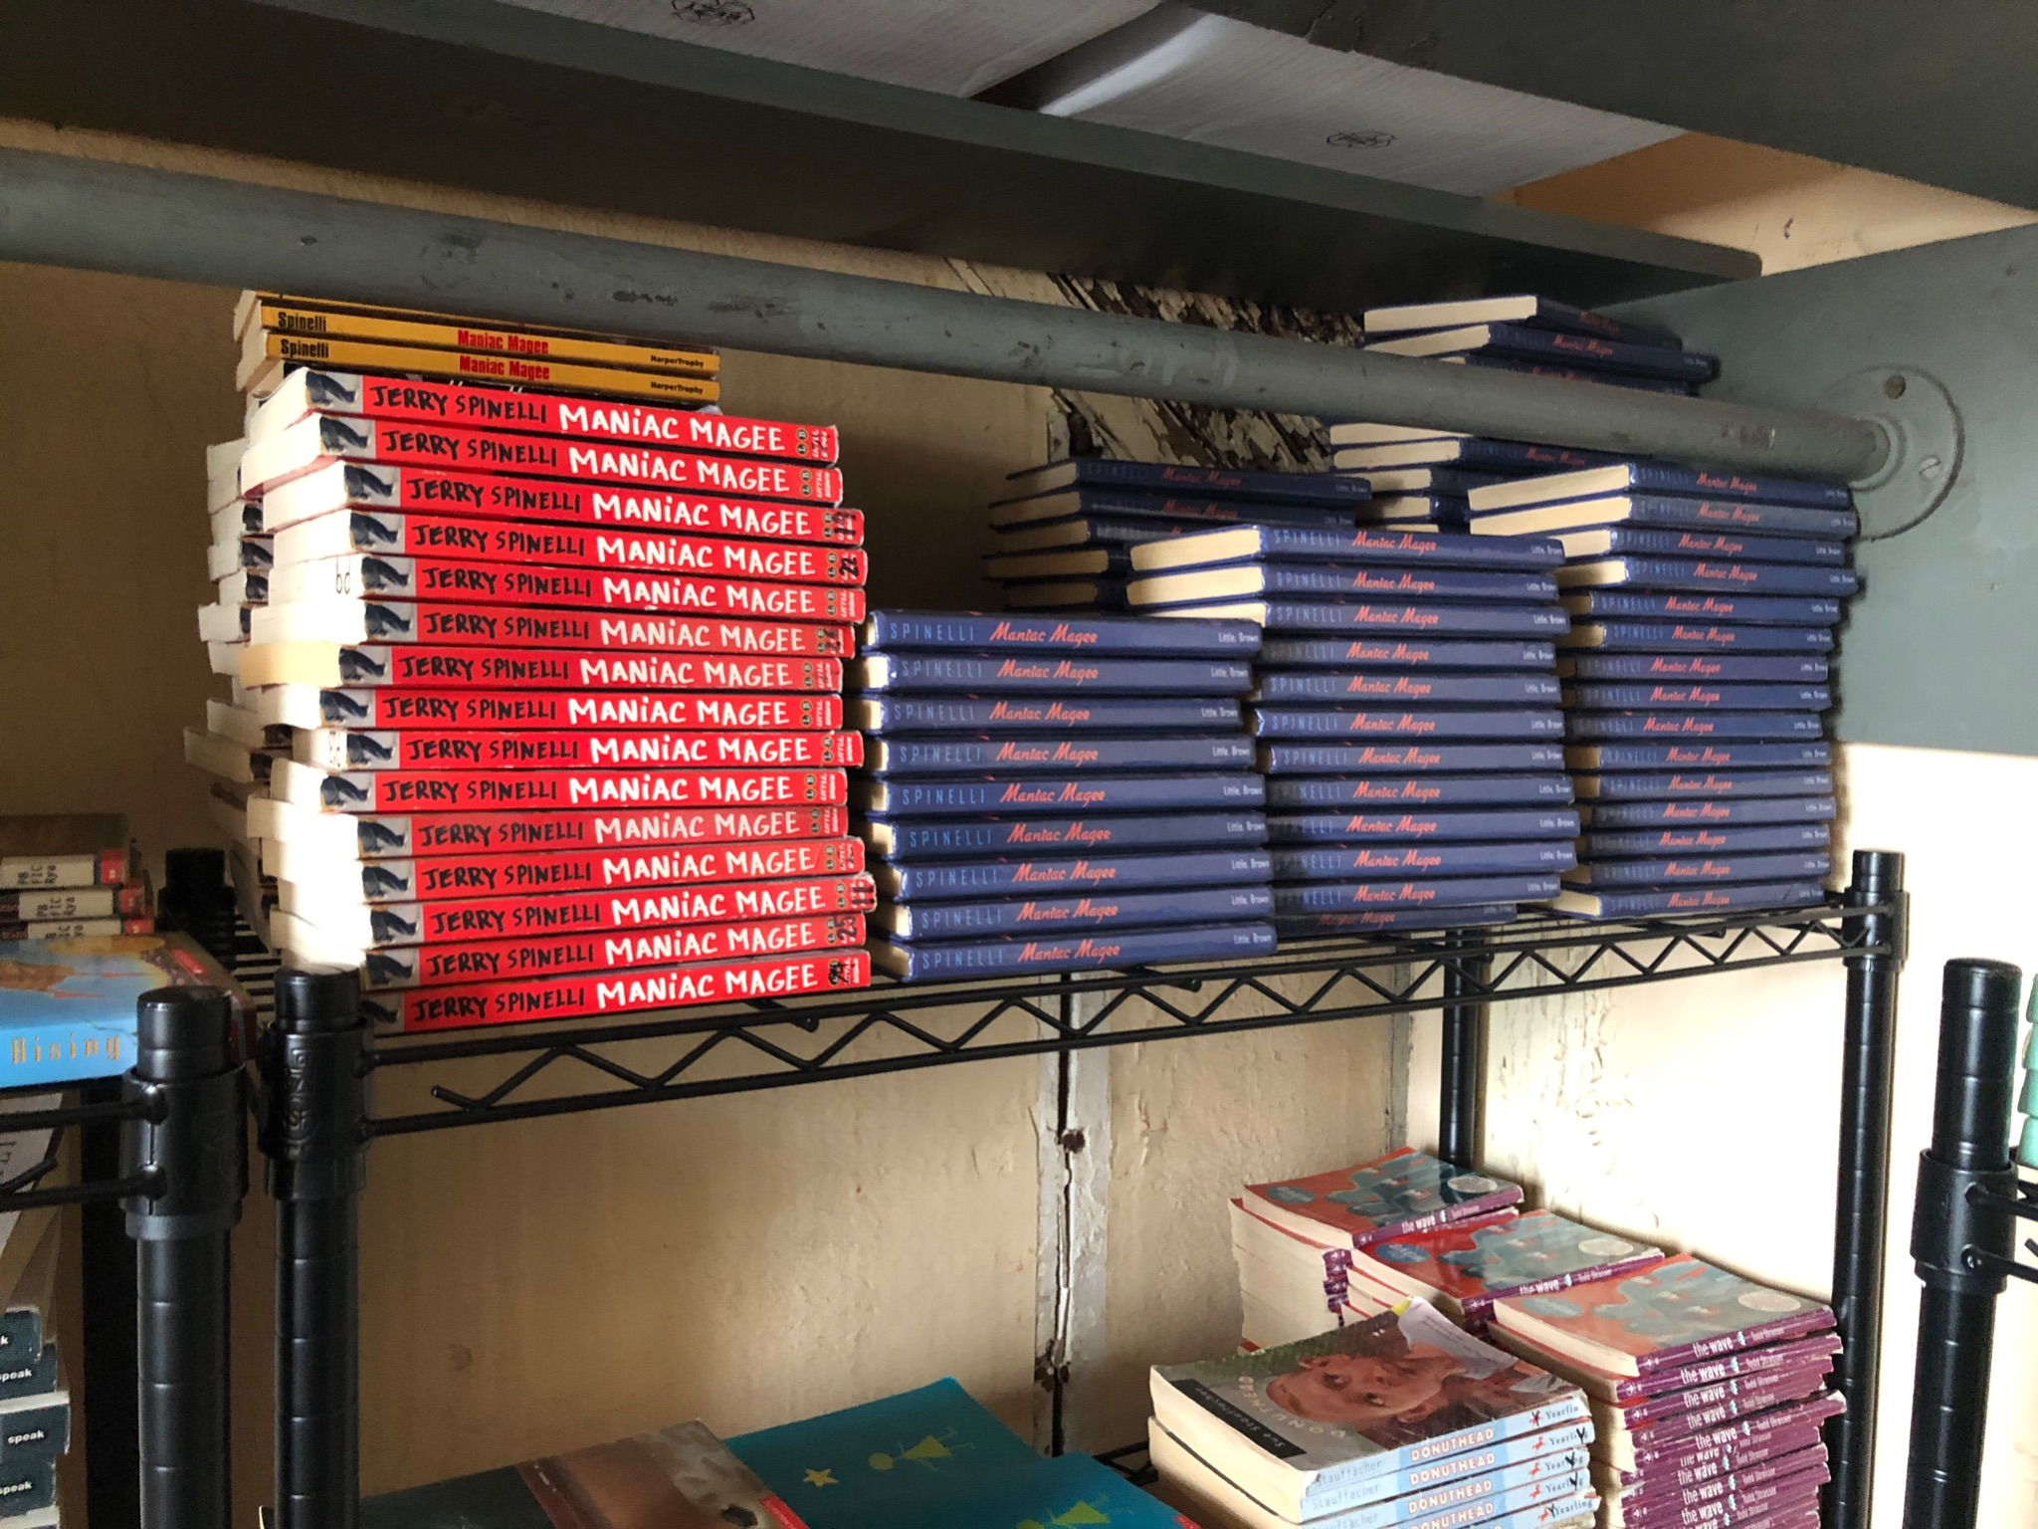
LLC Book Checkouts by
Grade
Our new classroom set book room in the attic
5th Grade 3,719
6th Grade 2,898
7th Grade 1,341
8th Grade 2,770

Slide 6
Research with the Roosevelt LLC
Screen time
Recess
Video games
Homework
Famous Francophones
Harlem Renaissance
Les Régions de France
Killer whales
School uniforms
Shelter animals
Global warming
Gun violence
Police brutality
Pollution
Vaping
Bullying
Later school day start times
Renewable energy
Clean energy
Fossil fuels
STEM Leaders (68 of them)
Social Media
1936 Olympics
Development Atomic bomb
Hate crimes
Immigration
LGBTQ rights
Racism
Danish Jews & Holocaust
Lincoln assasination
Indian boarding schools
Sarajevo, Bosnia
Plastic pollution
Zoos
Sharks
Underwater exploration
Extreme sports
Mental illness
Peaceful protest
Teen pregnancy
Child labor
Animal treatment
Child soldiers
Rights of disabled
Clean water
Electric cars
Endangered animals
Free speech
Gang violence
Gender equity
Poaching
Vaccines

Slide 7
LLC Resources
for staff
SORA
App for reading
Roosevelt LLC Professional Development
Educator’s Explora
ERIC
Professional Development Collection
This reading app is available to all Roosevelt students.
Over 530 books currently available
With an RFPL they can even access the public library books

Slide 8
Using Roosevelt LLC Research Tools
as of May 31, 2022
RESOURCE | SEARCHES/LOG INS
Biography Reference Bank | 3,860
Biography Reference Center | 5,006
Britannica | 48,489
Fact Cite | 592
LibGuides | 17,999
NoodleTools | 5,820
Middle Search Plus | 5,385
Novelist | 103
Points of View Reference Center | 5,869
Topic Overviews | 3,292

Slide 9
LibGuides
6th - Activism & Community Service | 5,000
STEM 2021-2022 | 4,692
7th - Harlem Renaissance | 1,241
8th - Elizabethan & Shakespearean | 947
6th - L’Afrique Francophone | 909
7th - Les Régions de France | 733
5th - Les Pays Francophones | 726
Famous Francophones | 718
5th - Argument & Advocacy | 333
6th - Research for Book Clubs | 219
5th - Argument Essay | 205
Memoirs | 108
Research assistance, subject guides and useful resources compiled by your Roosevelt Library staff
Table indicates titles and number of views from the most used Roosevelt LibGuides for 2021-2022 school year
108 Guides
16,416 Views
See all LibGuides here

Slide 10
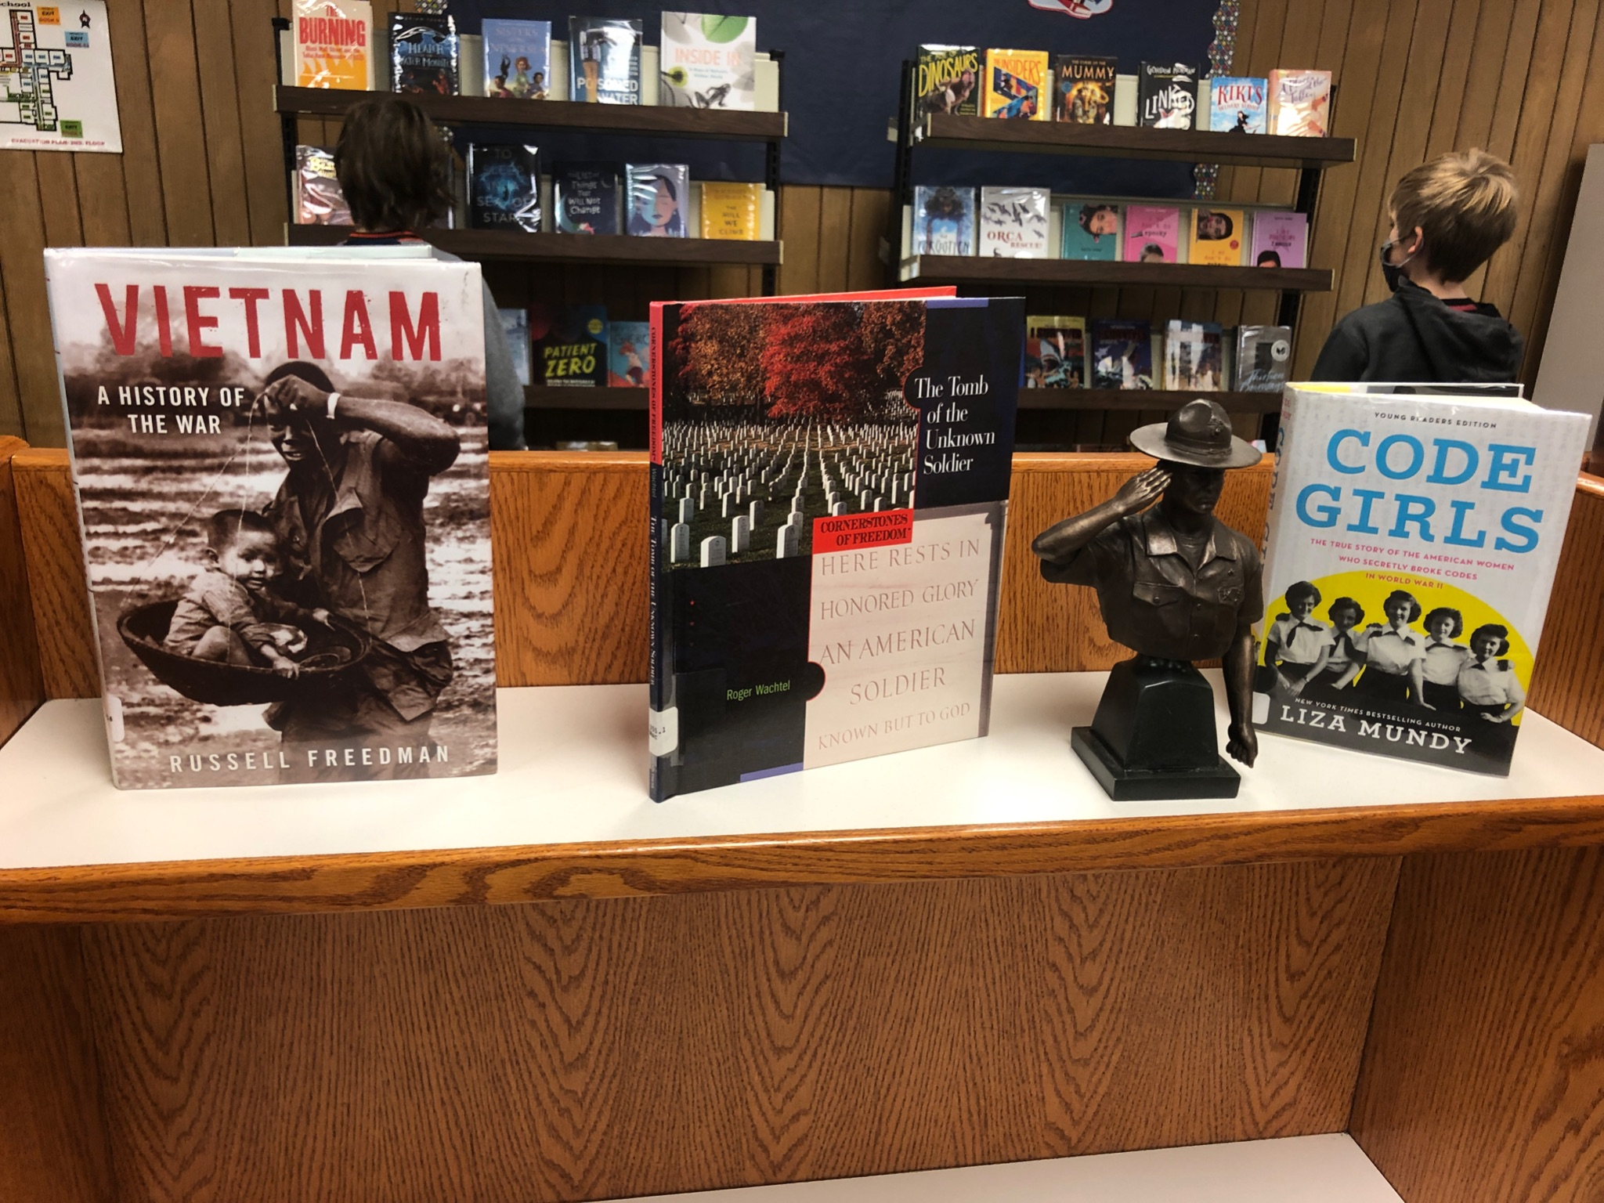
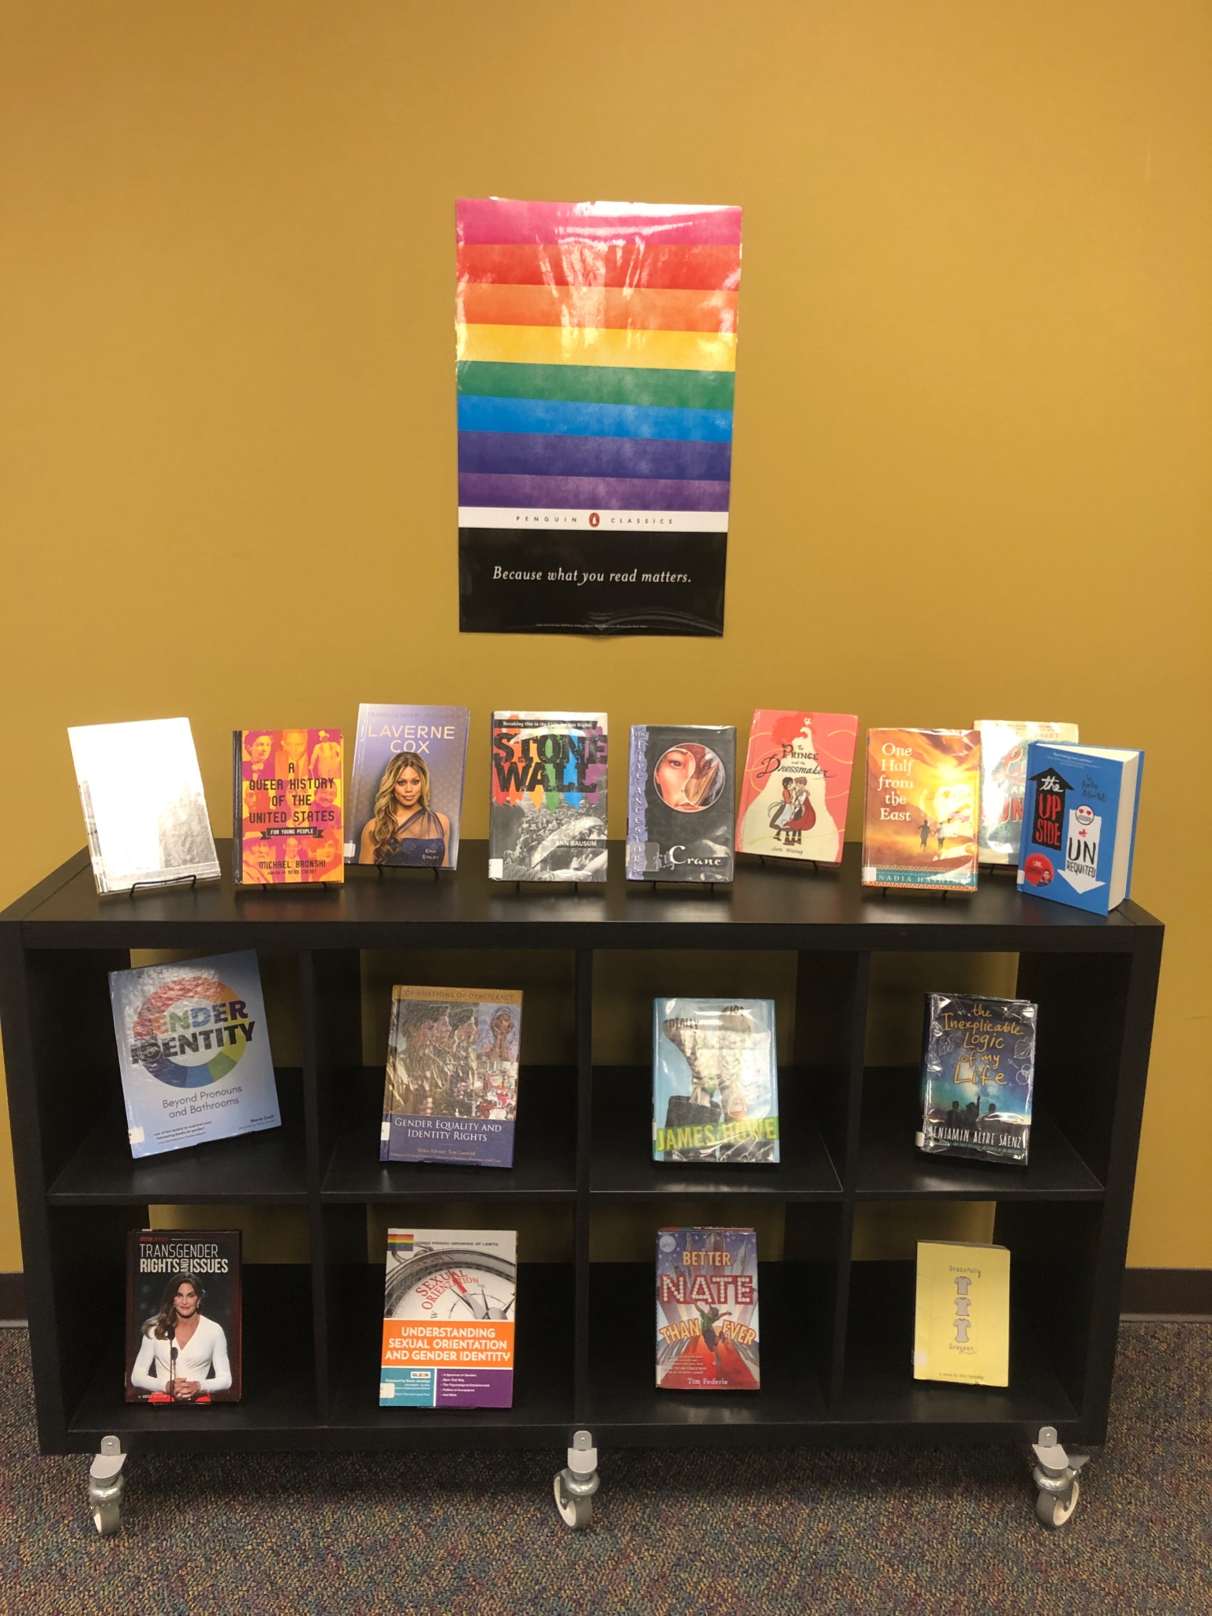
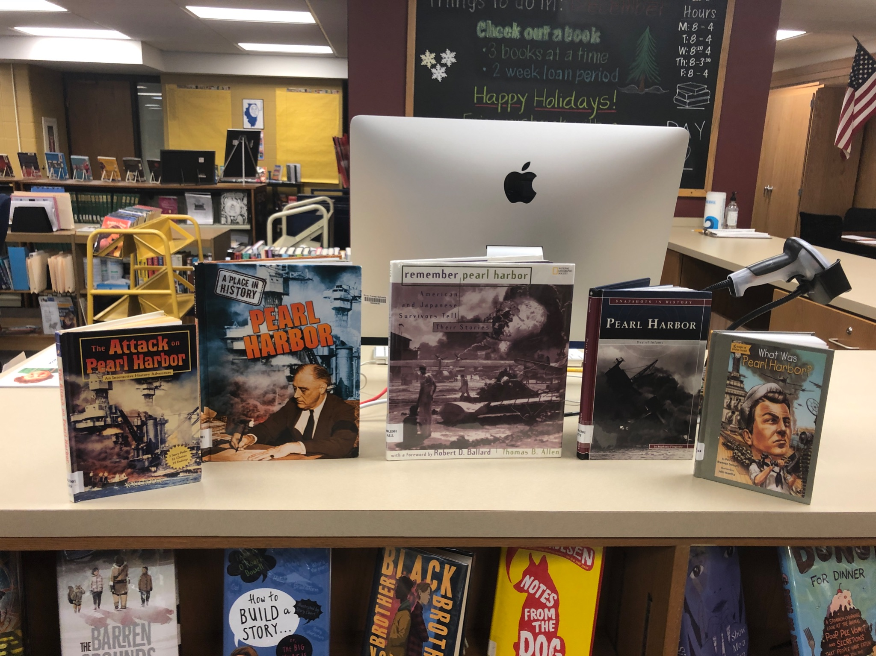
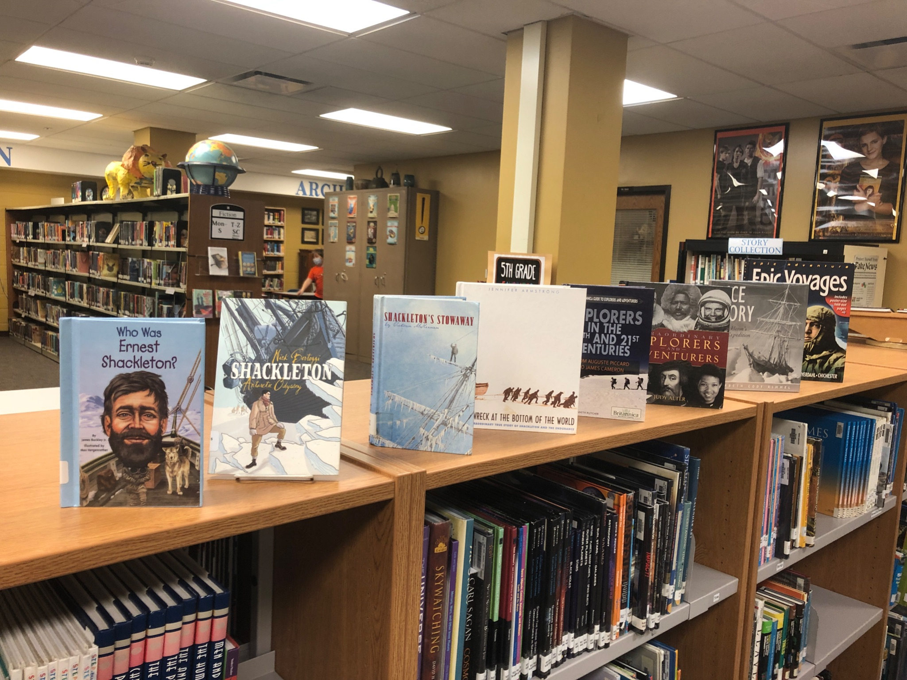
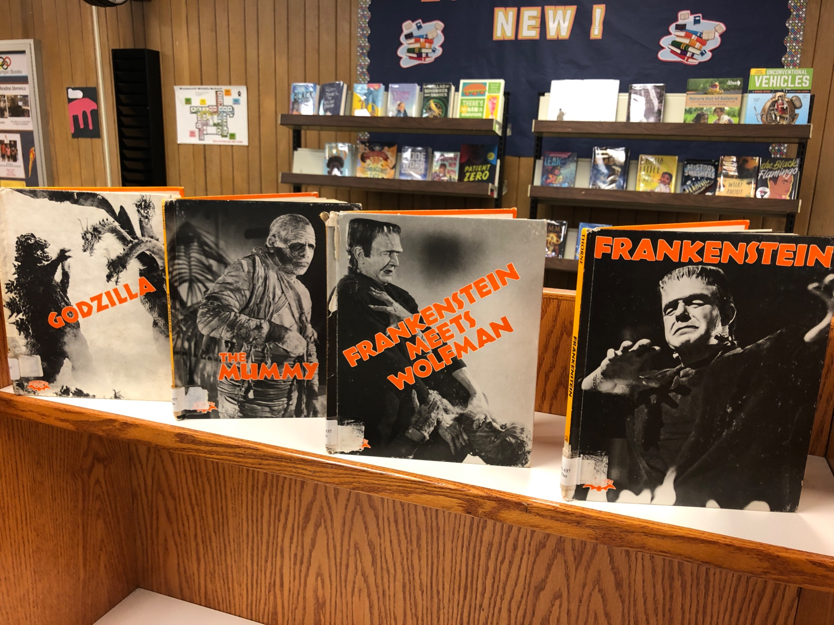
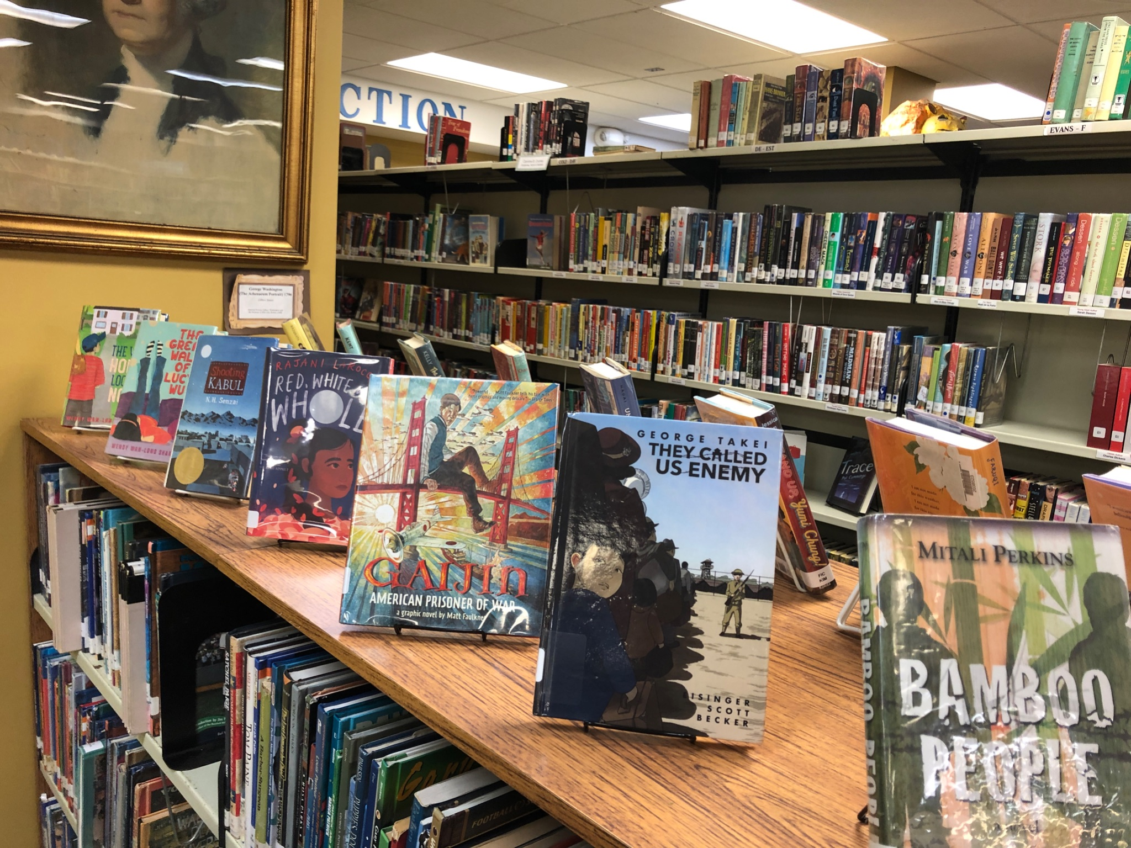
Pearl Harbor Day
Transgender Awareness Week
Veteran’s
Day
Reading Displays
Asian American Awareness
Halloween
Shackleton

Slide 11
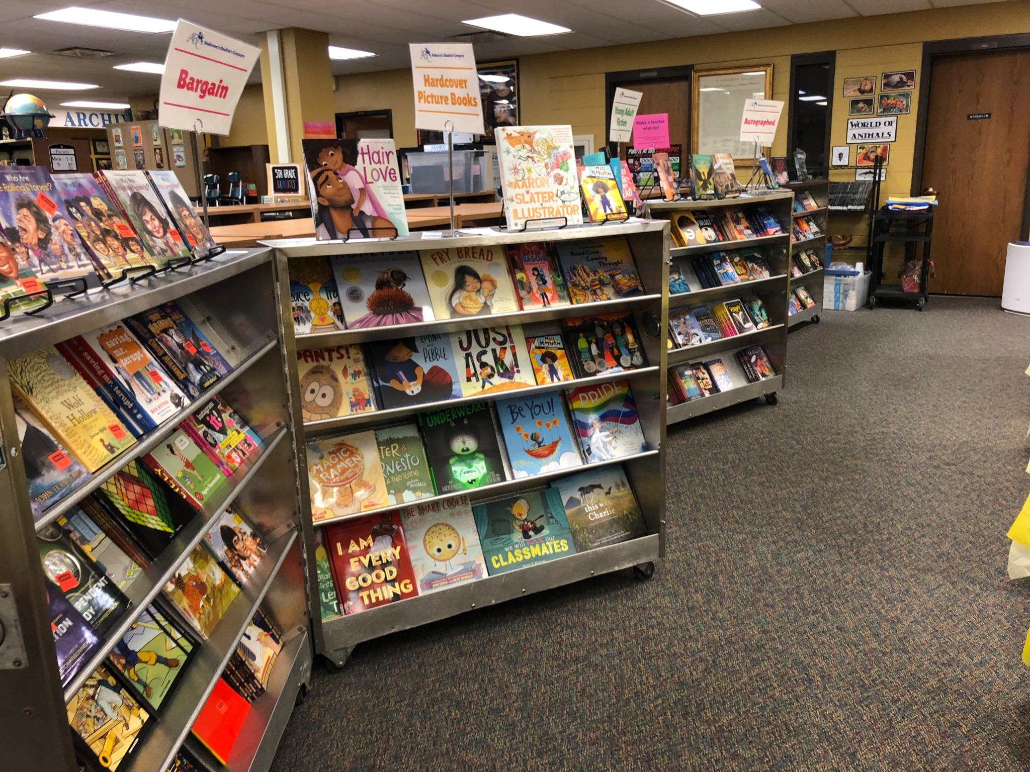
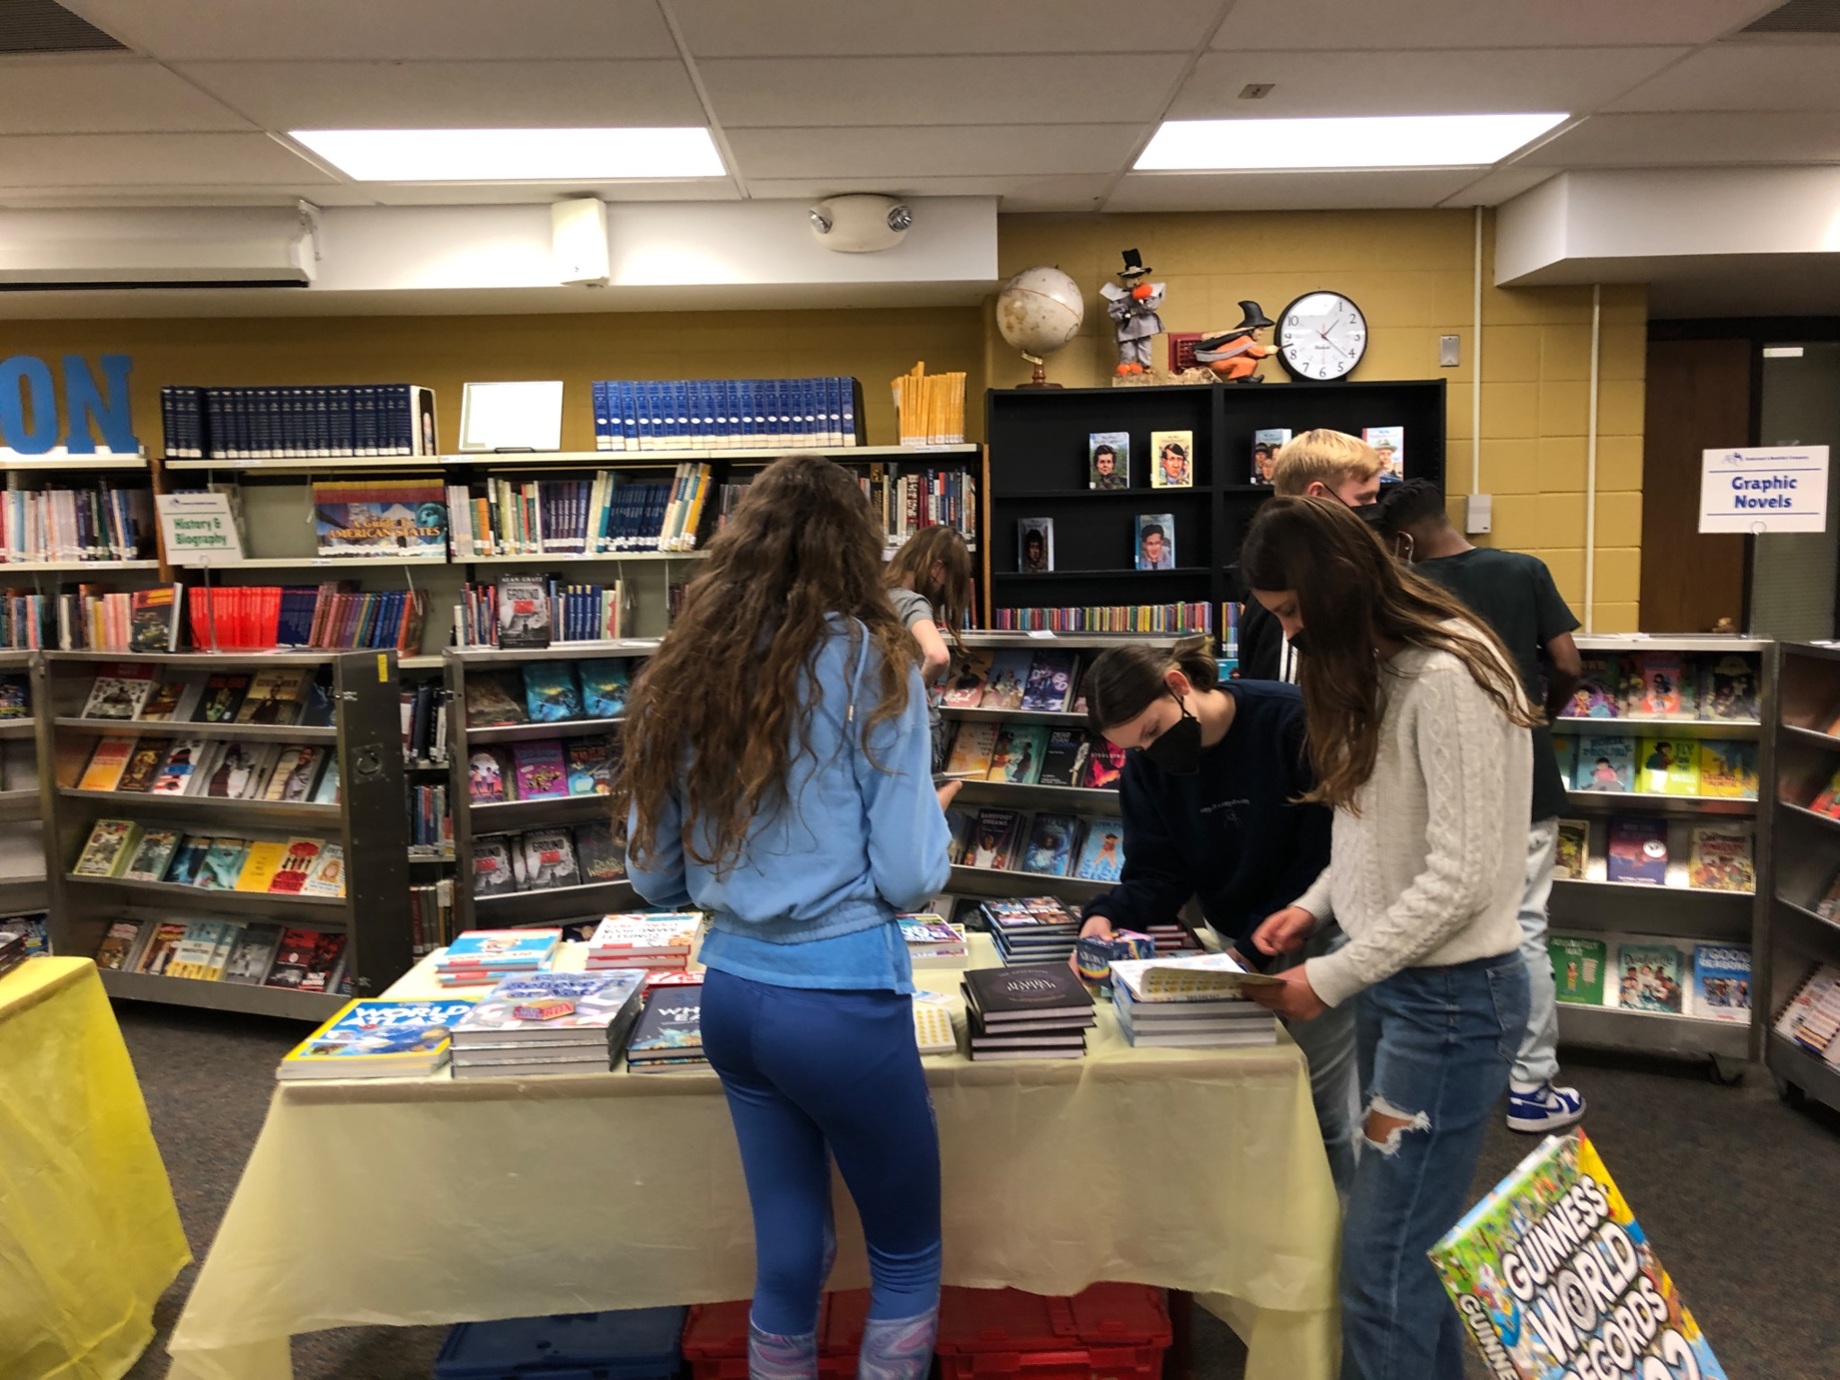
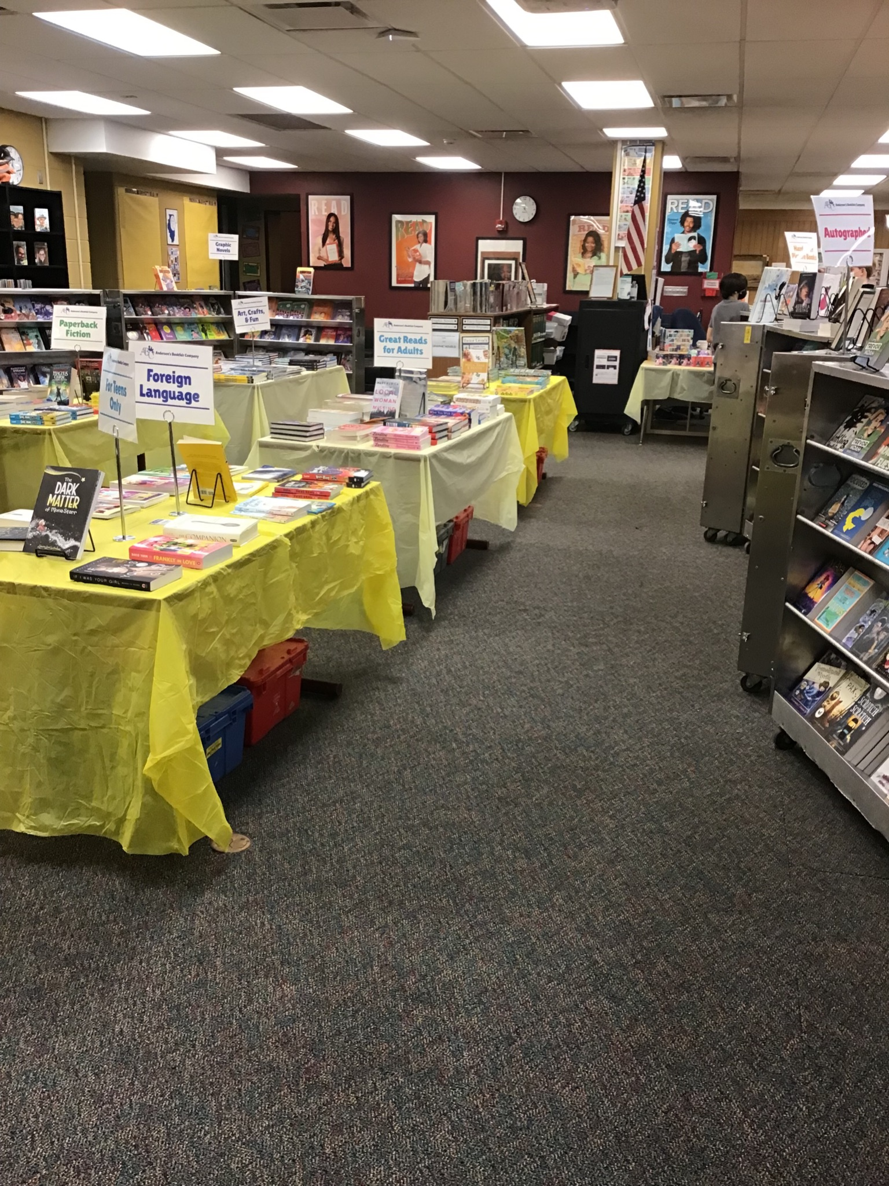
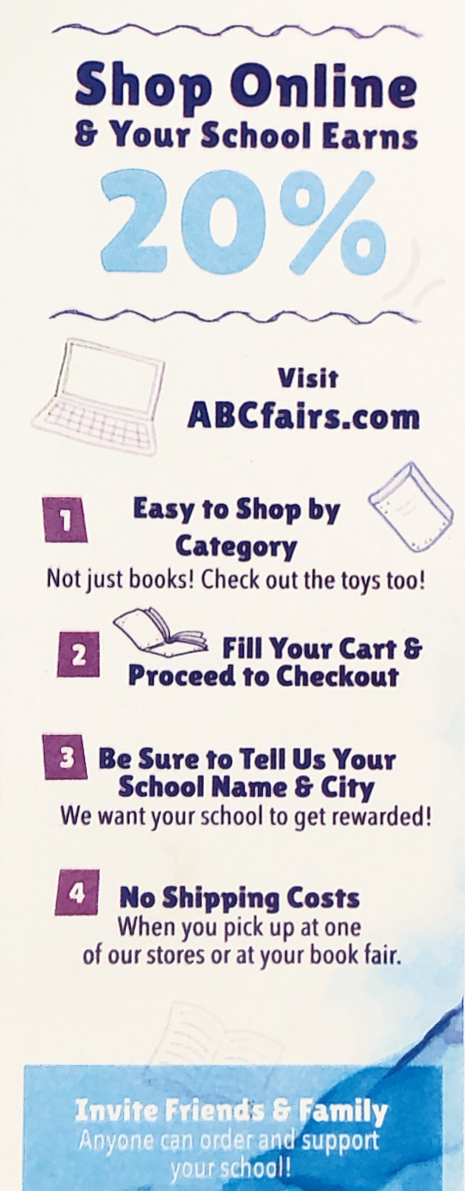
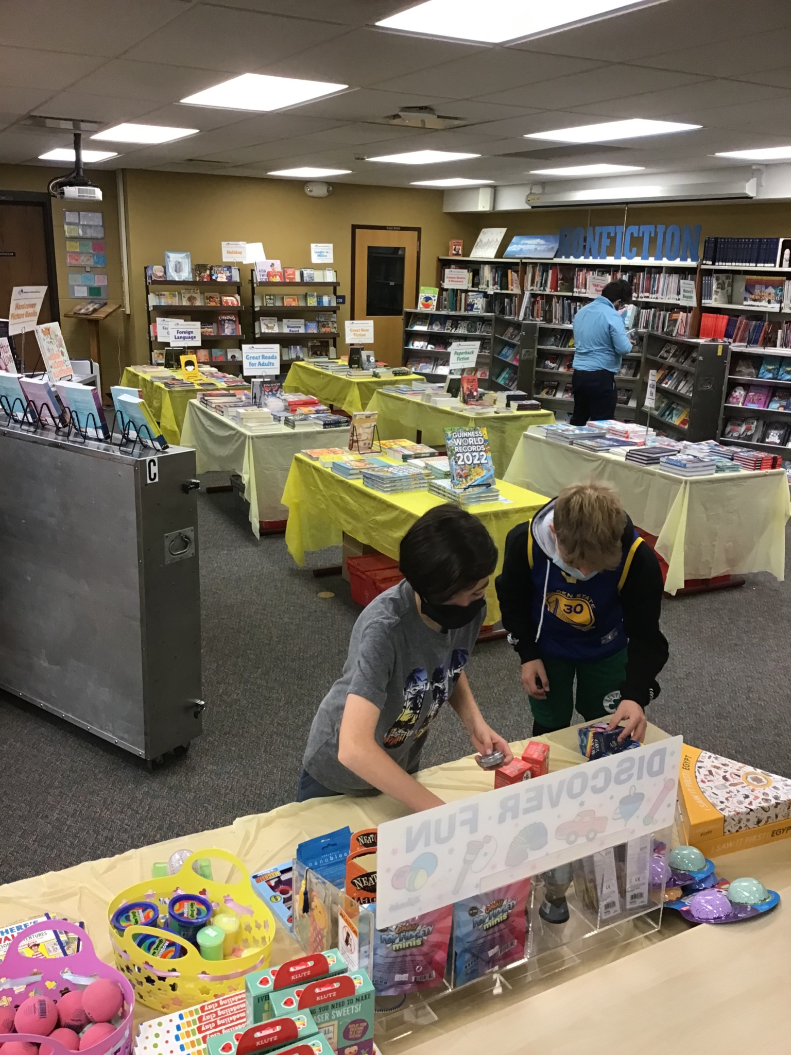
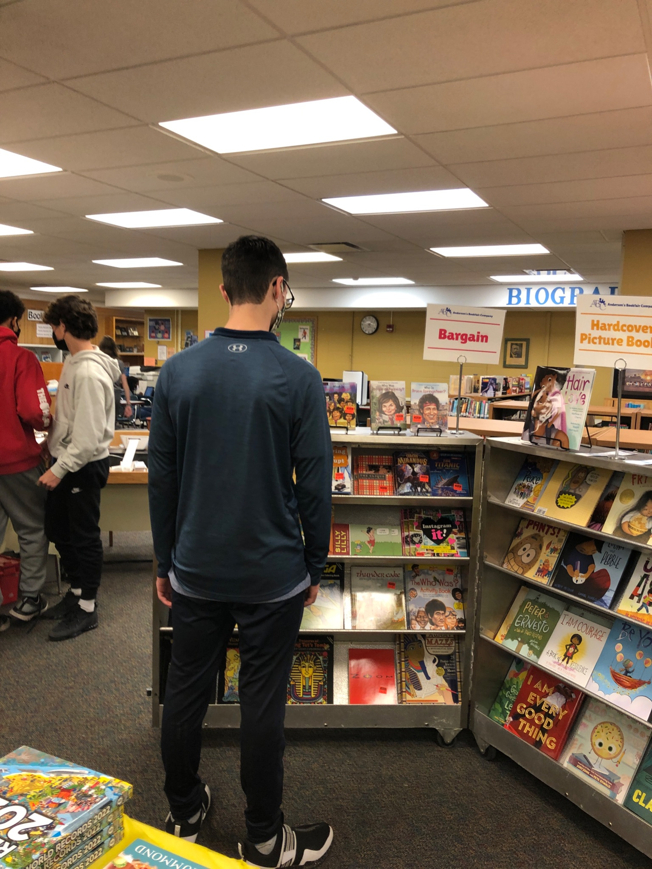
Book
Fair

Slide 12
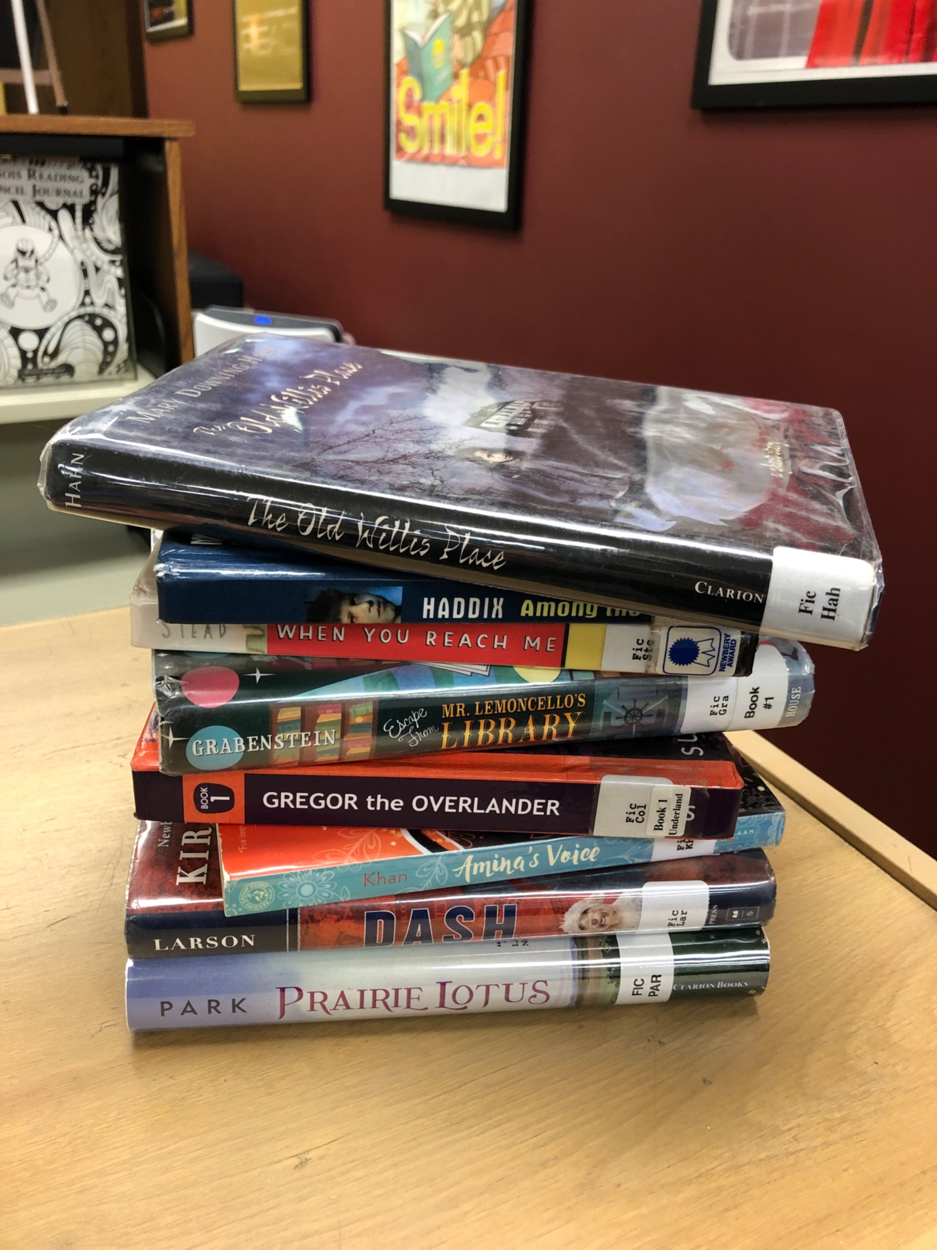
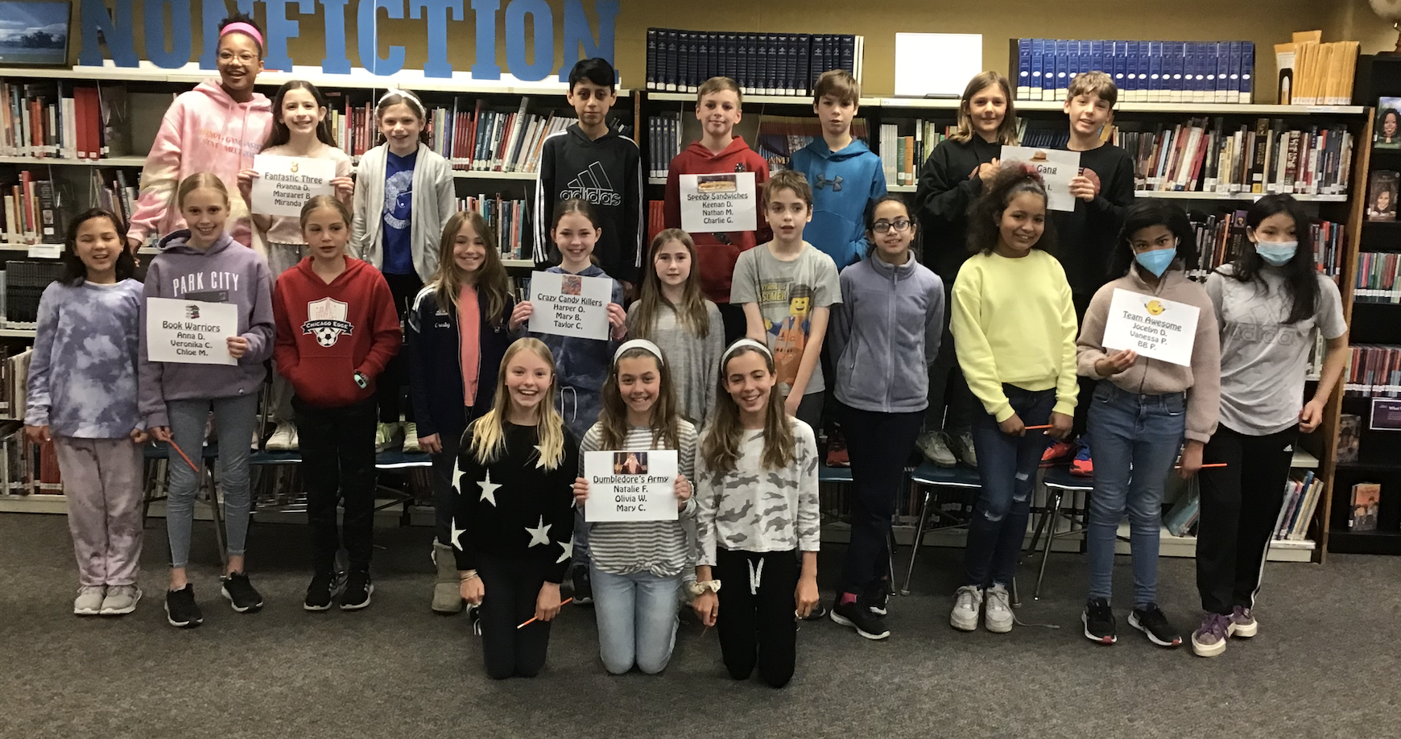
Reading Olympics

Slide 13
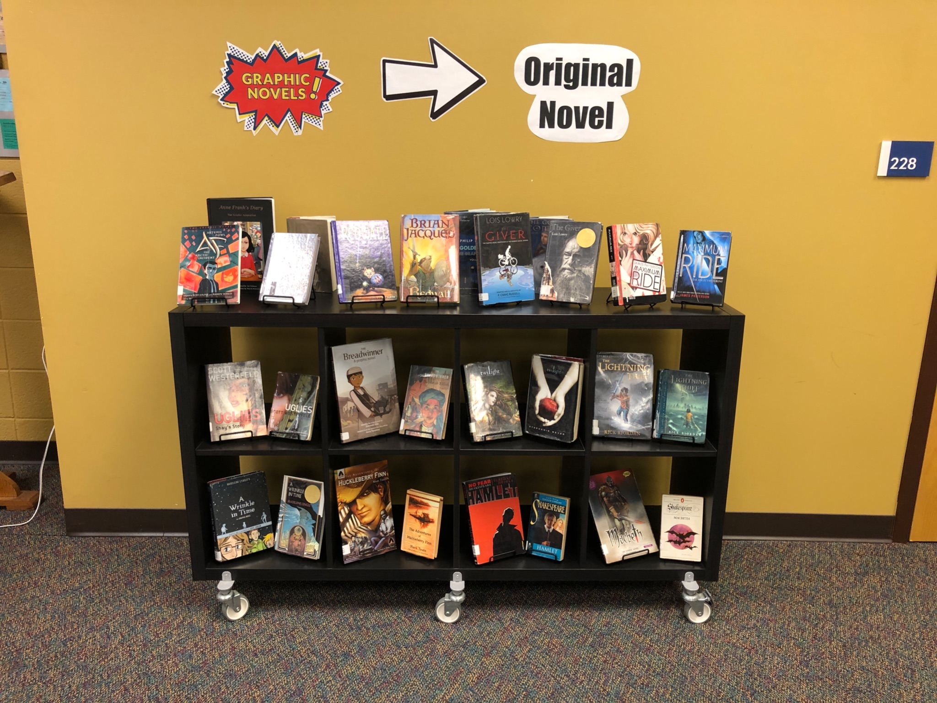
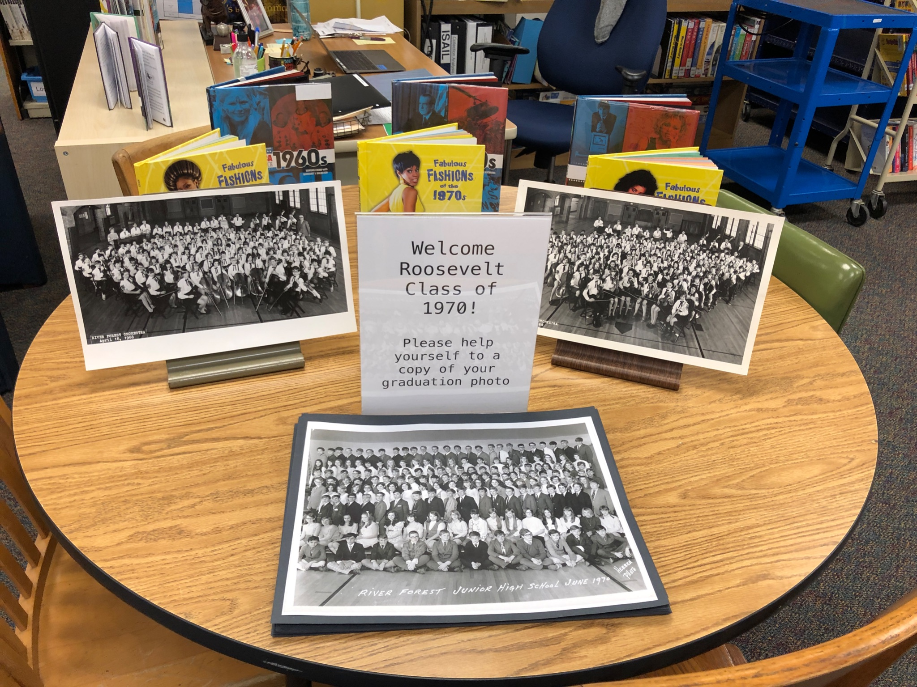
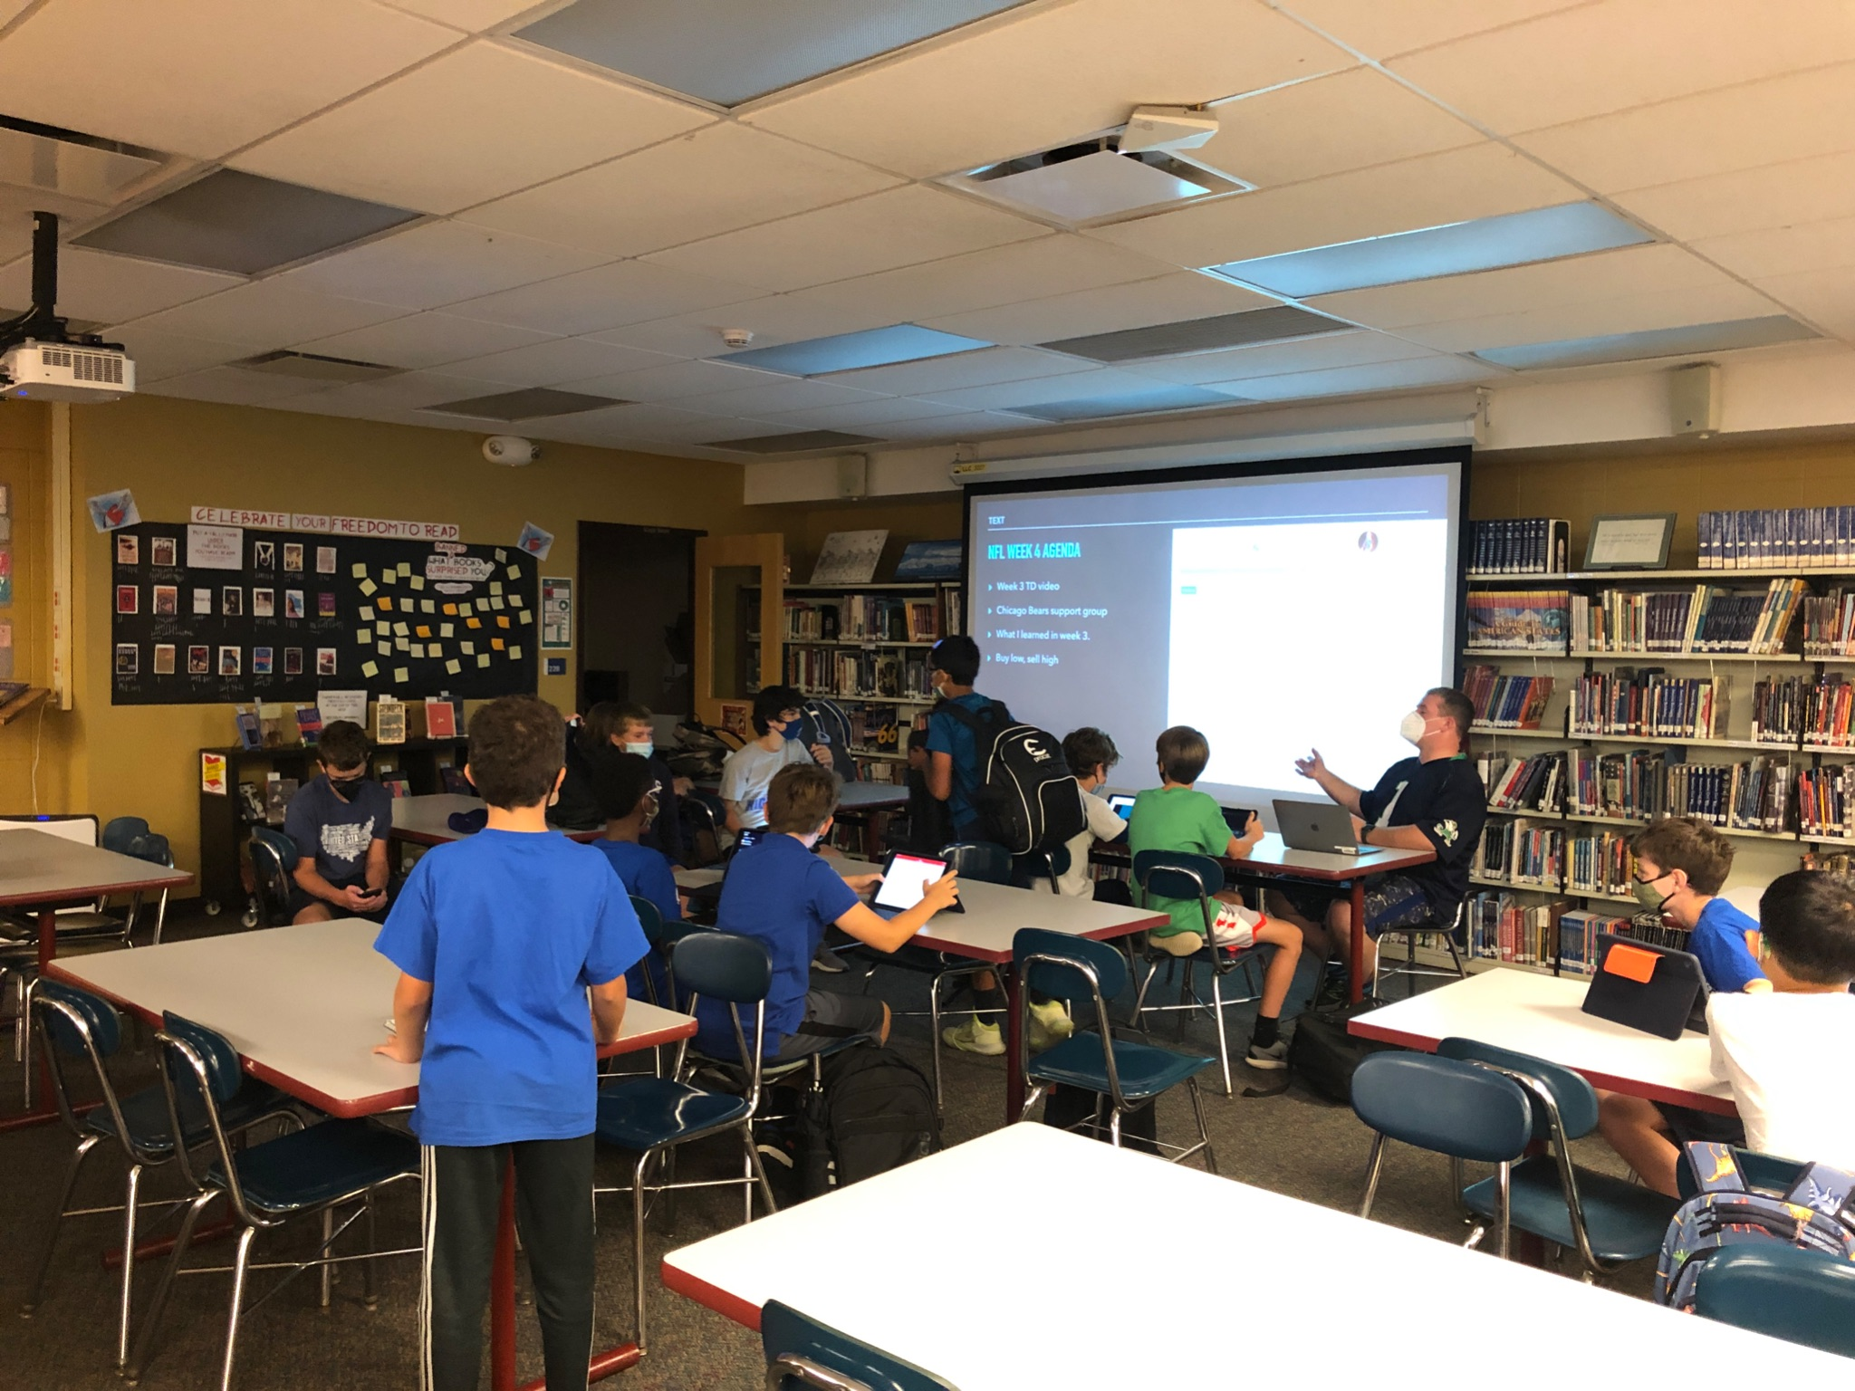
Reading Ideas
Special Visitors
Club
Meetings

Slide 14
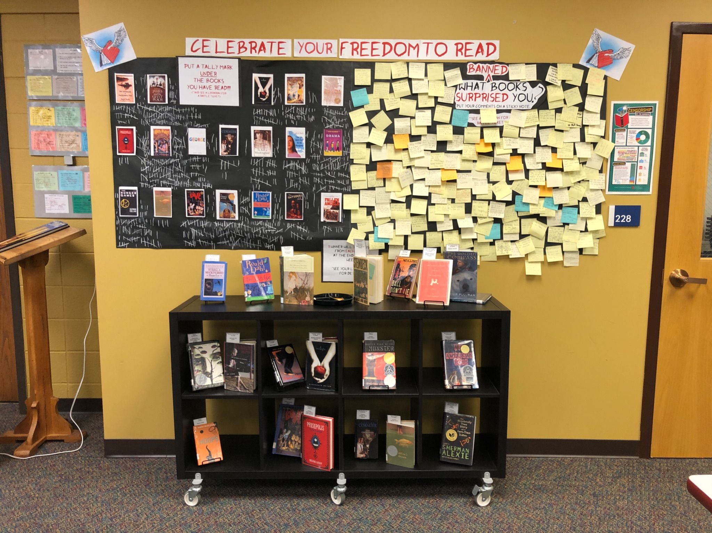
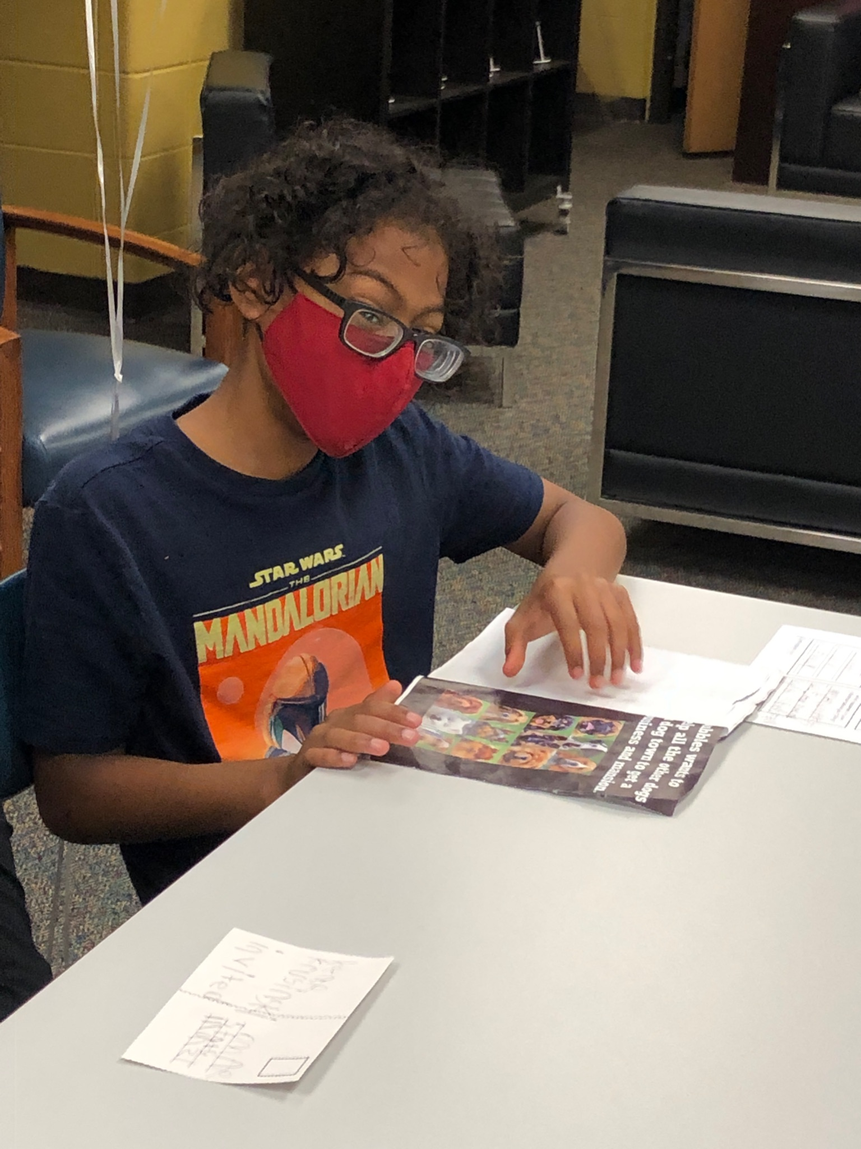
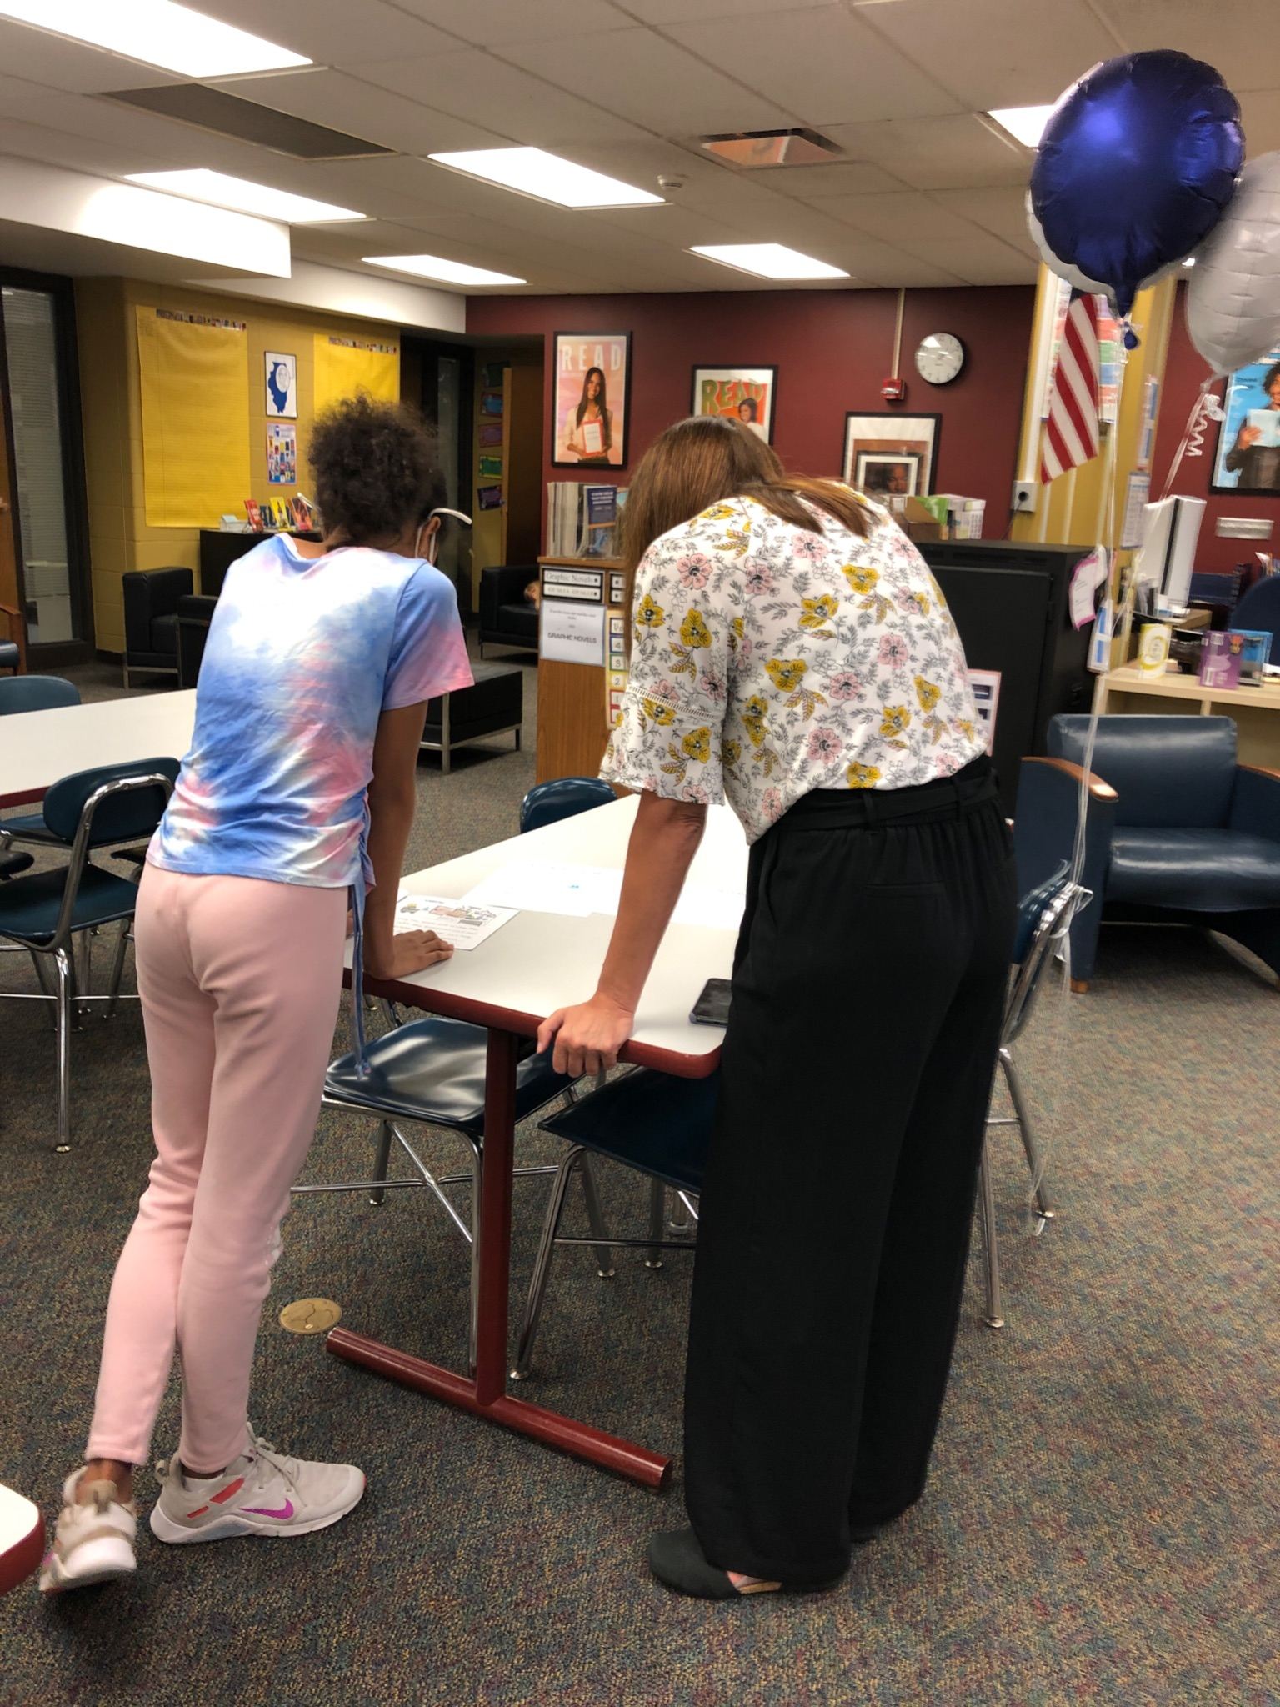
Authors
in the library
Banned Books Week

Slide 15
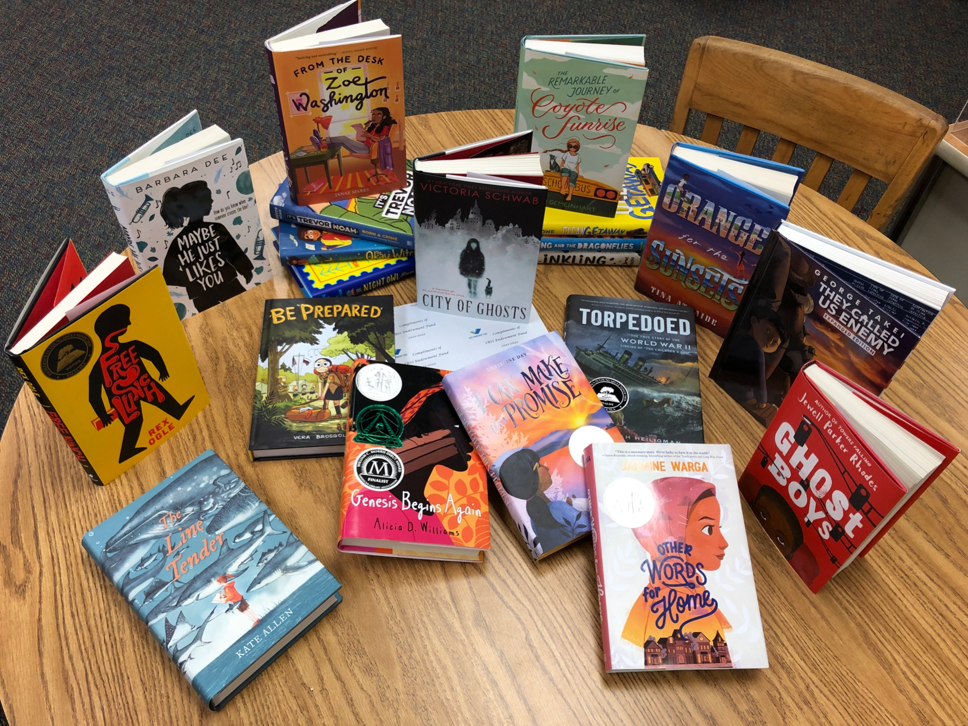
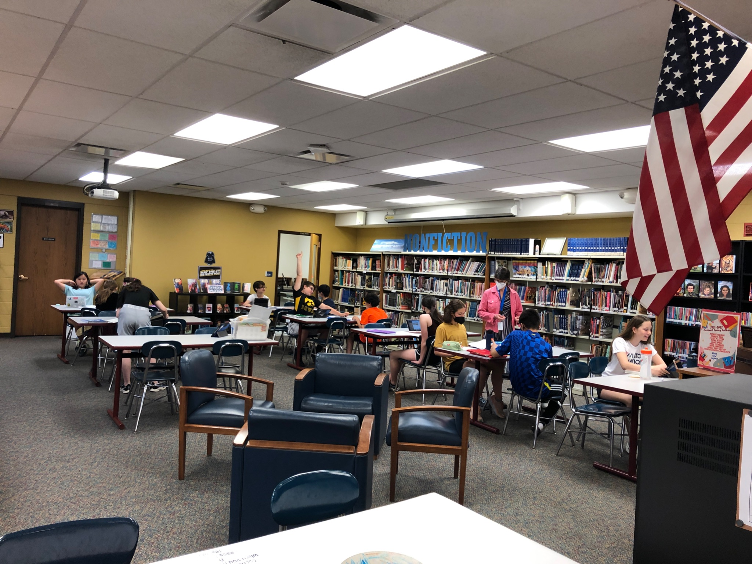
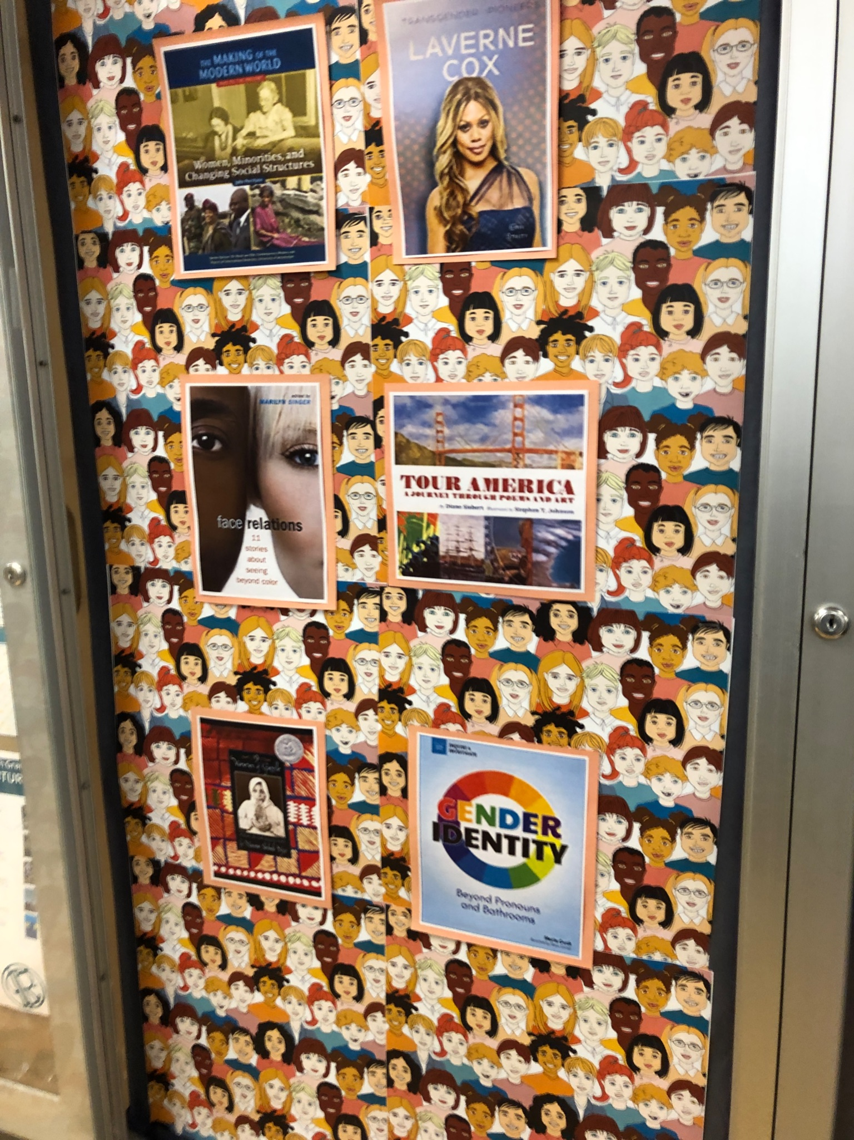
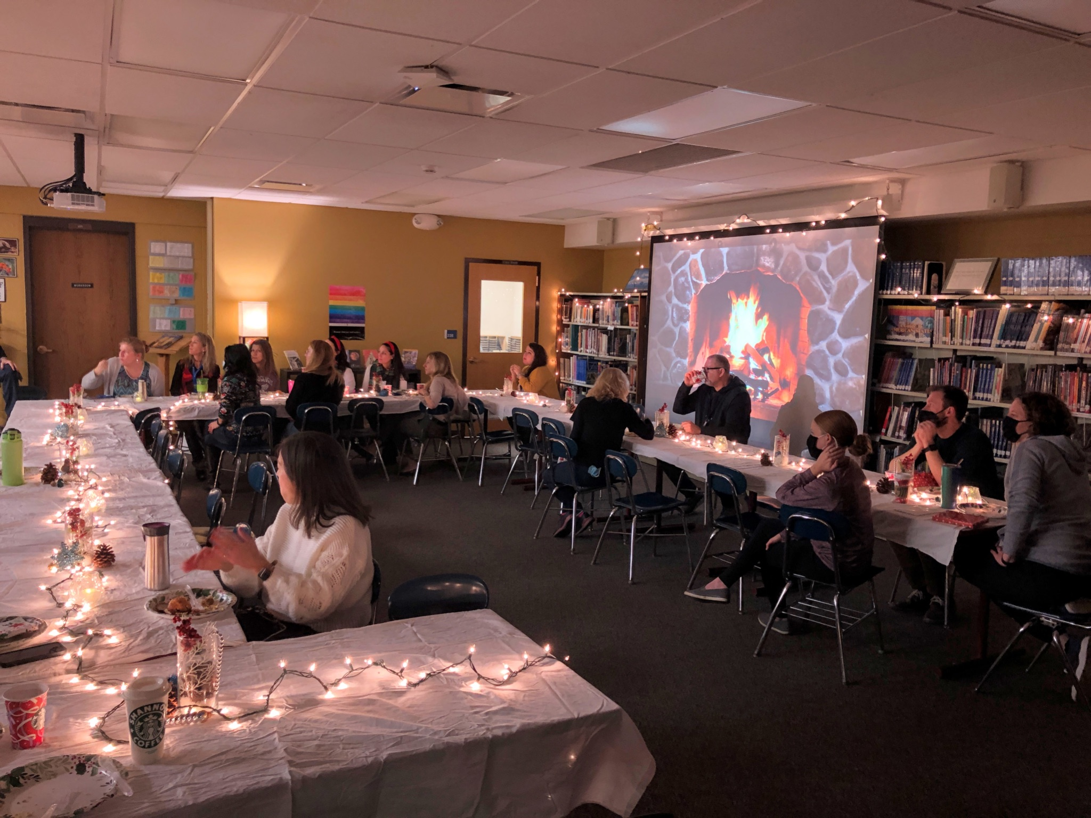
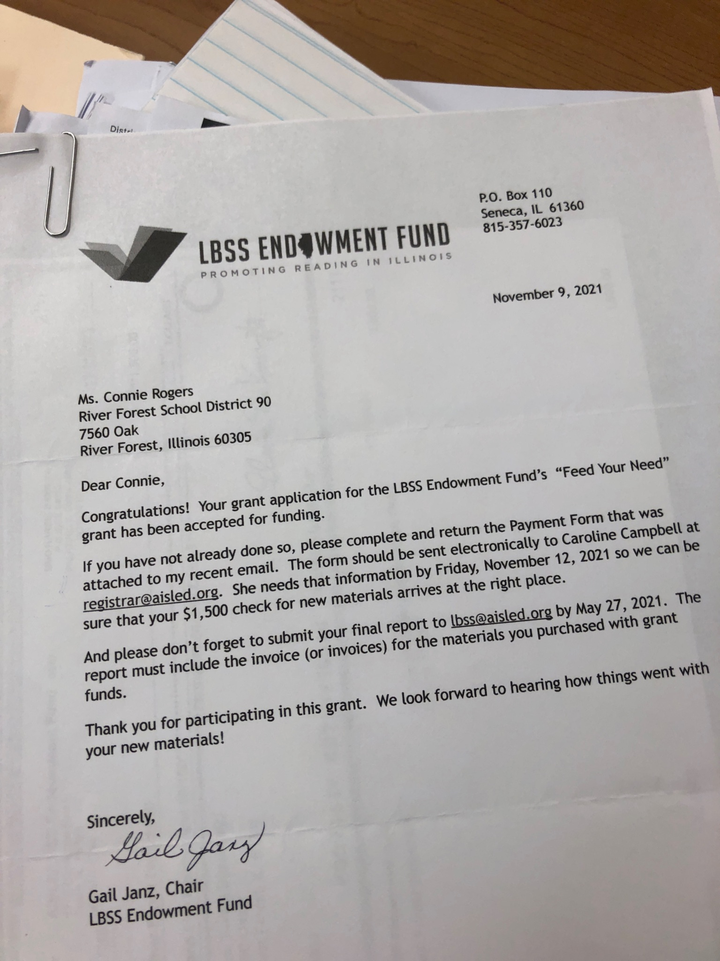
Research
New books from LBSS grant
Feed Your Need Grant
Diversity & Inclusion
Holiday Breakfast

Slide 16
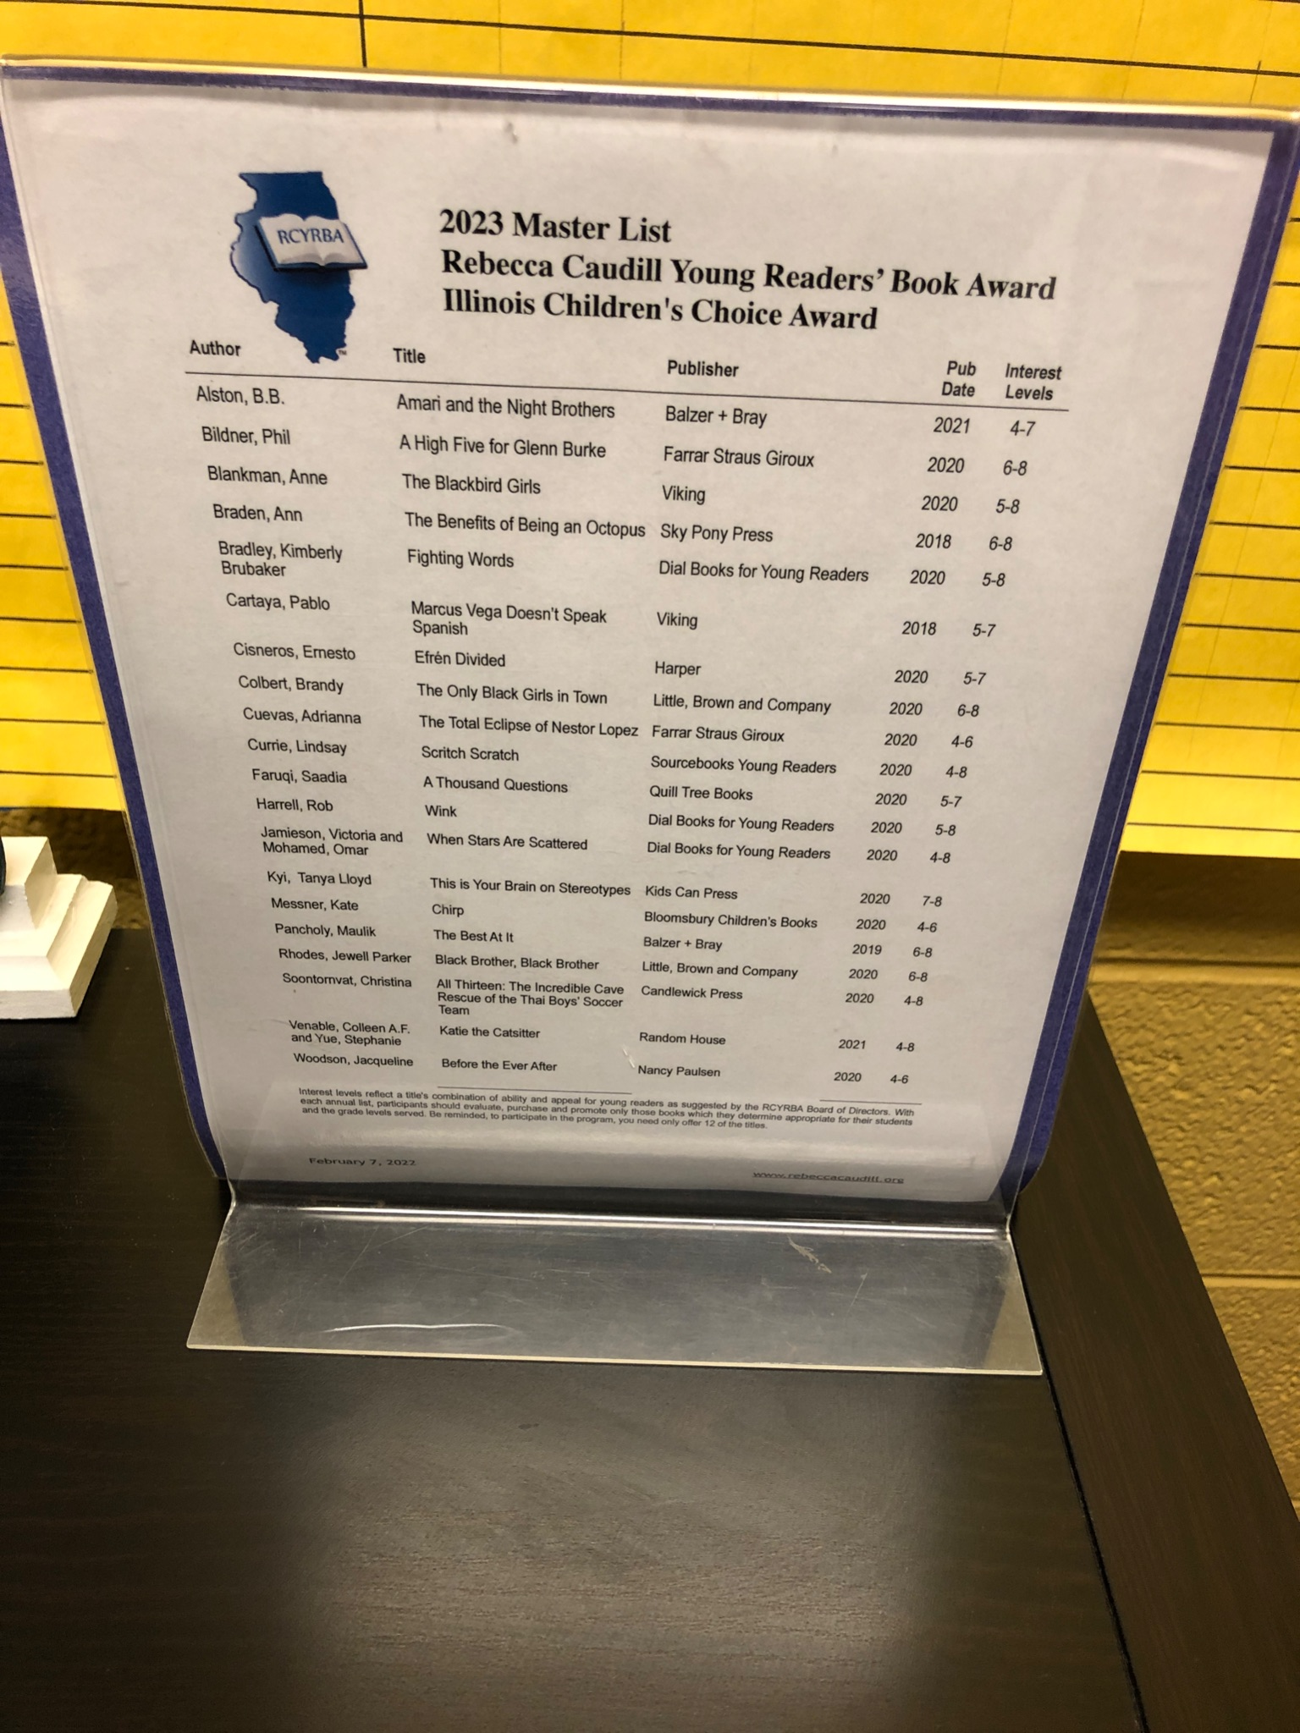
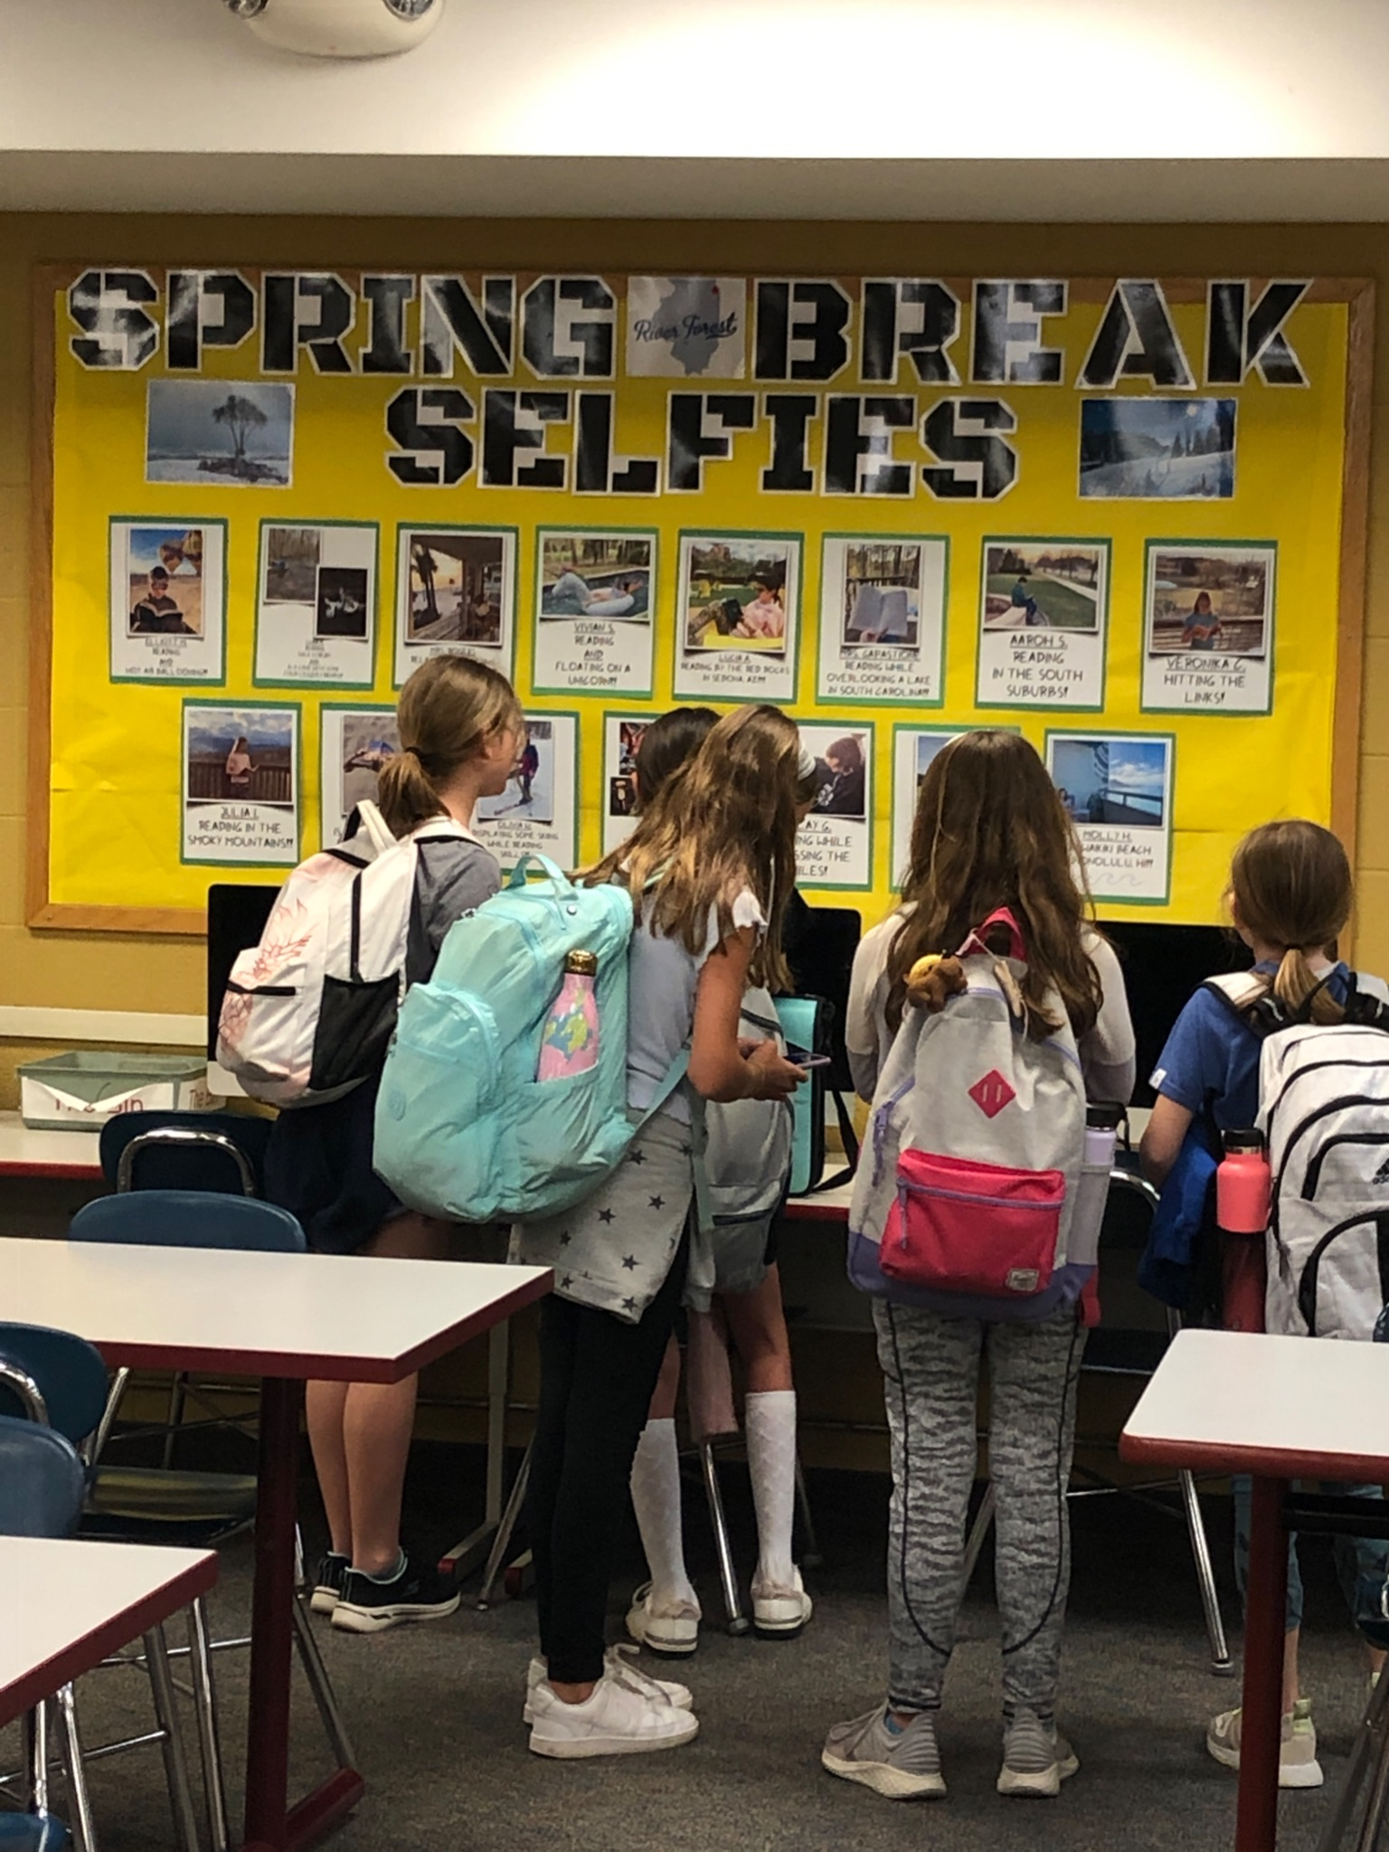
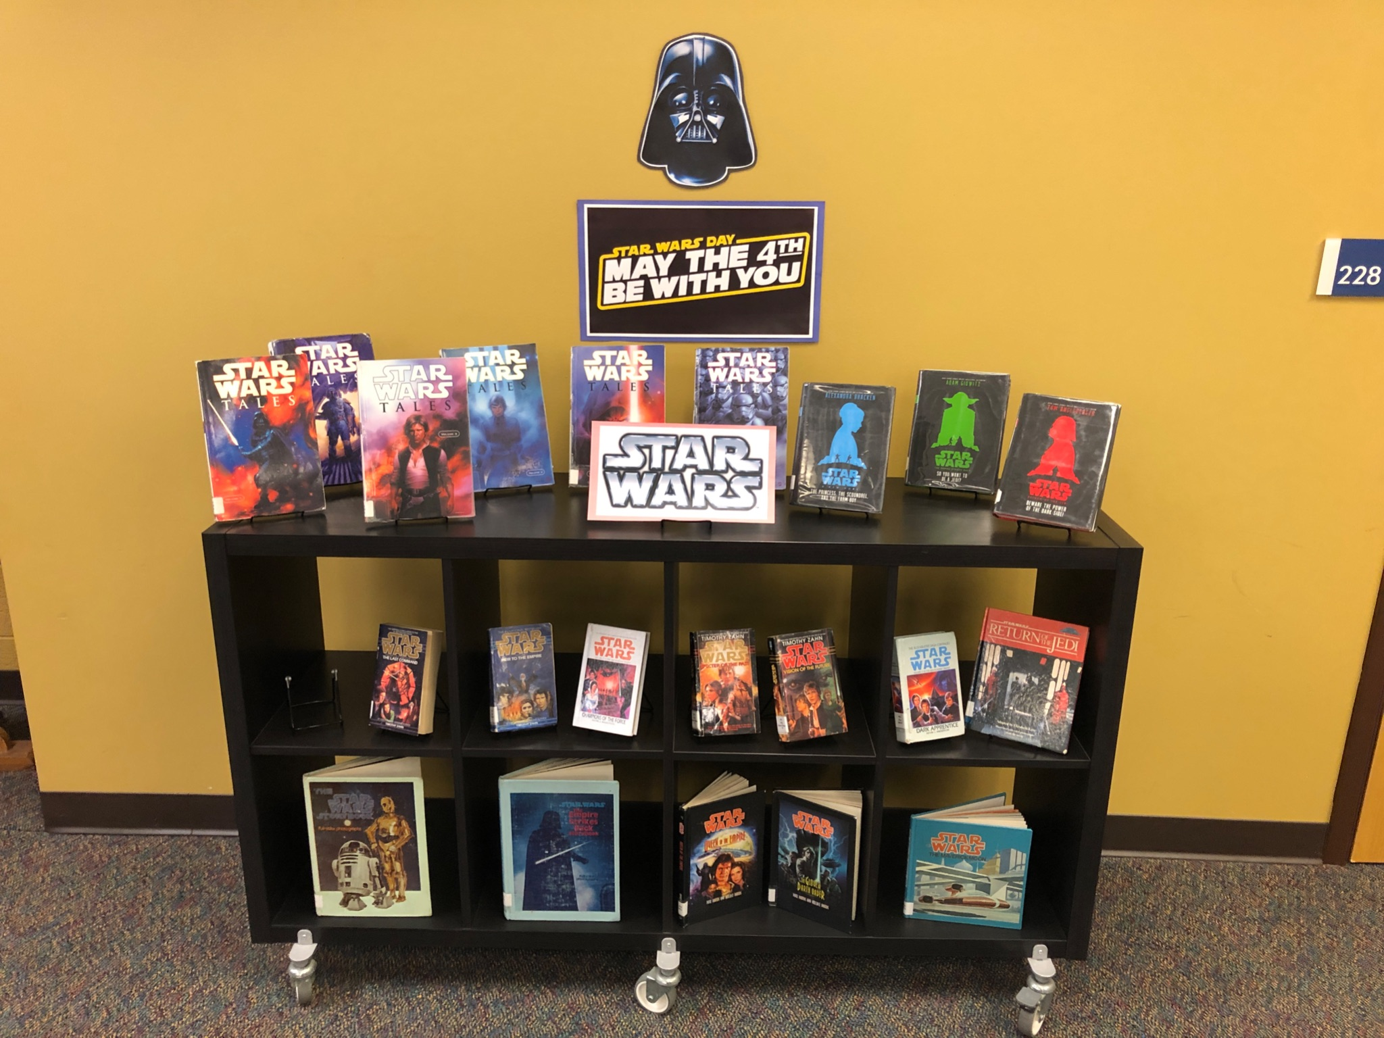
May the 4th Be With You
Caudill Reading Program
Spring Break Selfies

Slide 17
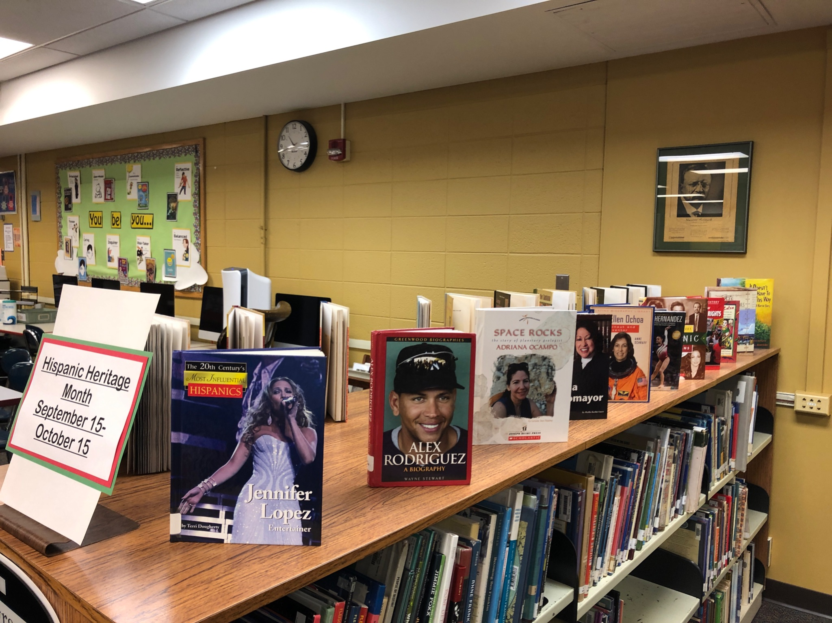
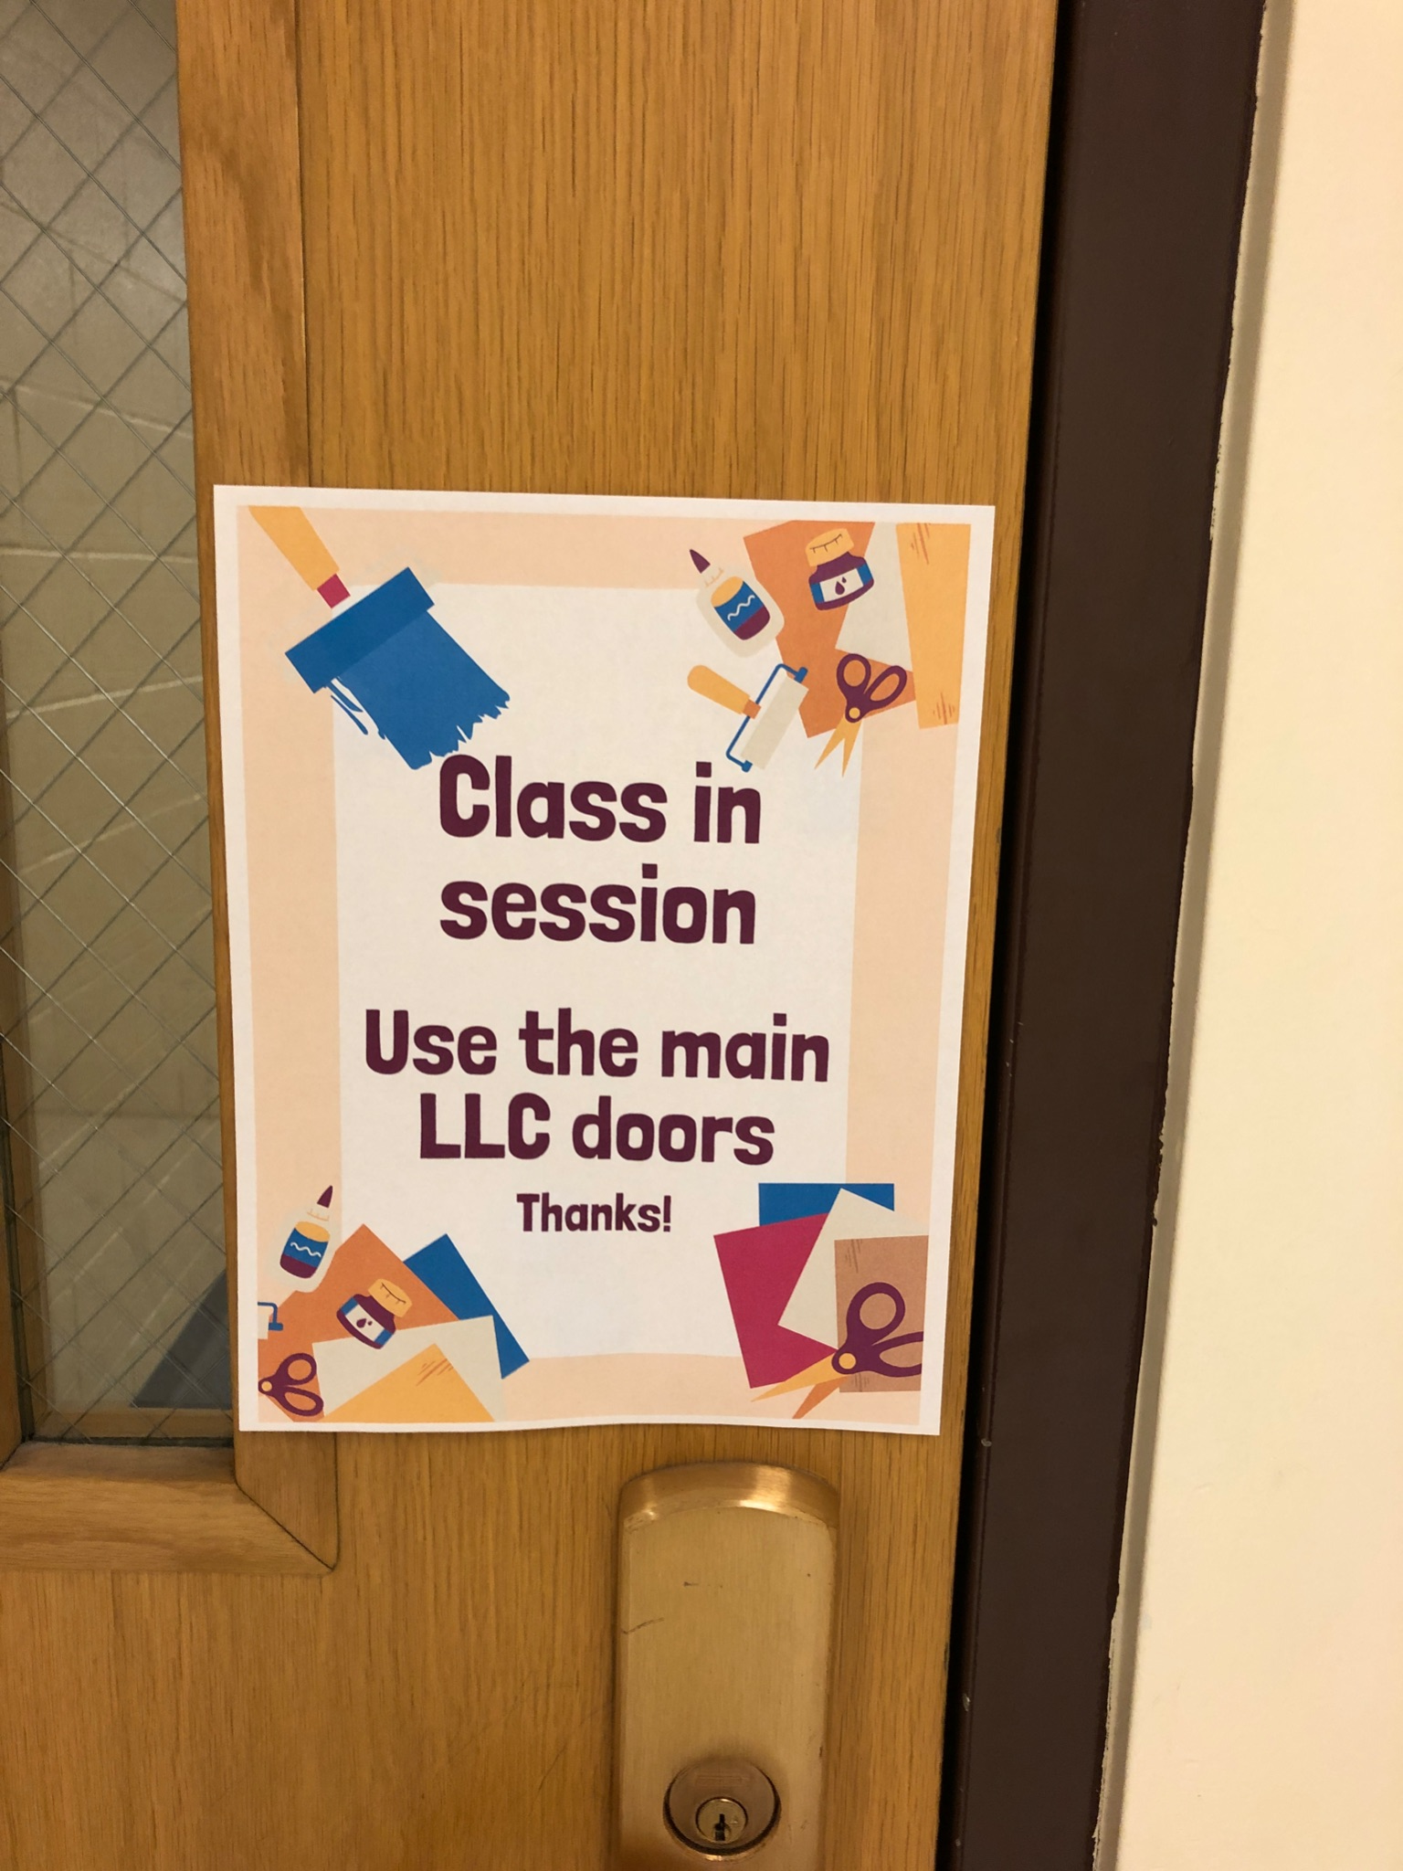
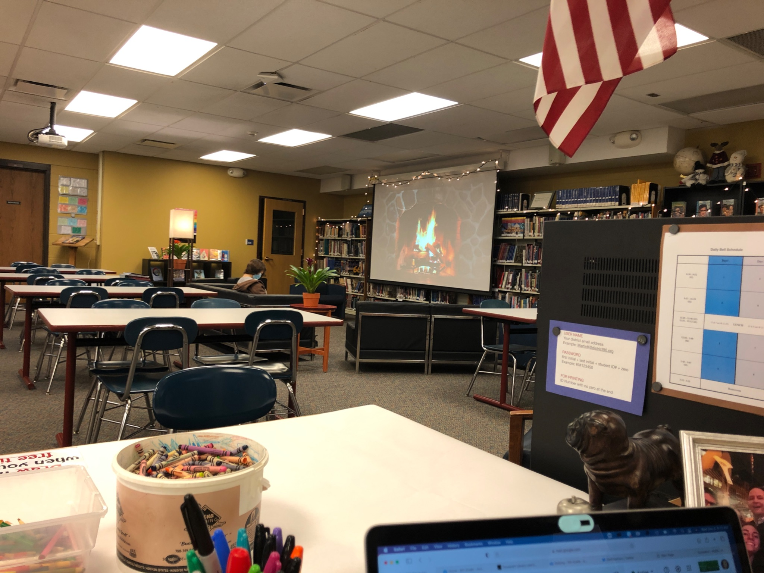
STAR, ELL,
Specialists and more sharing the space
Hispanic Heritage Month
Winter Fireplace

Slide 18
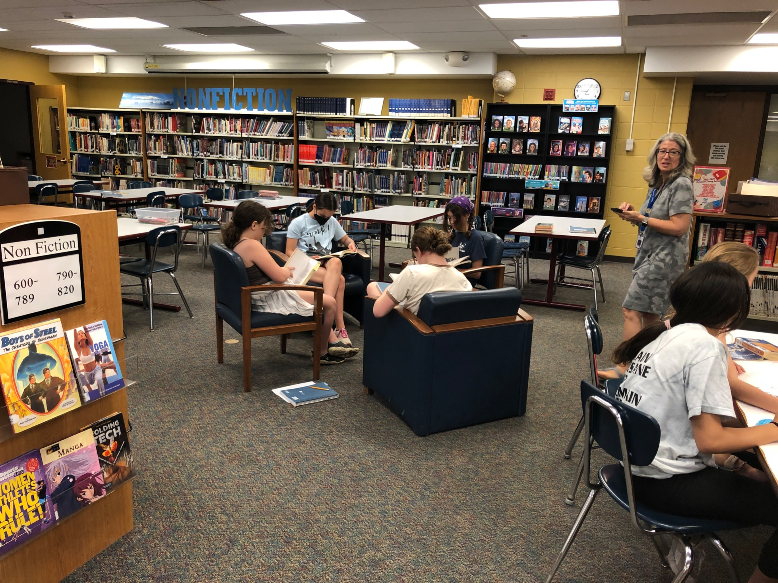
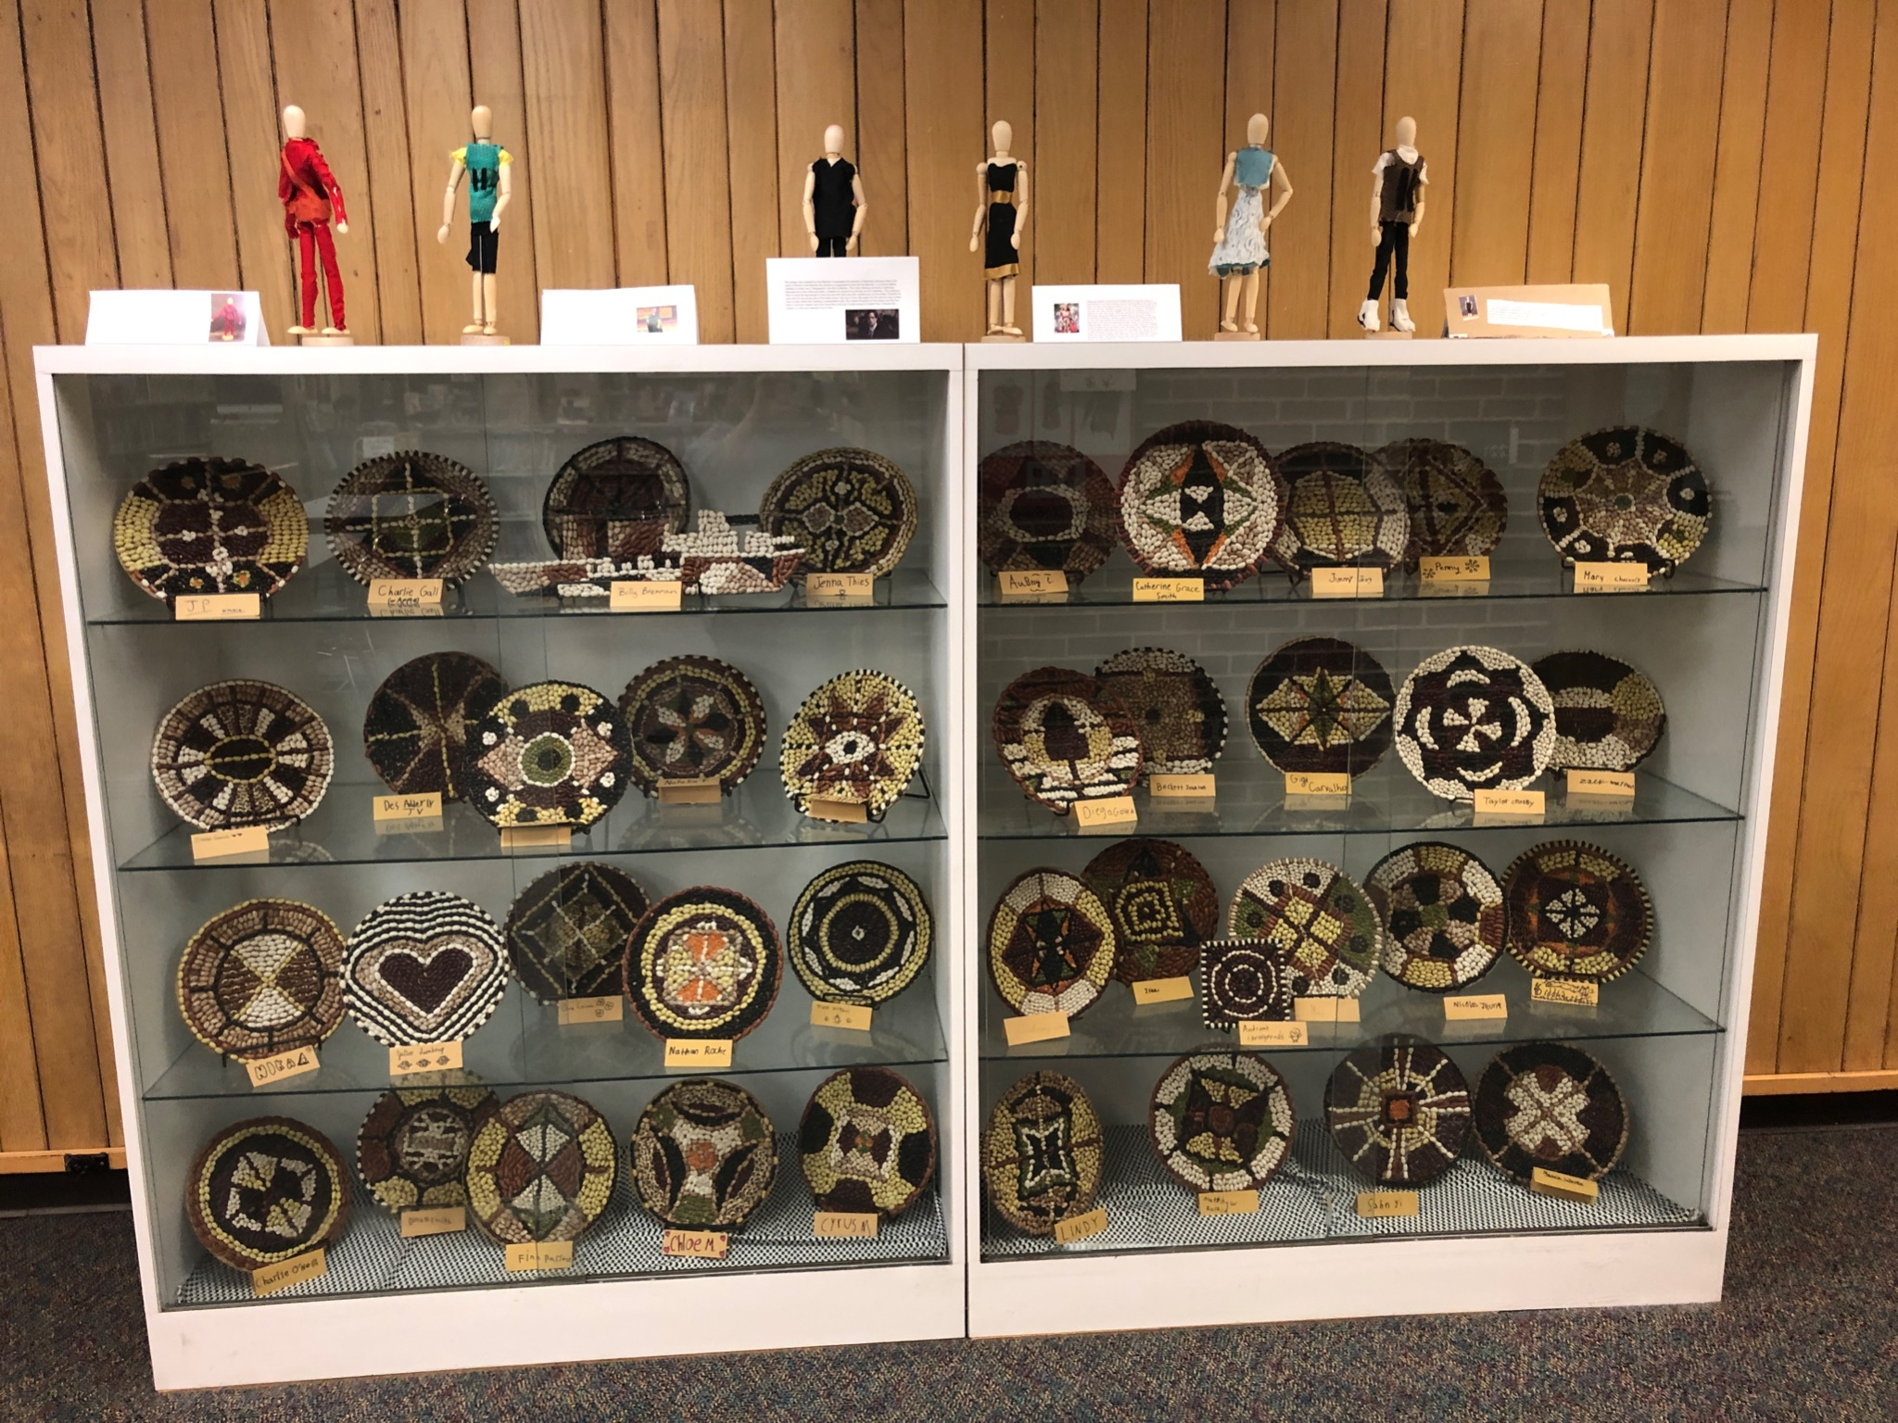
Student work on display
Comfy Reading

Slide 19
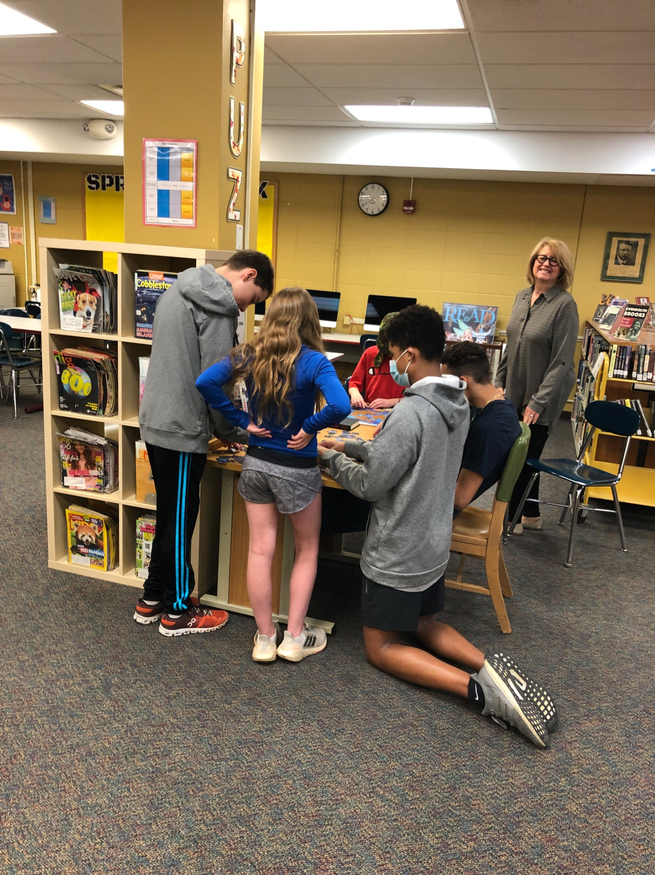
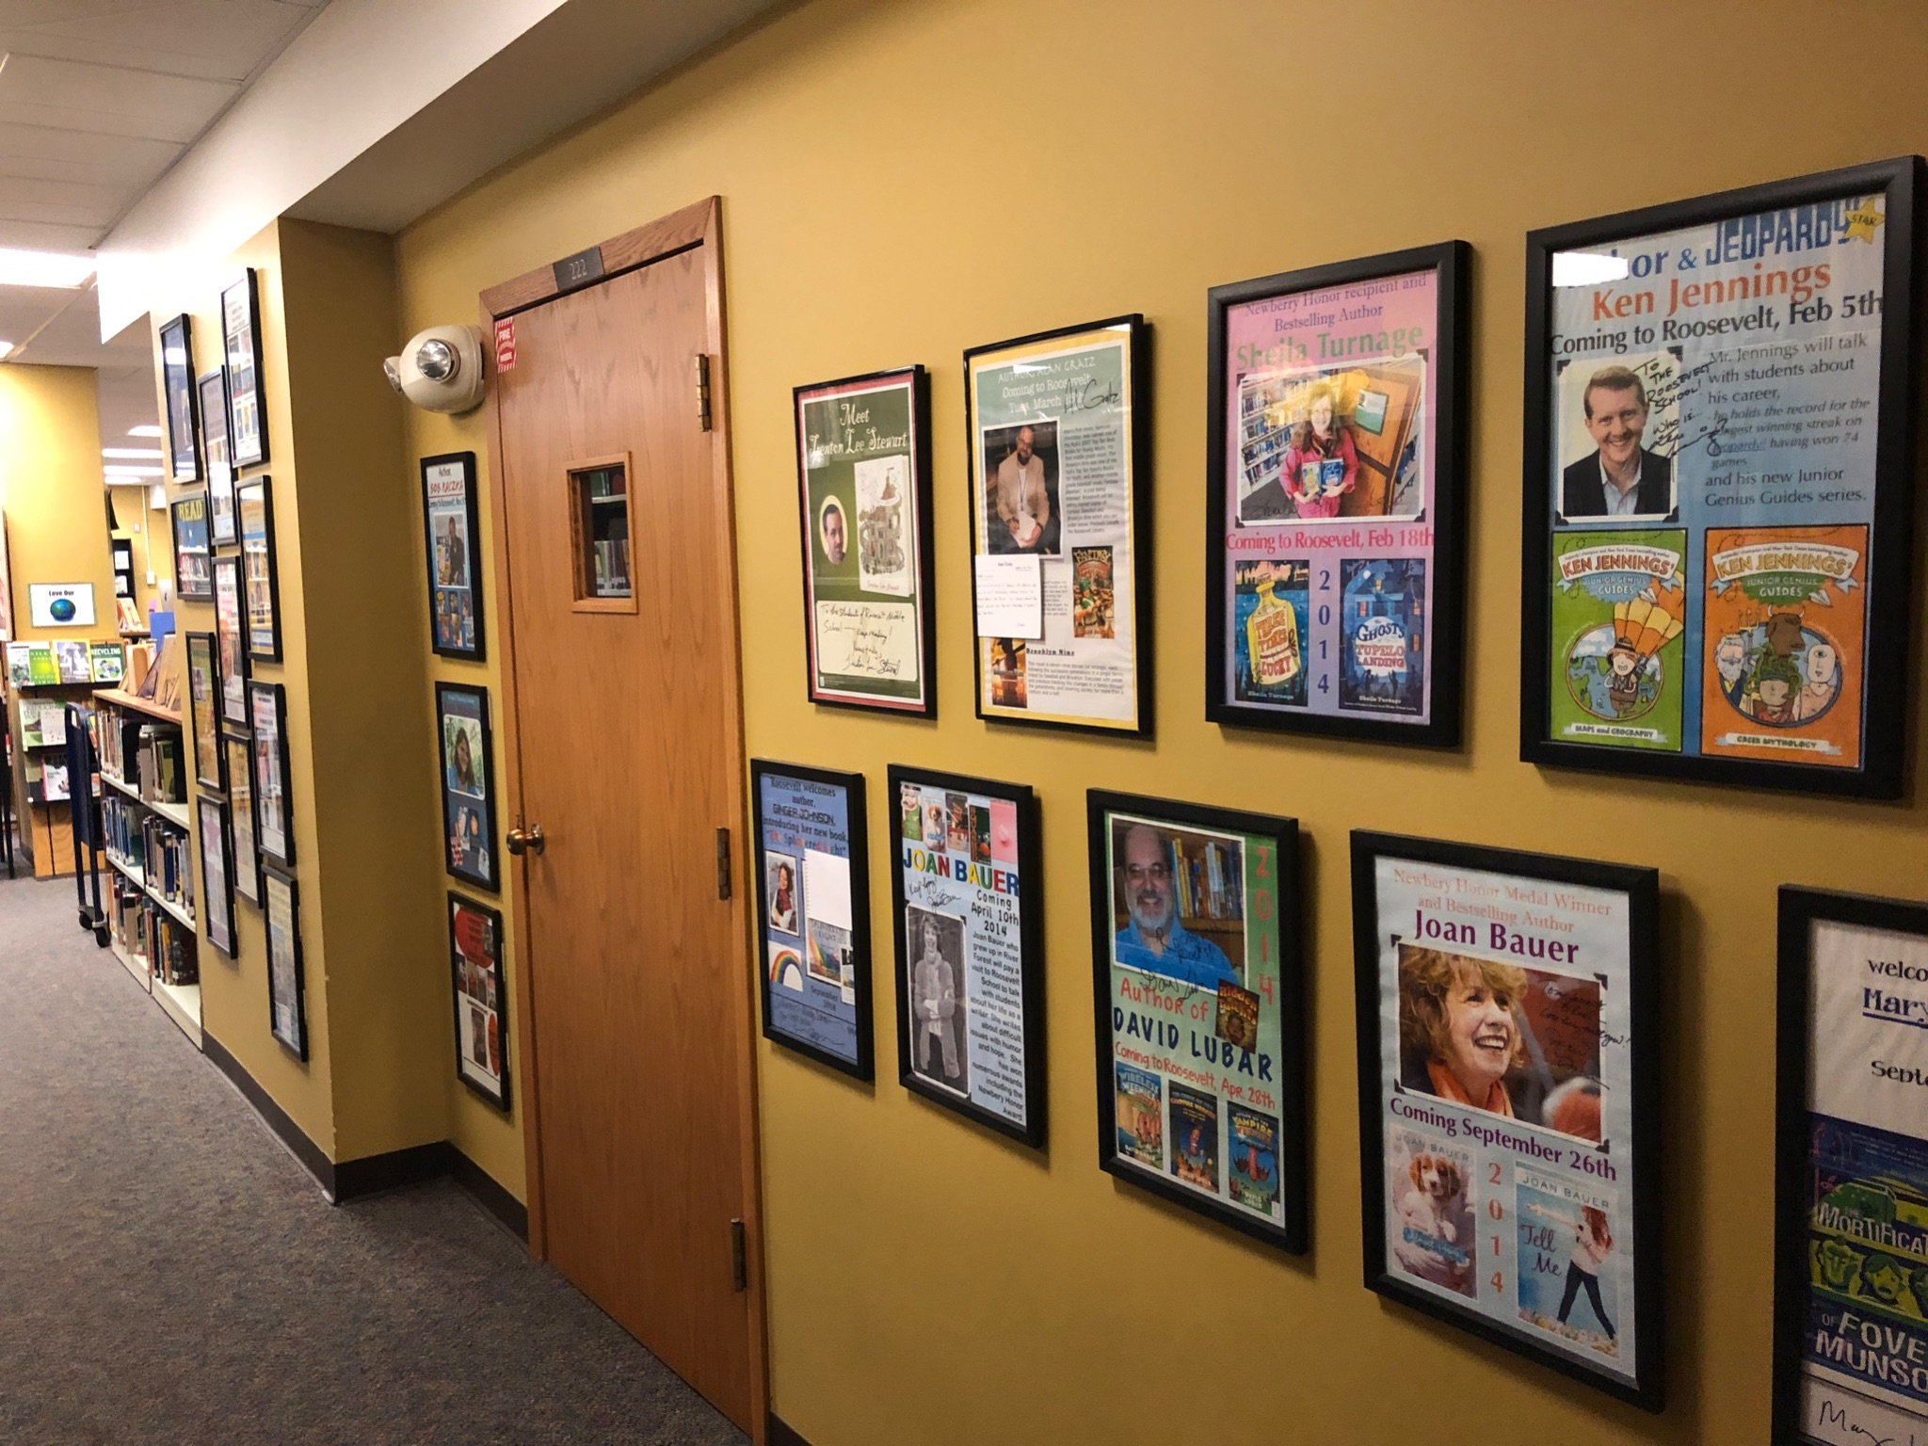
Wall of visiting authors
Puzzles

Slide 20
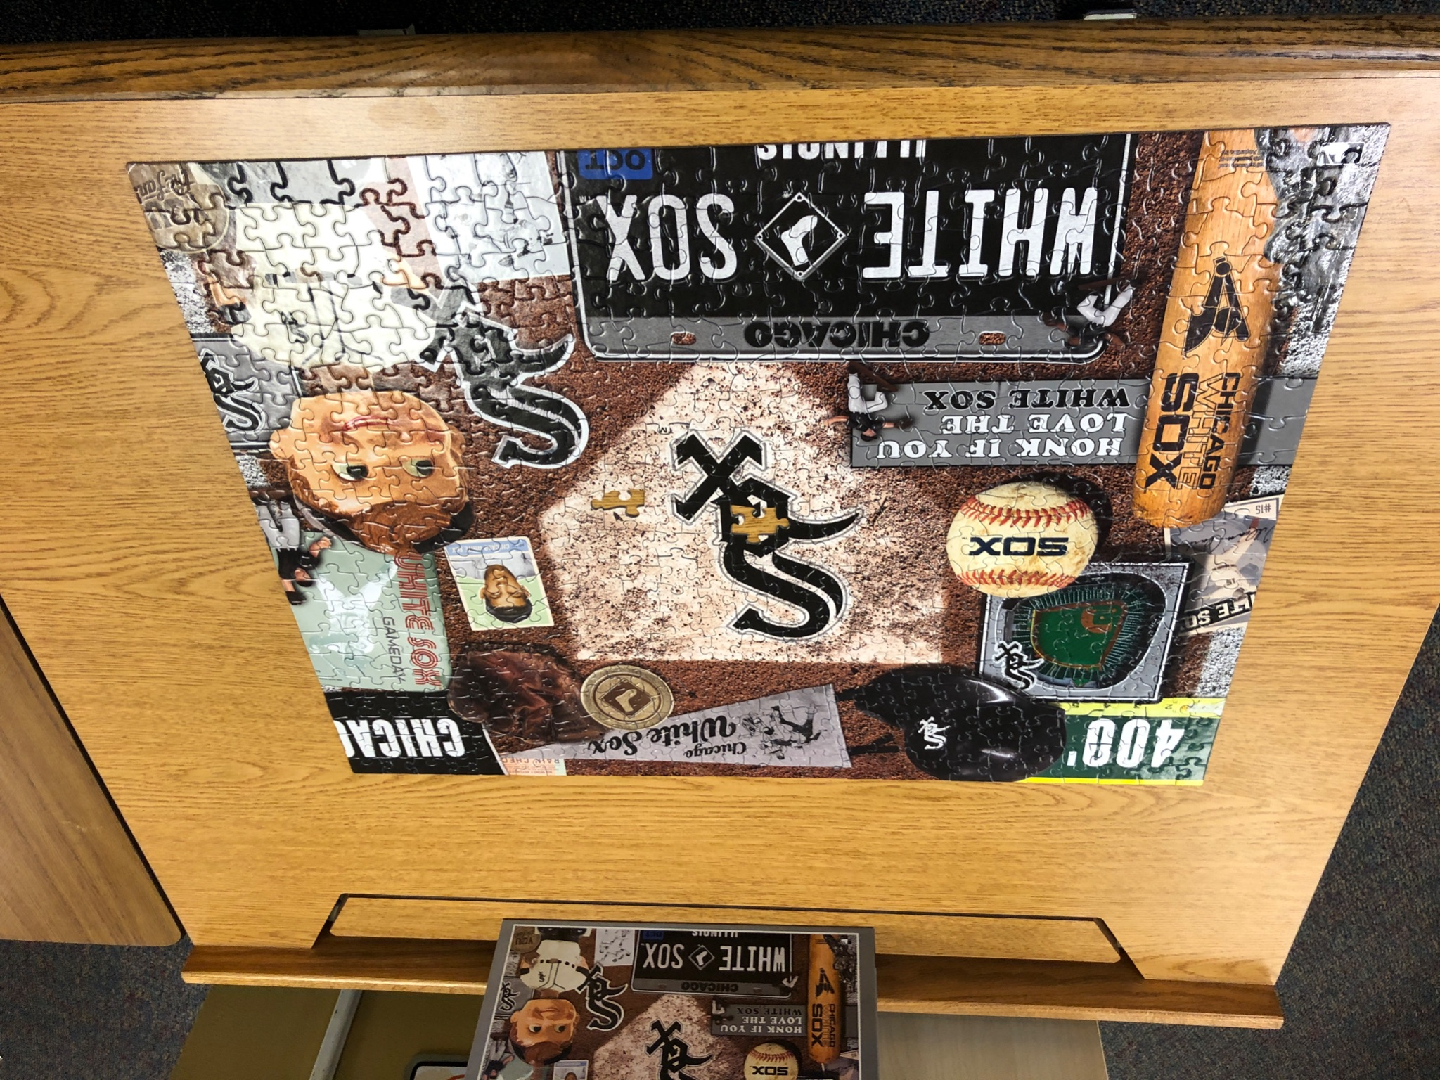
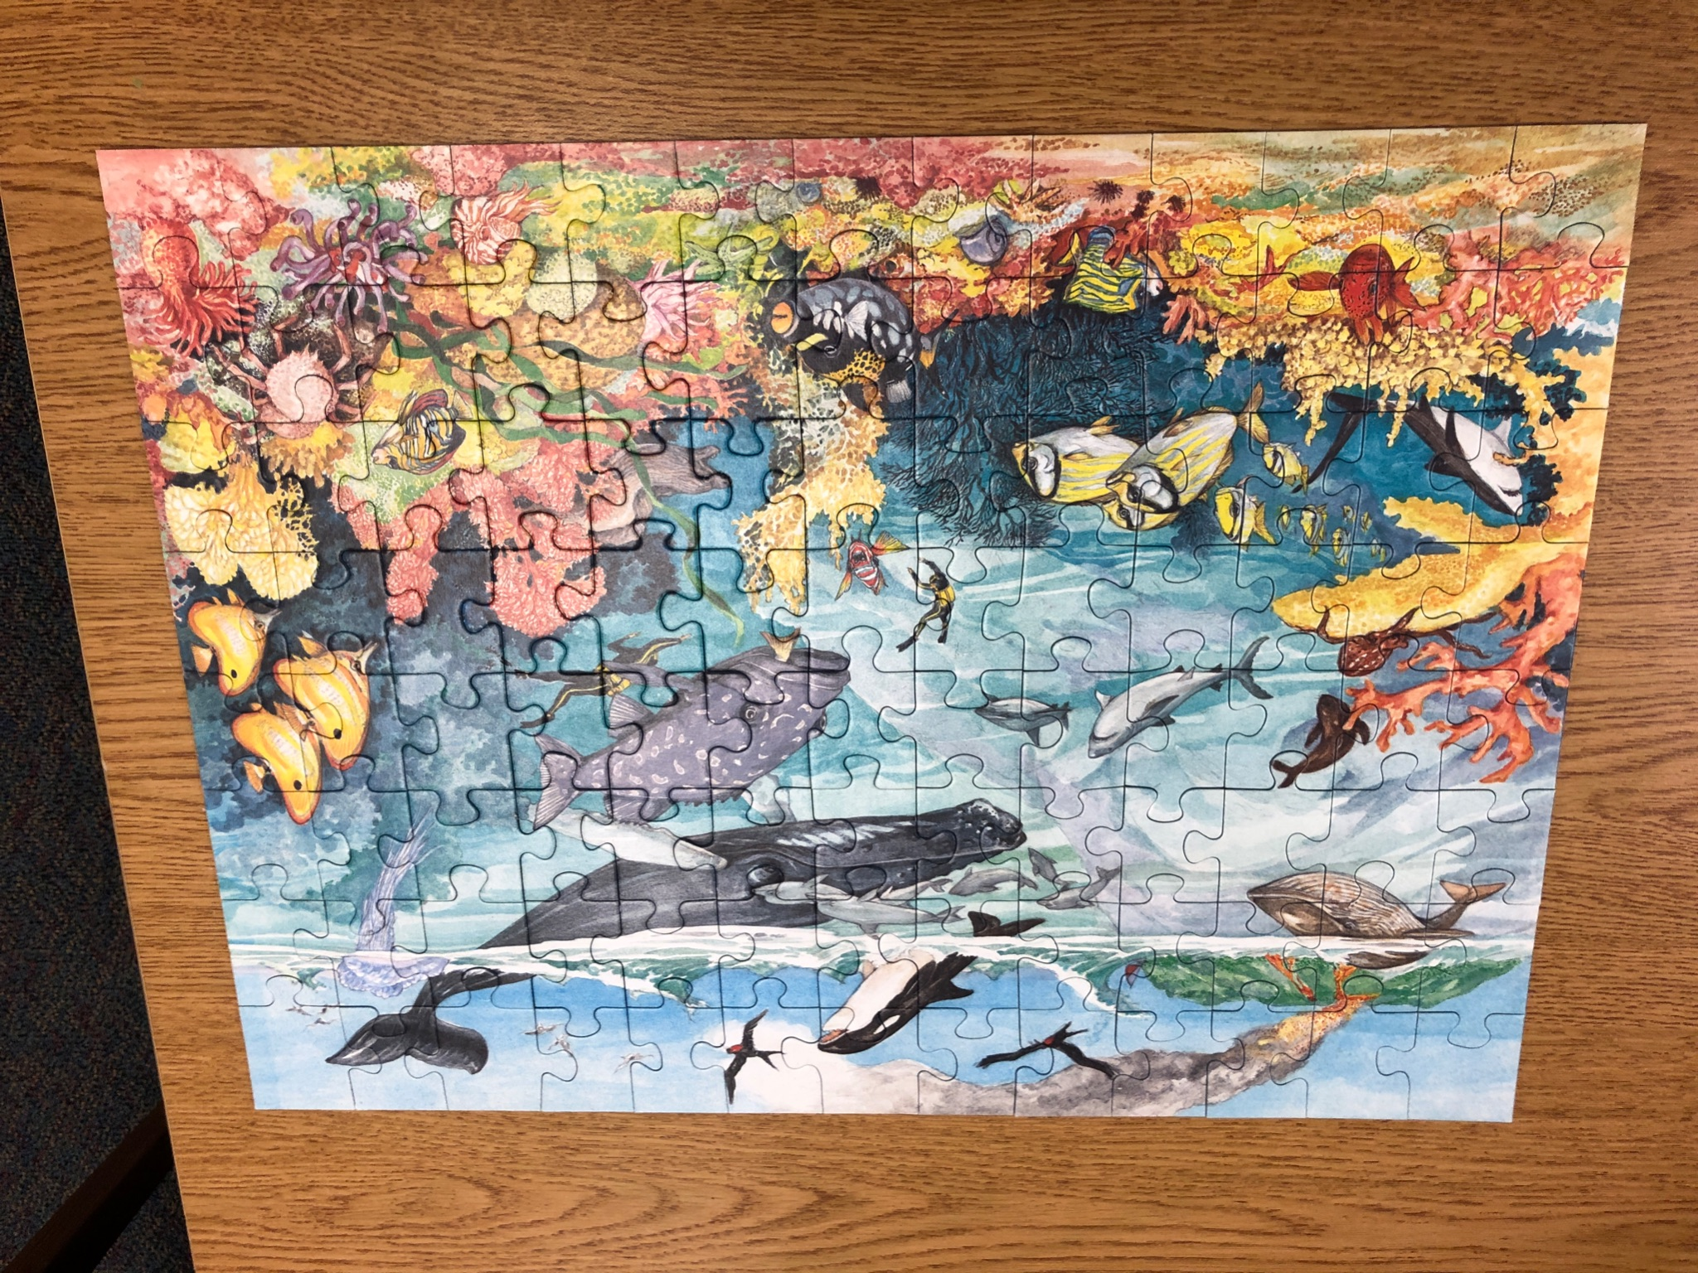
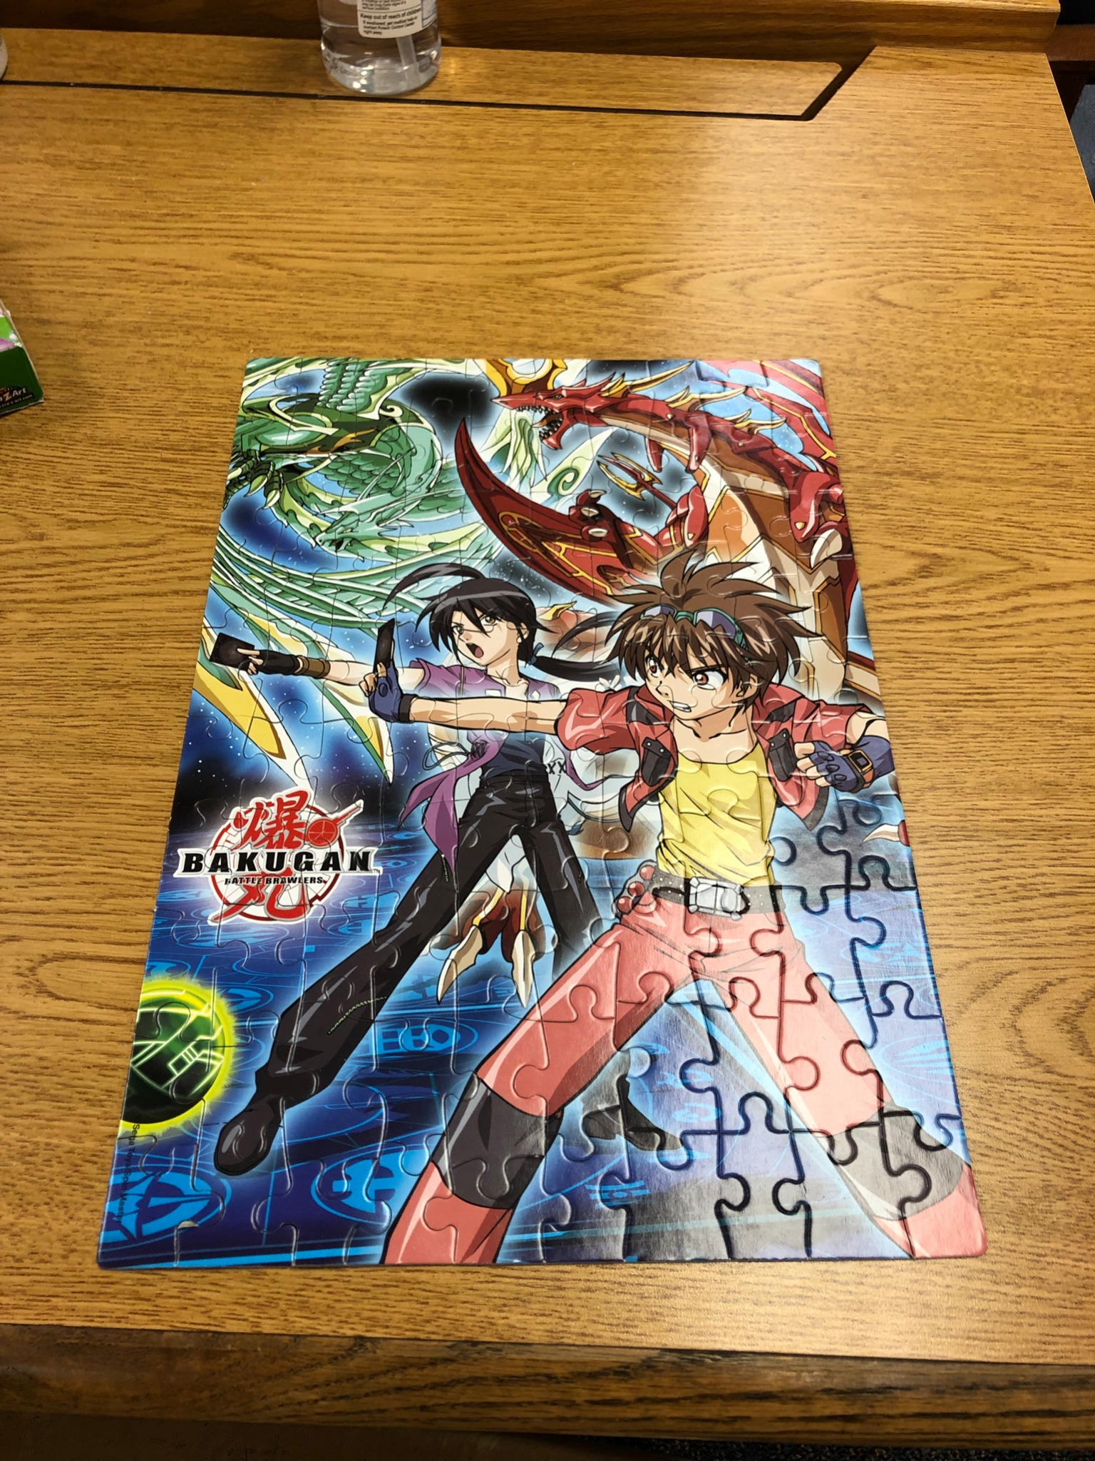
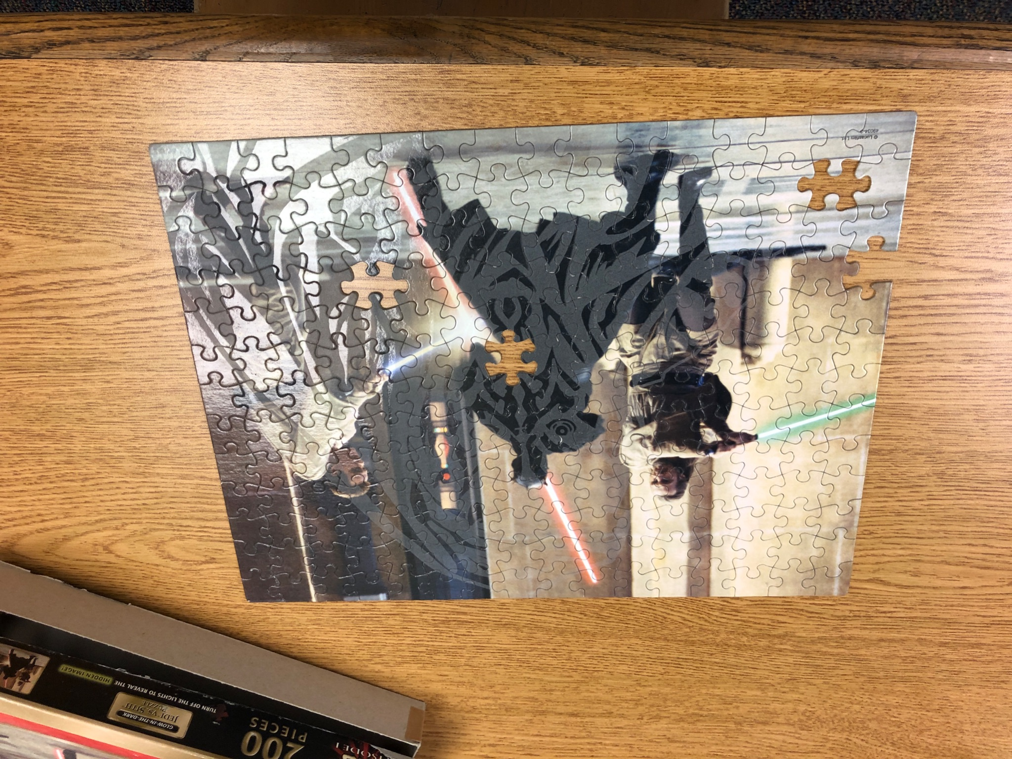
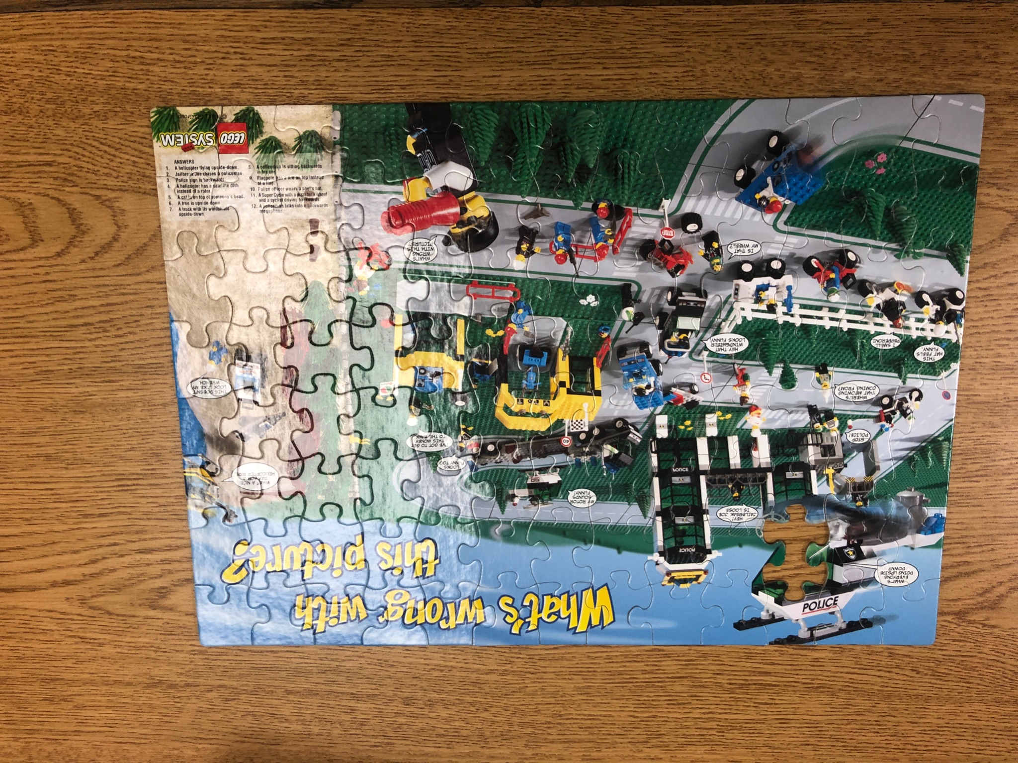
Just a few of this year’s puzzles

Slide 21
Stay in touch with the Roosevelt LLC!
LLC Website
LLC Book Catalog
Twitter - Mrs. Ziegler
Twitter - Mrs. Rogers
Caudill Reading List
Roosevelt Archives
Summer Reading

Slide 22
Mrs. Connie Rogers
School Library Media Specialist
Roosevelt Middle School
7560 Oak Avenue
River Forest, IL 60305
(708) 366-9230 x8648
rogersc@district90.org

