Slide 1
Roosevelt LLC
Roosevelt Middle School
Library Learning Center
7560 Oak, River Forest, IL 60305
2020 -2021

Slide 2
3,315 items checked out this school year!
Fiction
Nonfiction
Graphic Novels
Biographies

Slide 3
Roosevelt Top Tens for 2020 - 2021
FICTION
Out of My Mind Insignificant Events in the Life of a Cactus Gregor the Overlander Eddie Red: Mystery on Museum Mile The War That Saved My Life Miss Peregrine’s Home for Peculiar Children Almost Home Space Case The Fourteenth Goldfish Ghost
NONFICTION
Top 101 Scientists Oceans: Dolphins, Sharks, Penguins Everything Sharks Hidden Human Computers Hidden Figures Kids Top 10 Pet Dogs How Did It Really Happen? Good Night Stories for Rebel Girls Unsung Heroes of Science 1000 Makers of the Millennium

Slide 4
Roosevelt Top Tens for 2020 - 2021
GRAPHIC NOVELS
New Kid Smile Guts Real Friends Awkward Stickman Odyssey #1 Class Act Amulet #1 Sisters Ghosts
BIOGRAPHY
It’s Trevor Noah: Born a Crime Muhammad Ali Louis Armstrong Who Was Jane Austen? Who Was Lucille Ball? Coco Chanel Who Was Walt Disney? Notorious RBG Who Is Ruth Bader Ginsburg? You Wouldn’t Want to be Joan of Arc!

Slide 5
Some of the Research done with the LLC
Famous Francophones
Harlem Renaissance
Japanese American Internment
Berlin Olympics 1936
Atomic Bomb
Les Pays Francophone
Famous People of Hispanic Heritage
Nazi Occupation of Poland
Holocaust
Code Talkers
Nazis
1990s Cuba
Modern Syria
England during WWII
Spanish Virtual Trip
Argument & Advocacy
Plastic Pollution
Zoos
Sharks
Underwater Exploration
Space Exploration
Extreme Sports
Activism & Community Service
National Parks

Slide 6
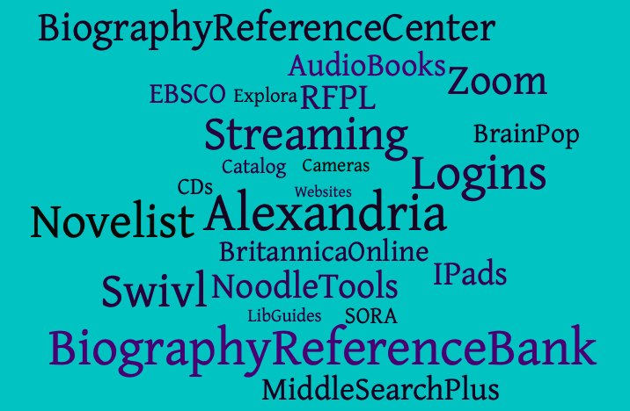
Staff Resources Technology in the LLC
Roosevelt LLC Professional Collection
Educator’s Explora
ERIC
Professional Development Collection

Slide 7
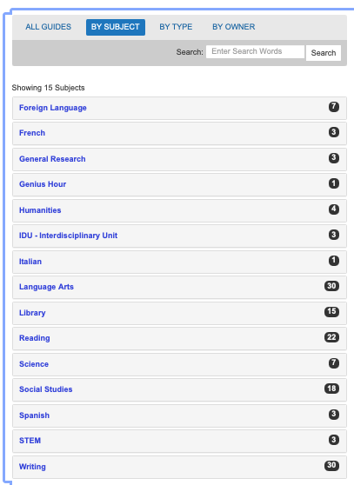
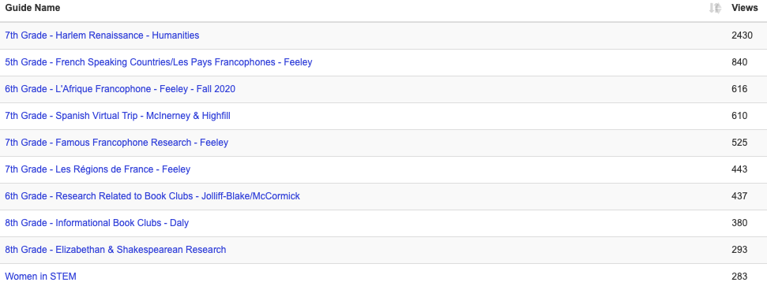
LibGuides - research assistance, subject guides and useful resources compiled especially for Roosevelt students by the library staff - 104 Guides, 8364 Views
Most Used Guides 2020 - 2021

Slide 8
Roosevelt LLC Online Research Tools
Resource | Searches
Biography Reference Bank | 383
Biography Reference Center | 591
Middle Search Plus | 527
Novelist | 19
Points of View Reference Center | 427
Britannica | 17,443
Fact Cite | 938
Topic Overviews | 207
LibGuides | 8,364

Slide 9
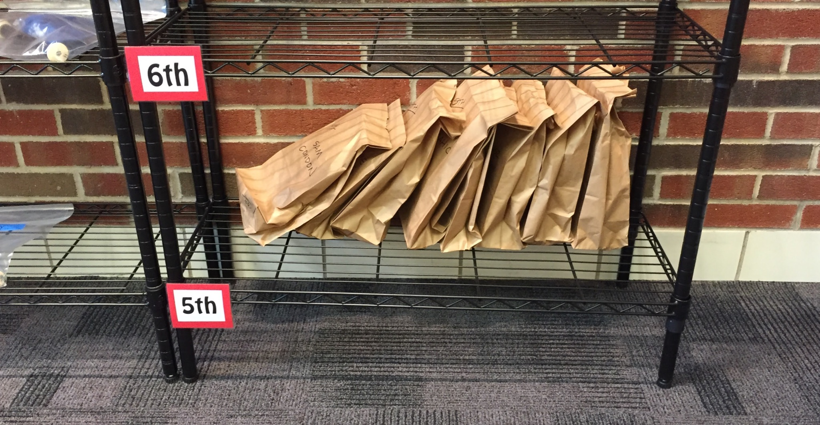
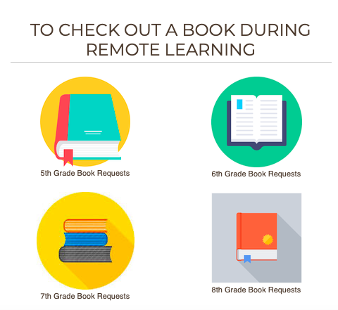
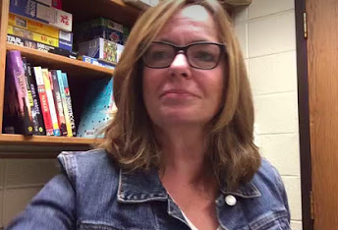
Distance Library
Grab and Go Book Check Out
417 +
Classroom Book Talks*
*spoken with the intent to convince someone to read a book
Zoom Open House
Online Databases from Roosevelt LLC

Slide 10
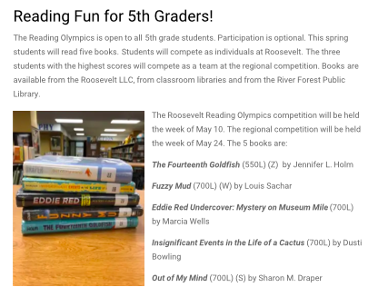
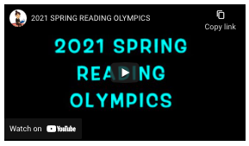
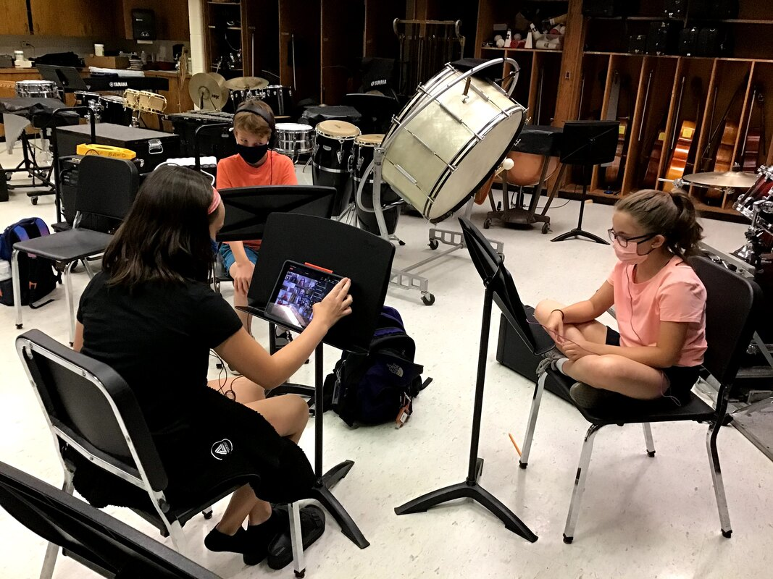
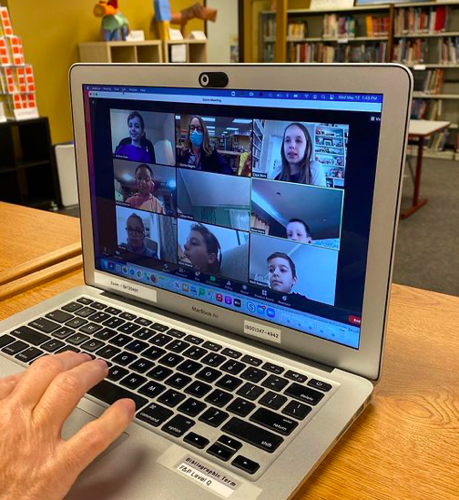
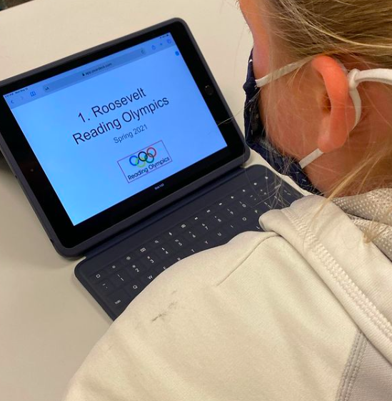
Reading Olympics
Via Zoom and in person
Regional Champs

Slide 11
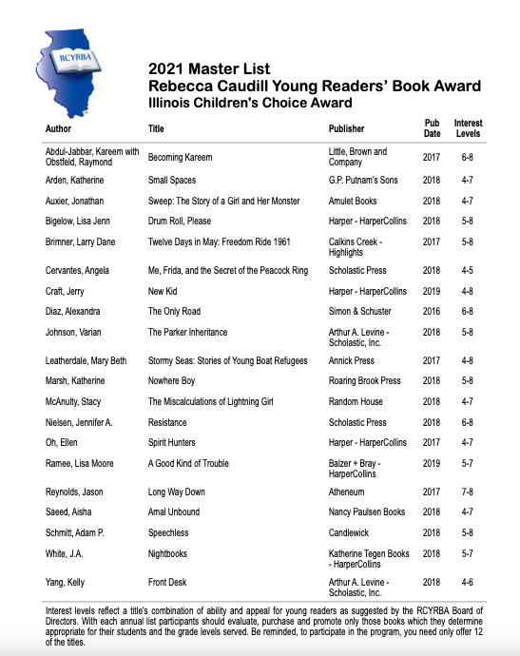
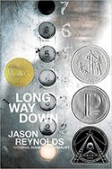
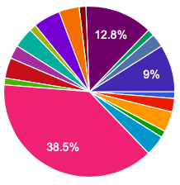
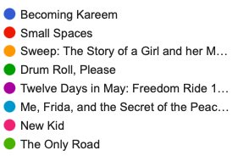
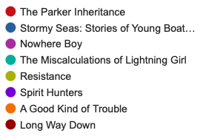
Caudill Reading
Voted Roosevelt’s favorite
Which ones did you read?

Slide 12
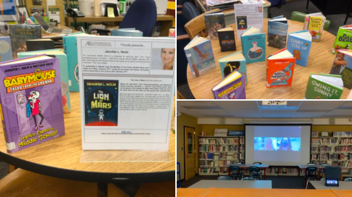
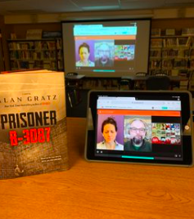
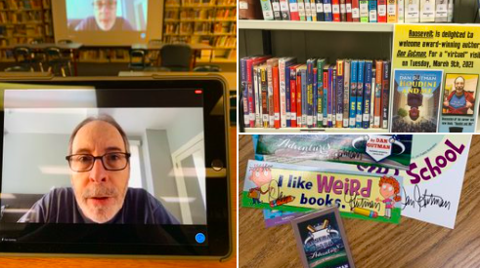
Author Visits
Jennifer L. Holm
Alan Gratz
Dan Gutman

Slide 13
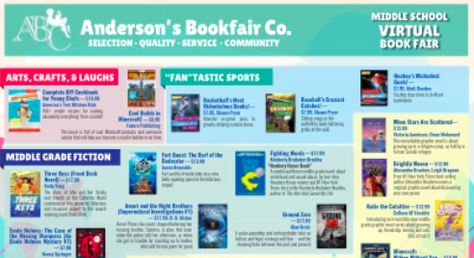
Book Fairs
TWO Book Fairs this year!!

Slide 14
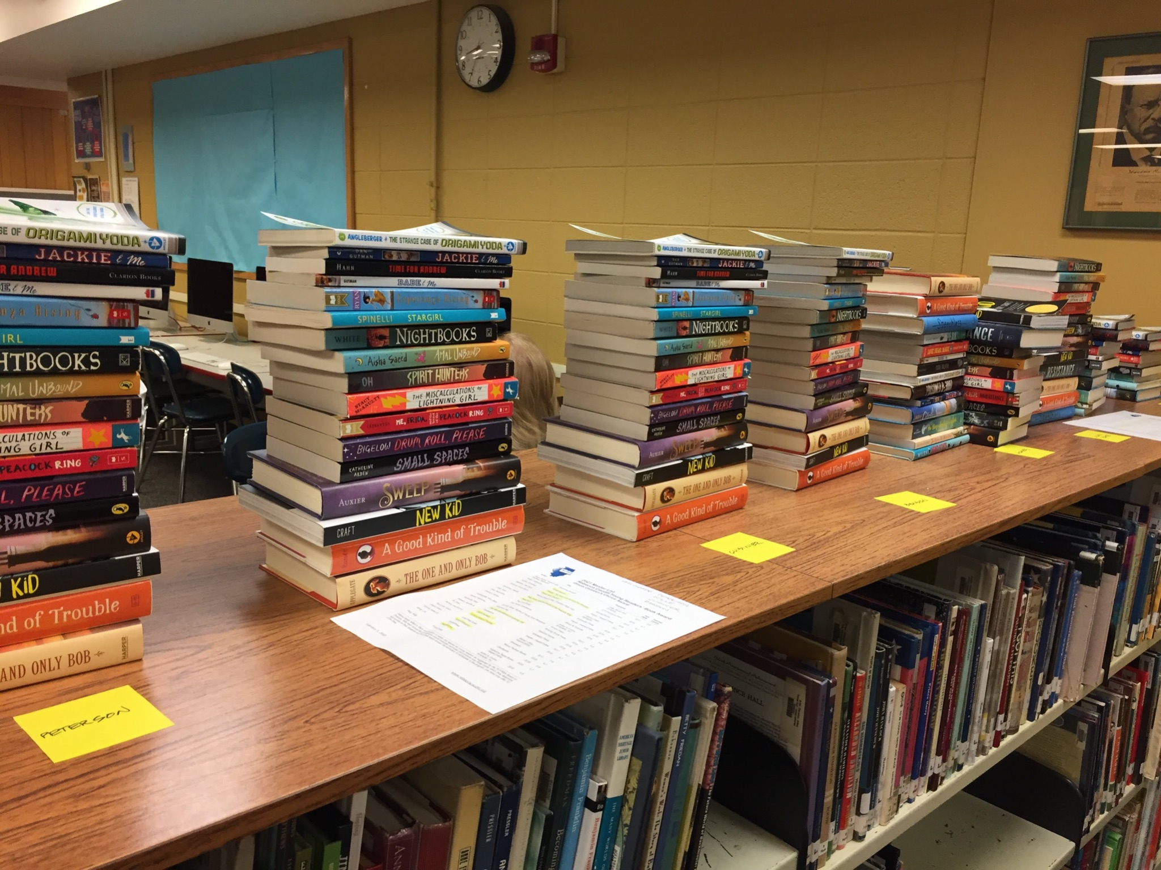
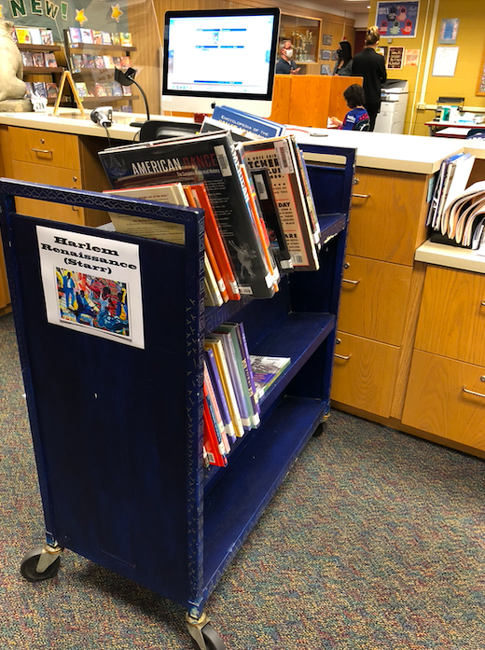
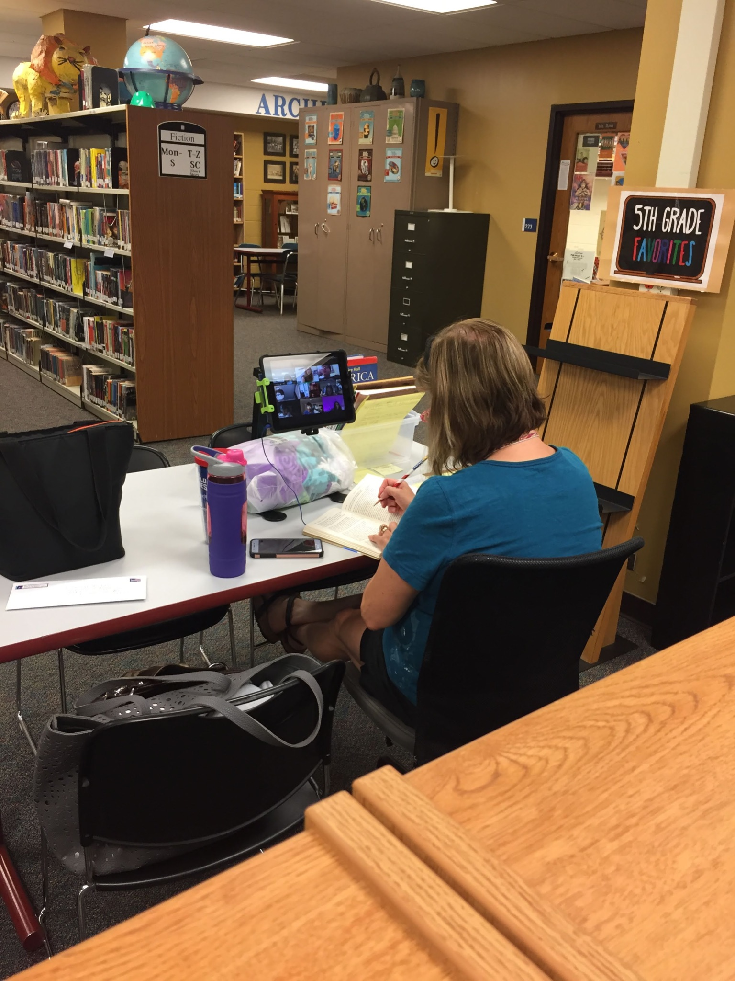
More from the LLC
Gifts to classroom libraries from the LLC
Lots of hardworking Aides in the LLC
Research carts are back!

Slide 15
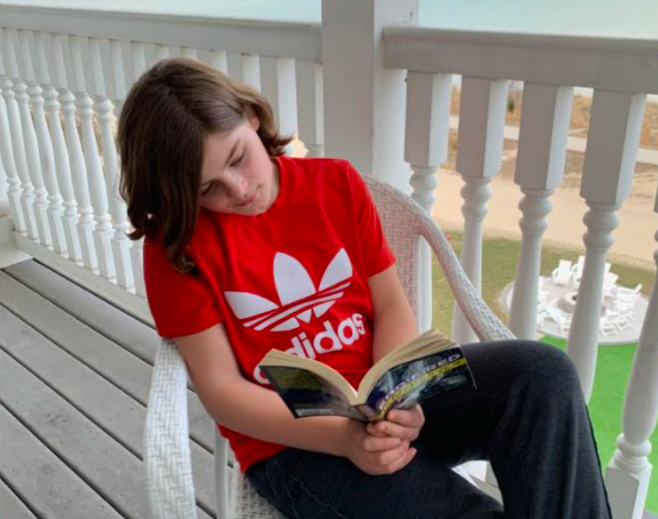
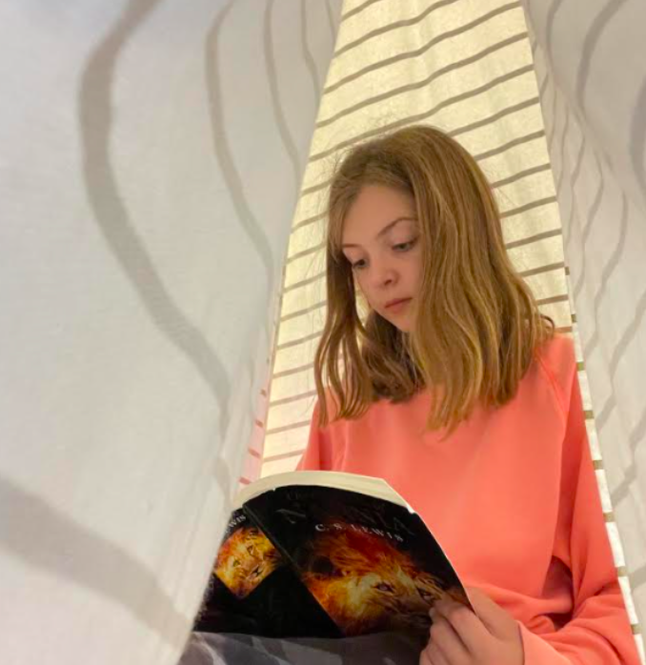
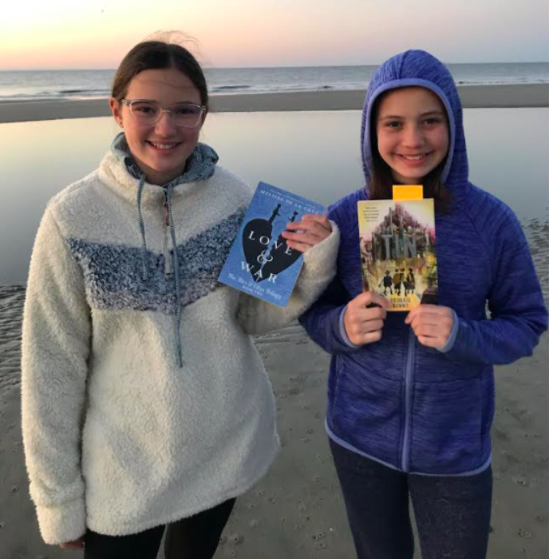
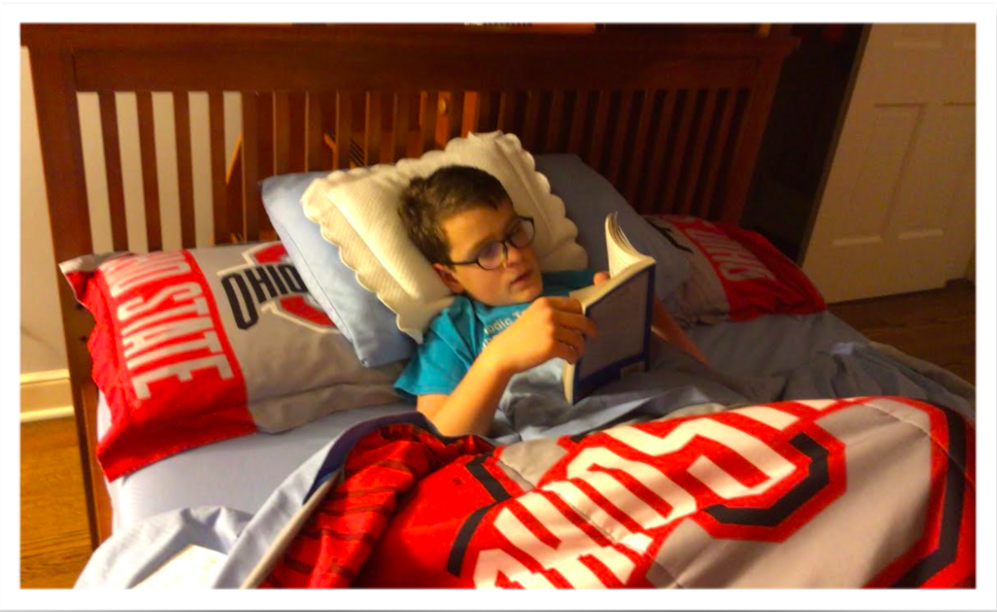
Spring Break Selfies

Slide 16
Stay in touch with the LLC!
LLC Website
Twitter - LLC
Twitter - Mrs. Ziegler
Reading Olympics
Caudill Reading List
Roosevelt Archives on Instagram

Slide 17
Mrs. Connie Rogers
School Library Media Specialist
Roosevelt Middle School
7560 Oak
River Forest, IL 60305
(708) 366-9230
rogersc@district90.org

